Slide 1
Pulses
From Farm to Table

Slide 2
What are pulses?
Notes:
Ask your group this question to see if they know what pulses are, then move to the next slide which talks about pulses in more detail.

Slide 3
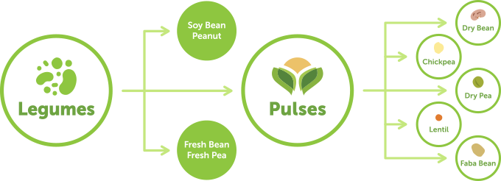
What are Pulses?
Notes:
WHAT ARE PULSES?
Pulses are the dry, edible seeds of pod plants in the legume family. A legume is any plant that grows in pods.
Legume family is divided into three categories:
Soybeans and peanuts contain protein and fibre, but they are not pulses because of their high fat content.
Fresh green beans, fresh yellow beans and fresh garden peas are not pulses because they have a high moisture content, are lower in protein and fibre, and are harvested fresh, not dry.
Pulses are high in protein and fibre, but low in fat. They are harvested dry and include dry peas, dry beans, lentils, chickpeas, and faba beans. The word “pulse” comes from the Latin word “puls” which means potage or thick soup.

Slide 4
What do we grow in Alberta?
Notes:
Ask your group this question to see if they know if we grow pulses in Alberta and if so, which ones? Next few slides go into more detail about the pulses we grow in Alberta.

Slide 5
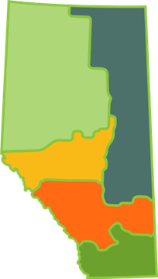
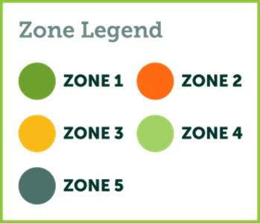
Pulses in Alberta
Provincial Growing Zones
Alberta is divided into 5 growing zones
Reflects the commonality of pulse crops and production methods between areas
Reflects direction of pulse trade
Align with the established growing zones of the barley, wheat and canola commissions
Notes:
GROWING PULSES
Alberta farmers grow a variety of pulses, depending on where their farm is located in the province.
Pulses are the first crop planted in the spring, typically from late April to late May. Pulses are also the first crop harvested, often by the end of August to the end of September.
Alberta is divided into five growing zones that reflect the commonality of pulse crops and production methods between areas, as well as the direction of trade of pulses. Alberta’s pulse growing zones also align with established growing zones of the barley, wheat, and canola commissions.

Slide 6
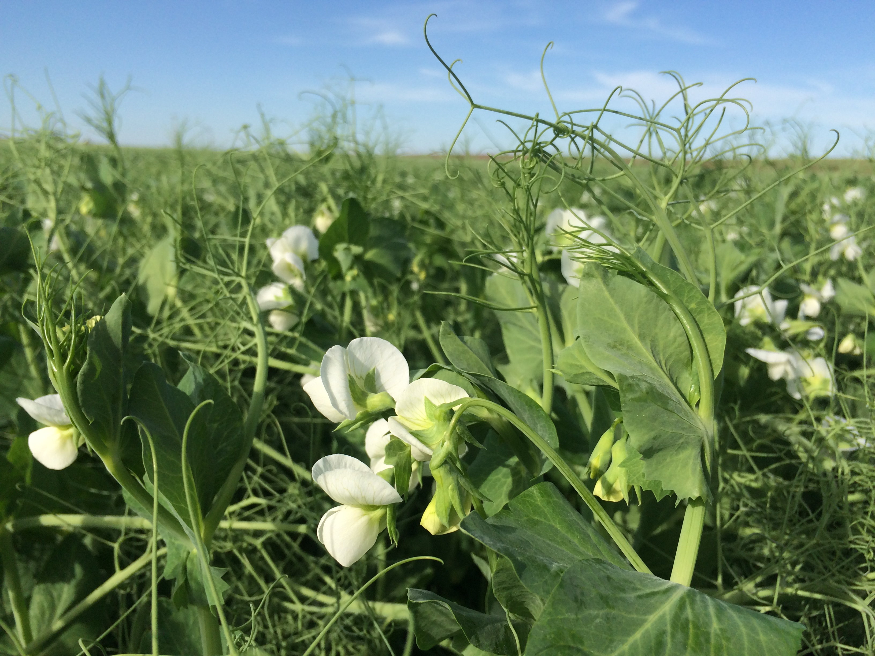
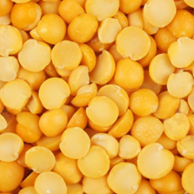
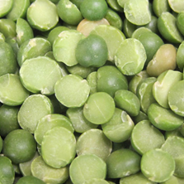
Pulses in Alberta
FIELD PEAS
Grown in all zones in the province
Include whole & split green & yellow peas
Largest crop with 90% yellow peas and 10% green peas
In 2023 – 1.2 million acres harvested which produced 1.1 million tonnes
Typically 6-8 peas in a pod
Yellow Split Peas
Green Split Peas
Flowering pea crop in the field
Notes:
FIELD PEAS
Harvested acres and yield from Alberta 2023 Crop Season in Review https://open.alberta.ca/dataset/5394242
Growing
Grown in all zones in the province
Includes whole & split green & yellow peas
The most commonly grown pulse crop in Alberta; 90% of pea crops are yellow peas and 10% are green peas
1.51 million acres were seeded in 2018, which produced 1.75 million tonnes of peas
Cooking
Most often used in hearty soups
A great addition to salads, wraps, and stir-fries for more protein and fibre
Whole peas need to be soaked before cooking while split peas do not

Slide 7
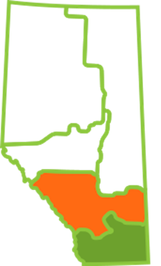
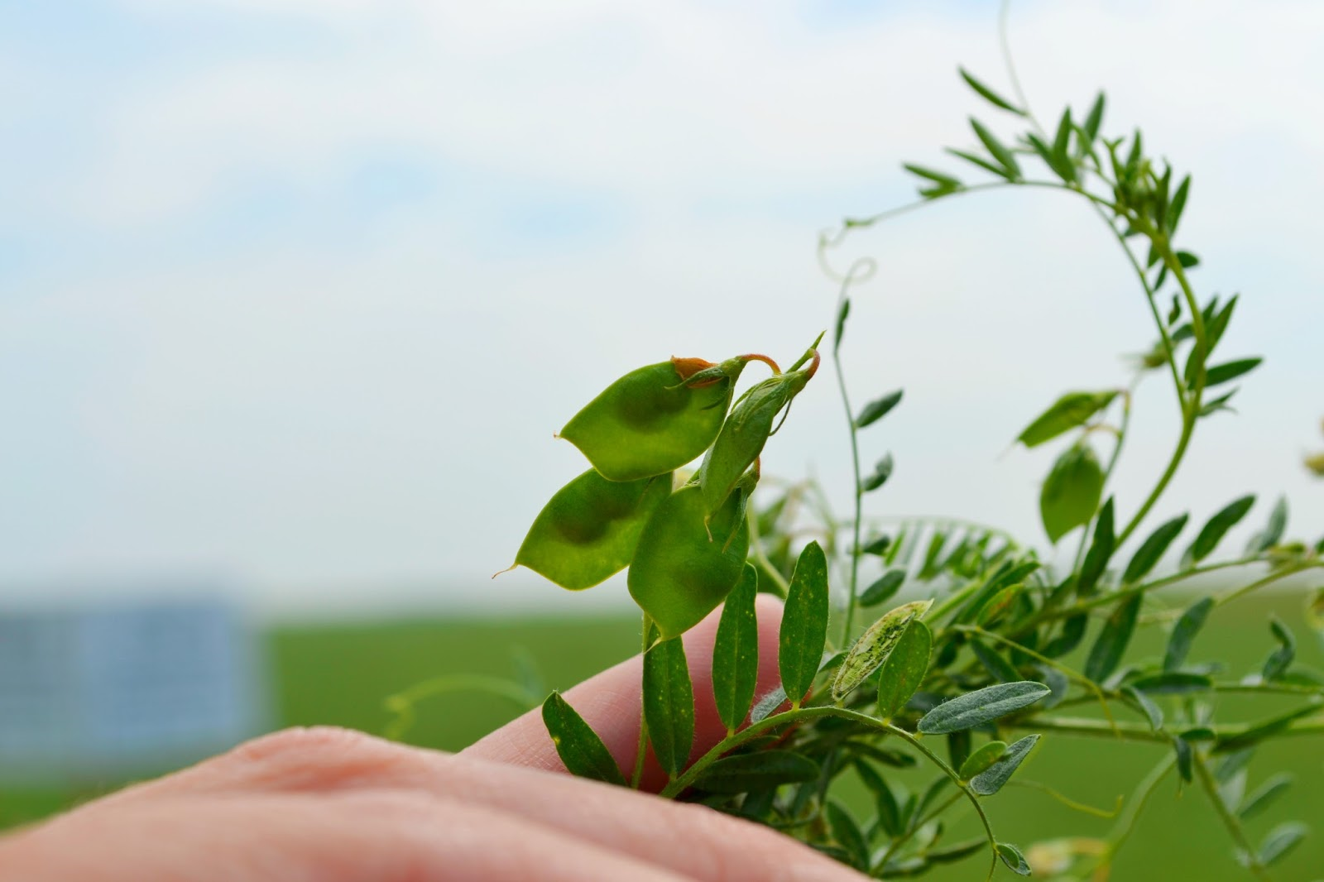
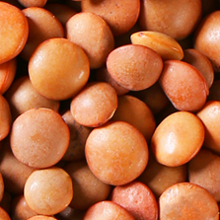
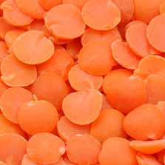
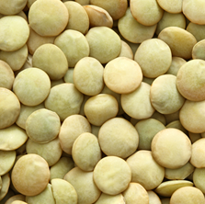
Pulses in Alberta
LENTILS
Grown in Zones 1 & 2
Includes green & red lentils
Second largest pulse crop in Alberta
In 2023 – 462,000 acres harvested which produced 156,391 tonnes
Usually 2 lentils in a pod
Whole Red Lentils
Red Split Lentils
Whole Green Lentils
Lentil plant with pods showing 2 lentils/pod
Notes:
LENTILS
Harvested acres and yield from Alberta 2023 Crop Season in Review https://open.alberta.ca/dataset/5394242
Growing
Grown primarily in Zones 1 and 2
Includes green and red lentils
Second-largest pulse crop in Alberta
550,200 acres were seeded in 2022, which produced 334,200 tonnes of lentils
Cooking
The fastest cooking of the all the pulses
Do not need to be soaked before cooking
Whole red and green lentils hold their shape when cooked, while split red lentils change colour and become mushy the longer they are cooked
Cooked lentils can be added to smoothies, burgers, meatloaf, soups, salads, and wraps
Can be pureed and added to baking for additional protein and fibre

Slide 8
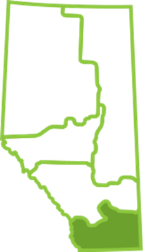
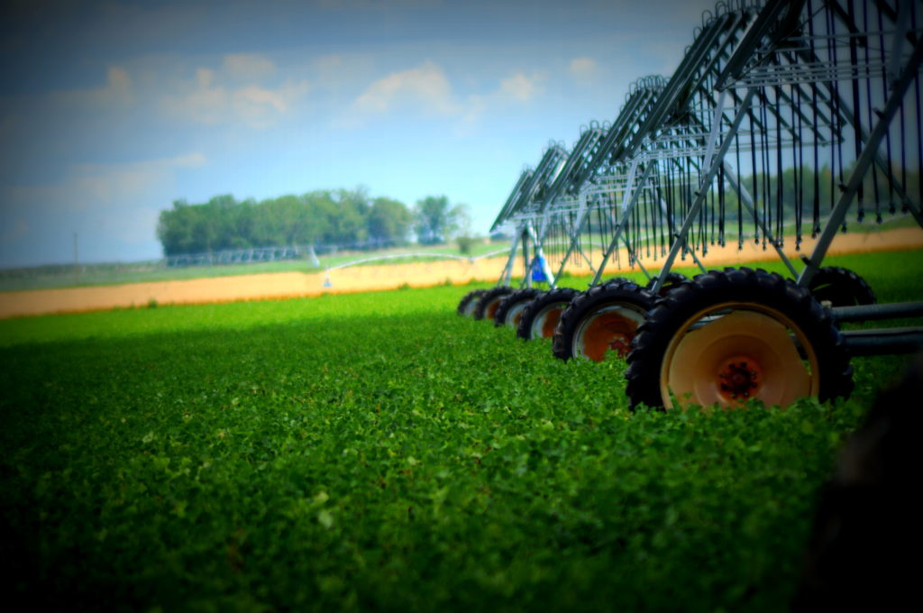
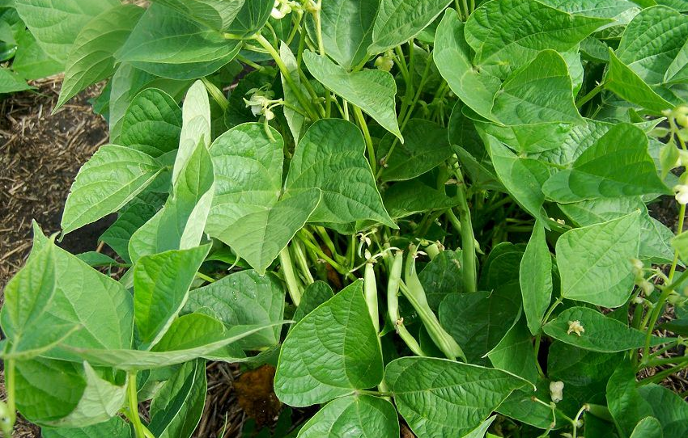
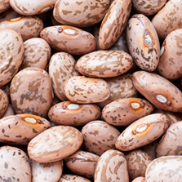
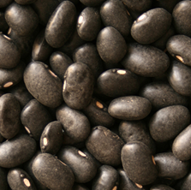
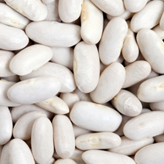
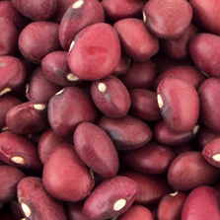
Pulses in Alberta
DRY BEANS
Grown under irrigation in Zone 1 between Taber, Vauxhaul & Bow Island
Third largest pulse crop in Alberta
Includes black, pinto, Great Northern, small red & yellow beans
In 2023 – 56,100 acres harvested which produced 75721 tonnes
Pinto Beans
Black Beans
Bean crop with pivot irrigation system
Bean plant – usually 5-8 beans in a pod
Great Northern Beans
Small Red Beans
Notes:
DRY BEANS
Harvested acres and yield from Alberta 2023 Crop Season in Review https://open.alberta.ca/dataset/5394242
Growing
Grown under irrigation in Zone 1 between Taber, Vauxhaul and Bow Island
Includes black, pinto, Great Northern, and small red beans
Third largest pulse crop in Alberta
49,800 acres were seeded in 2022, which produced 49,700 tonnes of beans
Cooking
Pinto Beans are the main ingredient in refried beans as well as many Mexican recipes. Pinto beans lose their “speckles” when they are cooked and look like a smooth pink bean.
Black Beans are often used in Mexican-style cuisine with tacos, nachos and enchiladas but are also a popular addition to soups, salads and casseroles.
Great Northern Beans can be used in any recipe that calls for a “white bean” or can be used in place of cannellini, navy or white kidney beans. This bean is often used in chili or baked beans and can also be pureed and added to baking like cookies, muffins or quick breads to add protein and fibre and reduce fat. This bean can also be added to smoothies for additional protein!
Small Red Beans are grown in Alberta, but they are all exported to the southern United States, Mexico and South America and are used in traditional dishes like Red Beans and Rice. When cooked, they are similar in taste and texture to a light red kidney bean, only smaller in size.

Slide 9
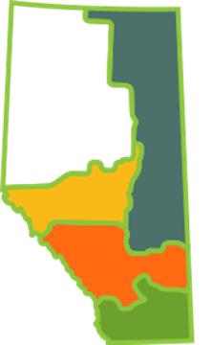
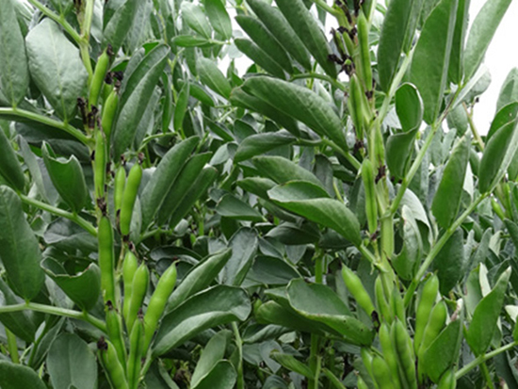
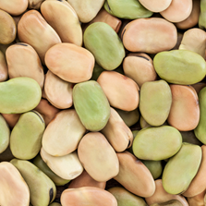
Pulses in Alberta
FABA BEANS
Grown in Zones 2, 3 & 5
Also grown in Zone 1 under irrigation
In 2023 – 47,100 acres harvested which produced 70,400 tonnes
Faba Beans
Faba bean plants often grow 6 feet tall!
Notes:
FABA BEANS
Harvested acres and yield from Alberta 2023 Crop Season in Review https://open.alberta.ca/dataset/5394242
Growing
Faba beans prefer slightly cooker conditions for growing and are grown in Zones 2, 3 & 5
Also grown in Zone 1
34,700 acres were seeded in 2018, which produced 46,100 tonnes of faba beans
Also known as Fava beans or broad beans
Cooking
Used in many Mediterranean and Middle Eastern stews or on their own as a side dish

Slide 10
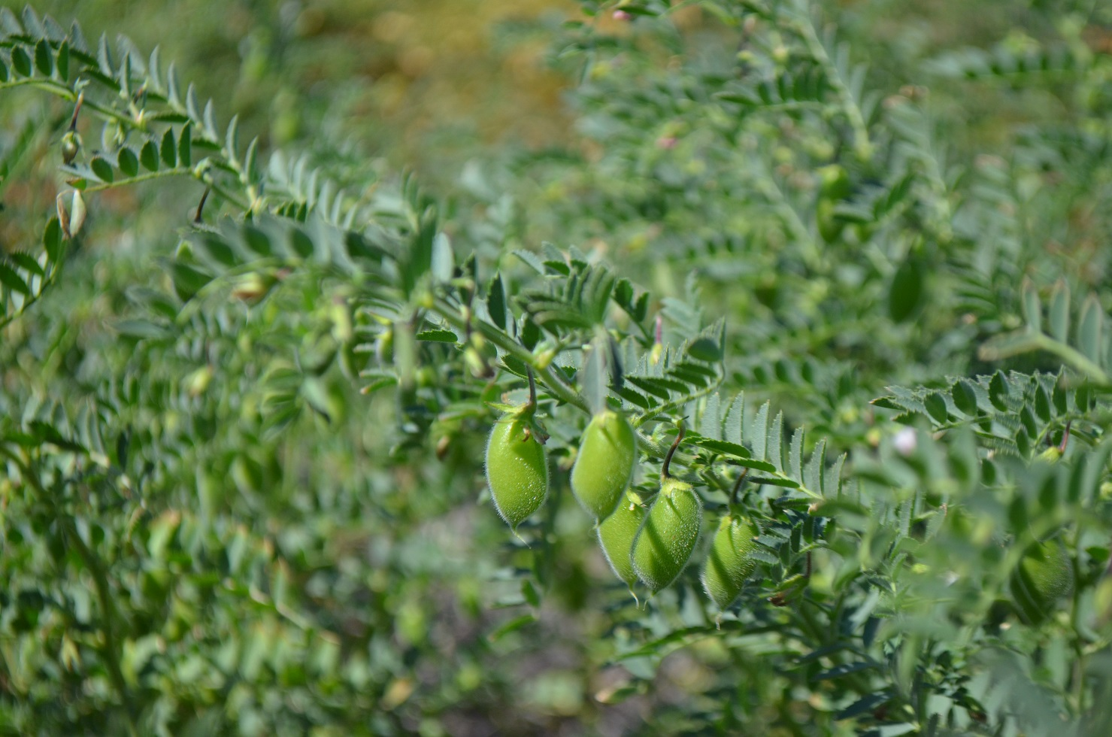
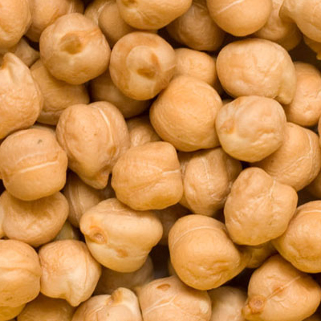
Pulses in Alberta
CHICKPEAS
Grown in Zones 1 & 2
Smallest pulse crop in Alberta
Includes Kabuli chickpeas
In 2023 – 43,300 acres were harvested which produced 18,400 tonnes
Kabuli Chickpeas
Chickpea plant with pods showing 1 chickpea/pod
Notes:
CHICKPEAS
Harvested acres and yield from Alberta 2023 Crop Season in Review https://open.alberta.ca/dataset/5394242
Growing
Grown in Zones 1 and 2, in the SW corner of the province around the Medicine Hat area
Smallest pulse crop in Alberta
Includes Kabuli chickpeas
73,400 acres were seeded in 2018, which produced 51,400 tonnes of chickpeas
Cooking
Chickpeas are the main ingredient in hummus
Can be added to just about any recipe for soups and salads
Can be roasted and eaten as a snack or added to salads for additional crunch and protein

Slide 11
Why grow pulses?
Notes:
Ask your group why they think we grow pulses in Alberta. This starts the conversation and leads into the environmental sustainability of pulses in the next few slides.

Slide 12
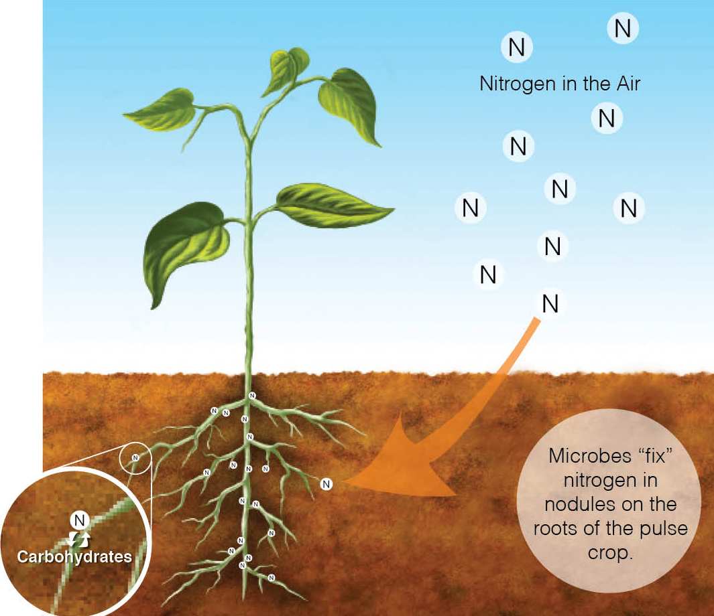
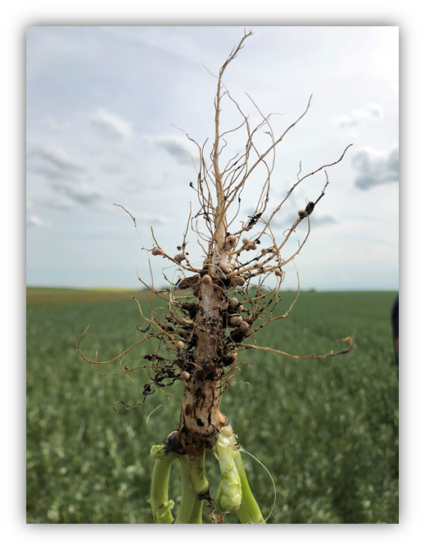
Why Grow Pulses?
Good for the environment!
Low carbon footprint food
Pulse plants have nodules on their roots that allow them to partner with bacteria in the soil.
The plant draws nitrogen from the air and with the help of the soil bacteria, converts it into a form of nitrogen that the plant can use.
This process is called Nitrogen Fixation, and it reduces the need for synthetic nitrogen fertilizers.
Nitrogen fixing nodules on the root of a pulse plant
Notes:
Pulse Sustainability Video https://www.youtube.com/watch?v=bllIMYu0GzA
They have a low carbon footprint
Greenhouse gas emissions from agriculture largely come from nitrogen fertilizers. Pulses only require a small amount of fertilizer to grow because they partner with bacteria in the soil to convert the nitrogen in the air into a fertilizer that crops can use. This relationship that pulses have with soil bacteria reduces the need for nitrogen fertilizers, which means that farmers need to add little to no nitrogen fertilizer to their pulse crop.

Slide 13
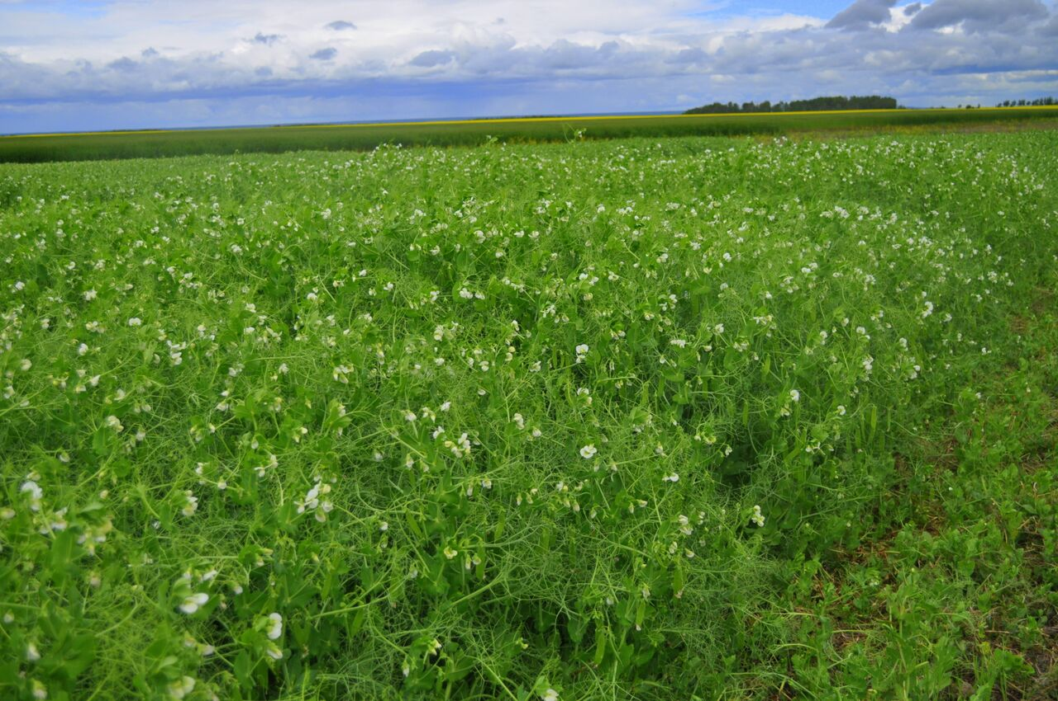
Why Grow Pulses?
Good for the environment!
Enrich the soil where they are grown
Produce compounds that feed microorganisms in the soil which improves soil health.
Improve crop rotations as other crops grow better after a pulse crop.
Videos
https://www.youtube.com/watch?v=bllIMYu0GzA https://albertapulse.com/eating-pulses/resources/
Pea Field in Bloom
Notes:
Videos:
Pulse Sustainability Video (5:04 minutes long) https://www.youtube.com/watch?v=bllIMYu0GzA
Pulse Power Point Environmental Sustainability (2:26 minutes long) https://albertapulse.com/eating-pulses/resources/ (scroll down to the videos)
Enrich the soil where they are grown
Pulses are full of nutrients that are good for the soil. They produce different compounds that feed microorganisms in the ground. This process improves soil health, which benefits other crops that grow in rotation with pulses. After pulse crops are harvested, they leave behind nitrogen-rich crop residues that provide extra nutrients for the next crop that is grown, so crops like wheat often grow better when they are planted after a pulse crop.

Slide 14
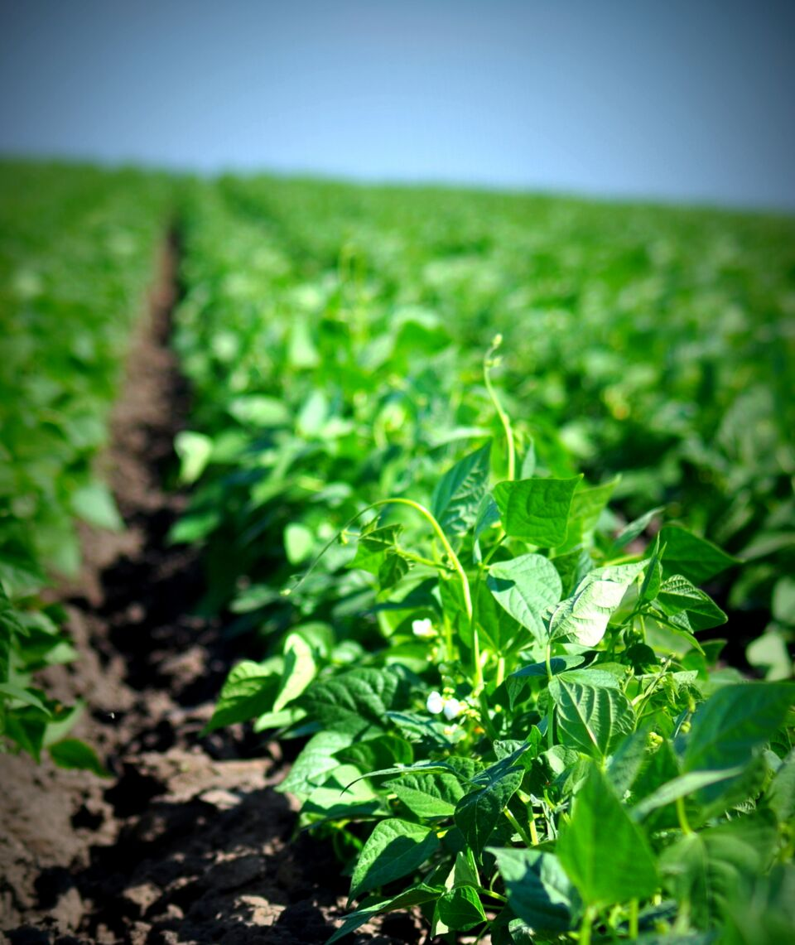
Why Grow Pulses?
Good for the environment!
Water efficient source of protein
Use 1/2 to 1/10 of the water used by other sources of protein
Adapted to dry environments
Different types of pulses can be grown in almost any type of climate
Bean Field in Southern Alberta
Notes:
Water efficient source of protein
Pulses use ½ to 1/10 of the water used by other sources of protein. Pulses can also help farmers adapt to climate change, because different types of pulses can be grown in almost any farming system and in almost any type of climate – wet or dry, and in cold or hot regions of the world.

Slide 15
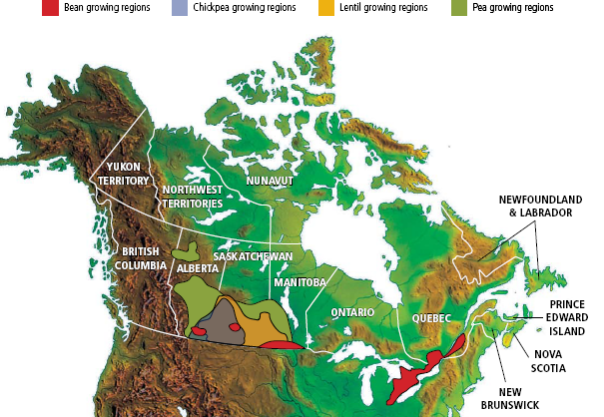
Why Grow Pulses?
Good for the economy!
Canada is the largest:
Producer of peas and lentils in the world
Exporter of peas and lentils in the world
Exported to 130 countries
Gross Domestic Product
Canada represents 40% of the global pulse trade
Pulse crops have over $3 billion in farmgate receipts and $3.88 billion in exports in 2020

Slide 16
Farm to Table Where do pulses go?

Slide 17
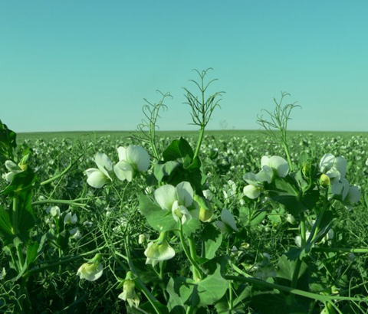
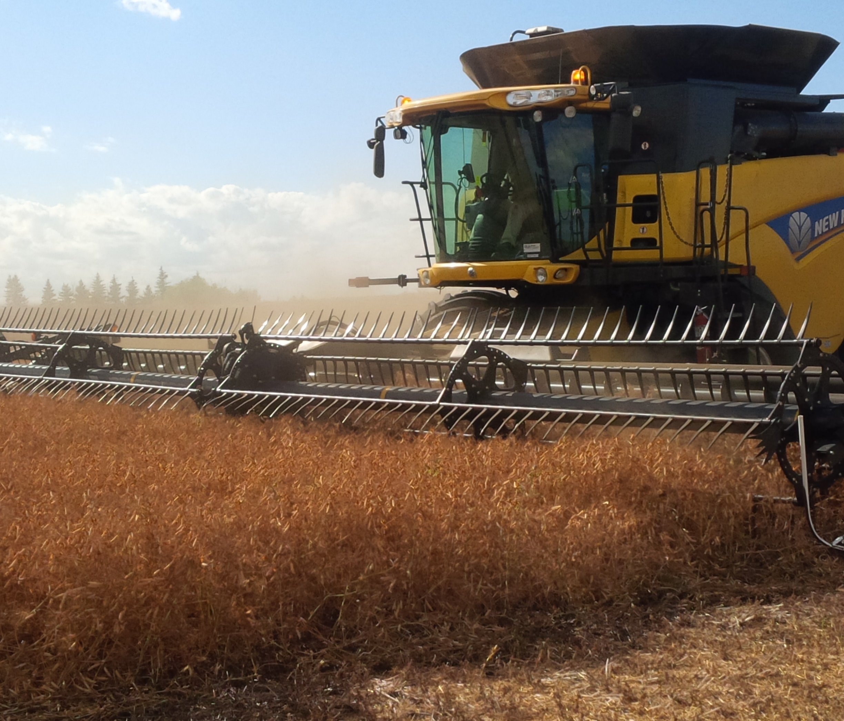
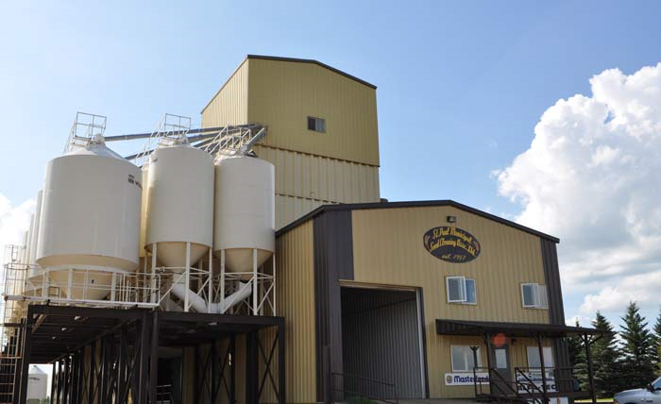
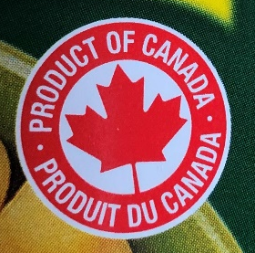
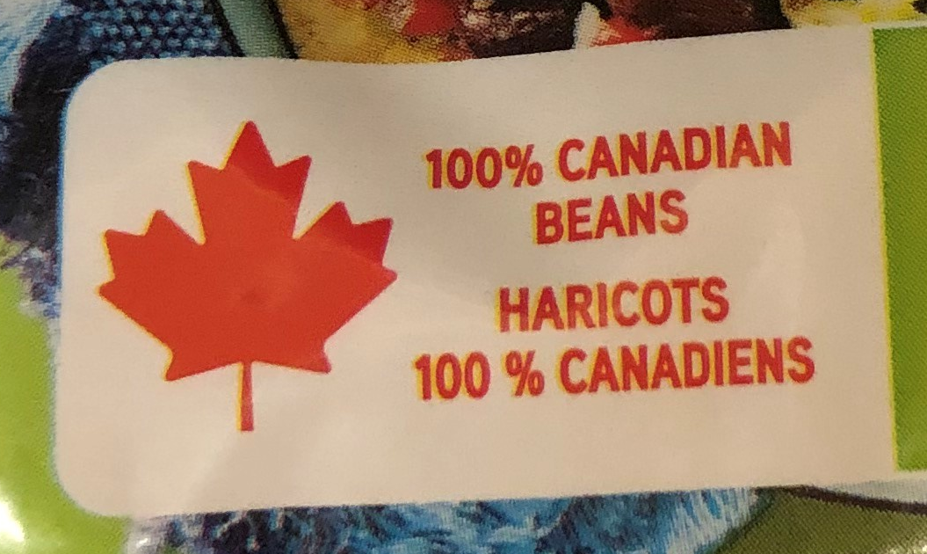


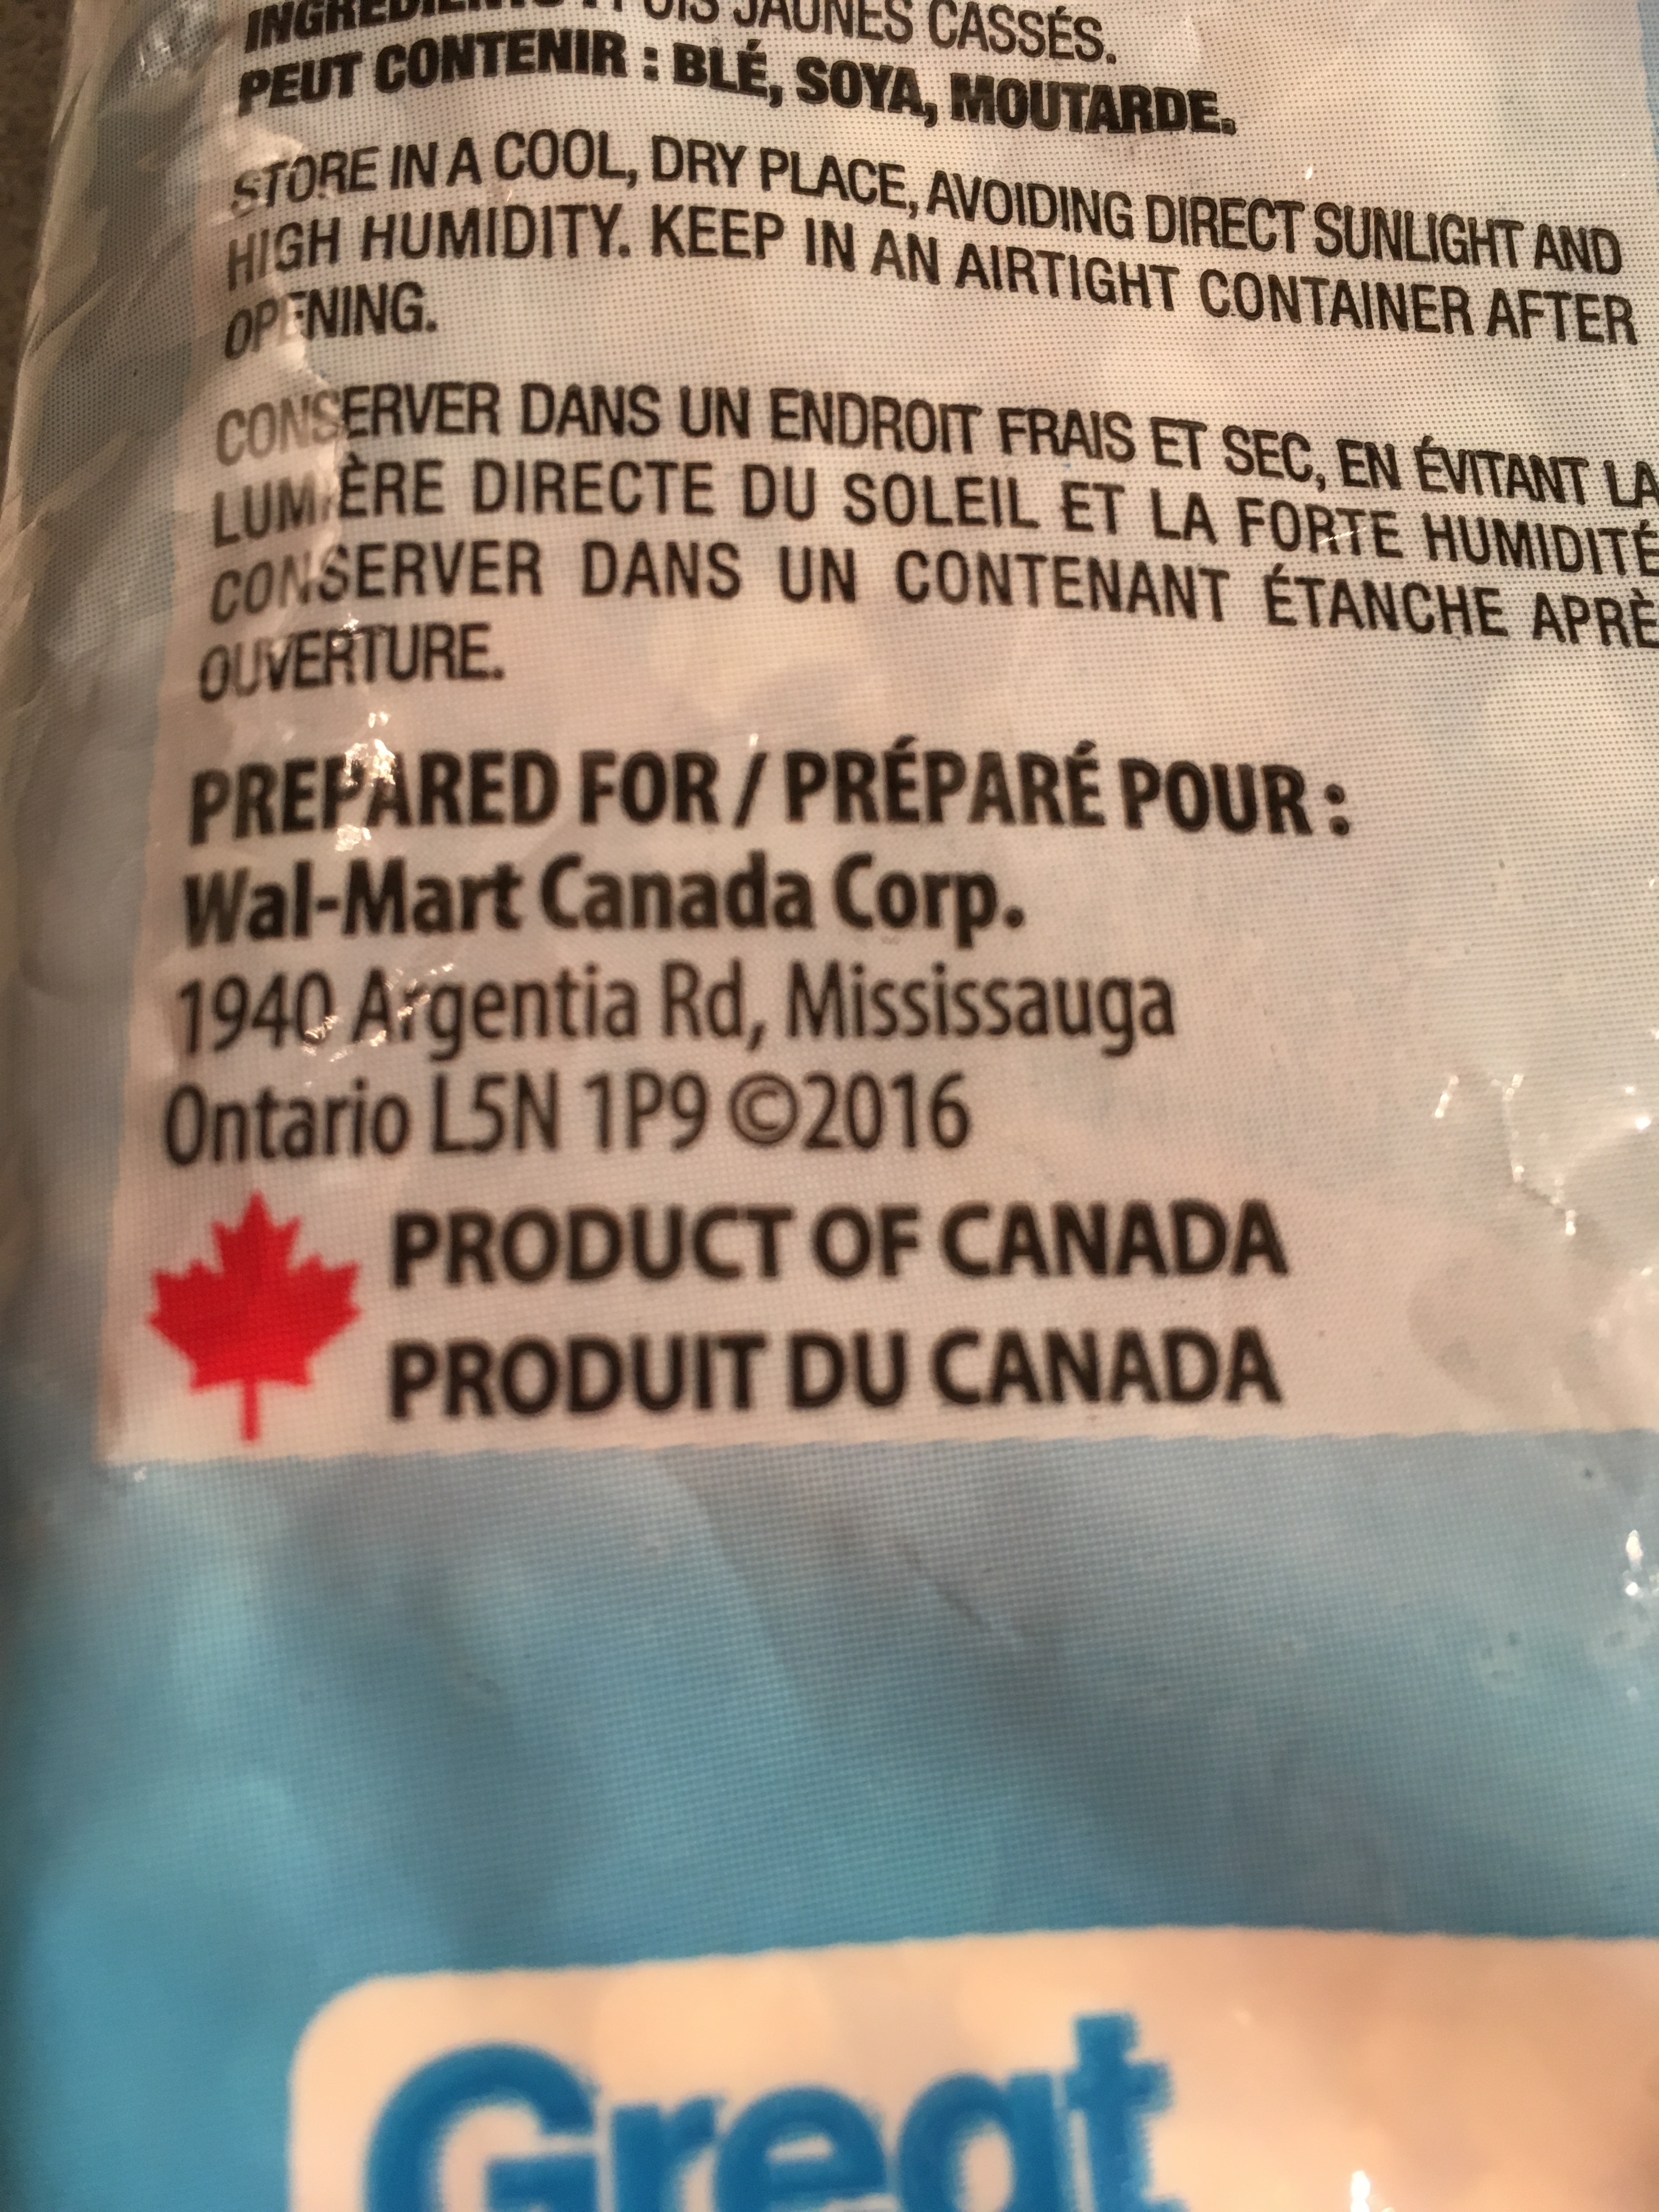
Pulses - Farm to Table
Pea crop in the spring
Pea crop being harvested
Delivery to the grain elevator
A year in the life of a pulse video
Canadian pulses in Canadian grocery stores
Export to other countries
Notes:
Pulses – Farm to Table
In Alberta, once the pulse crop is harvested, the farmer trucks it to the closest grain elevator. From there, the pulses are sorted and prepared for either export by boat to other countries or shipping by truck/train to other Canadian provinces for further sorting and final retail packaging for sale at grocery stores.
Video – A Year in the Life of a Pulse (3:19 minutes long) - https://www.youtube.com/watch?v=CkOTshjgO4w&t=79s
Where can I find Alberta-grown pulses?
Since final retail packaging is not done in Alberta, packaged dry pulses can’t be labeled as “Product of Alberta” or “Packaged in Alberta”. You can support local Alberta pulse farmers by buying “Product of Canada” labeled pulses.

Slide 18

Pulses Around the World!
Sweden
U.K.
Germany
France
Belgium
Portugal
Greece
Italy
Turkey
Spain
Romania
Croatia
Hungary
Albania
Angola
Morocco
Algeria
Cape Verde
S. Africa
Peru
Chile
Colombia
Argentina
Costa Rica
Mexico
USA
Jamaica
China
S. Korea
Japan
India
Pakistan
U.A.E.
Malaysia
Philippines
Australia
New Zealand
Notes:
Canada exports about 95% of the pulses grown here and is the largest exporter of peas and lentils in the world. Canadian pulses are exported to over 150 countries around the world.
Pulse growing regions include Saskatchewan, Manitoba and Ontario, along with Alberta.

Slide 19
Why eat pulses?
Notes:
Ask your group why we should eat pulses and then move onto the next slides that talk about health benefits.
Can also mention here that eating pulses contributes to environmental sustainability (as per the previous slides that talked about why we grow pulses).

Slide 20
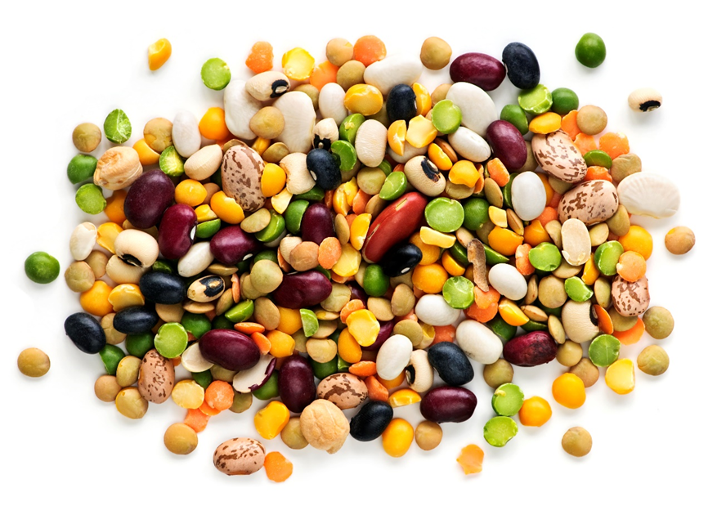
Nutrition Powerhouses
Packed with Protein
Up to 9 g protein per ½ cup cooked serving
High in Fibre
8 g fibre per ½ cup cooked serving
Low in Fat
No saturated fat
Nutrient Dense
Iron, folate, potassium, magnesium, zinc, B-vitamins
Good for people with dietary restrictions
Gluten free, vegetarian source of plant base protein, low glycemic index
Better Nutrition Video
Notes:
Video – Pulse Power Point Better Nutrition (3:05 minutes) https://albertapulse.com/eating-pulses/resources/ (scroll down to videos)
Packed with protein
Contain up to 9 g of protein per ½ cup cooked serving
Twice the protein of quinoa
2-3 times the amount of protein as wheat, corn, rice
High in Fibre
8 g fibre per ½ cup cooked serving
High in both soluble and insoluble fibre, which help with staying regular, managing weight, and feeling fuller longer.
Low in Fat
No saturated fat
Low in fat compared to many other protein-rich foods
Nutrient Dense
high levels of potassium, magnesium, zinc, and iron
Abundant in B-vitamins including thiamin, niacin, folate
One serving of lentils has 1.5 times the amount of iron as flank steak
Chickpeas have 3 times the folate of kale
A serving of dry peas contains as much potassium as a banana
Smart source of folate, a B-vitamin important during pregnancy for reducing the risk of neural tube birth defects and is essential to brain development and function.
Good for dietary restrictions
Pulses are naturally gluten-free
A vegetarian source of plant-based protein
Low glycemic index food
Ideal for special diets, allergies or sensitivities

Slide 21
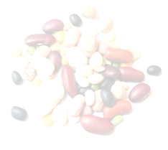
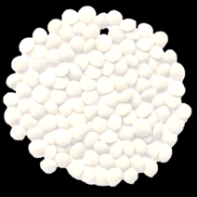
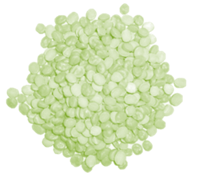
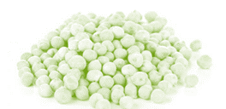
Health Benefits
Benefits of Pulses
Satiety
Regularity/ Digestive Health
 Blood Pressure
Cholesterol
Post-prandial glycemia
Healthy Outcomes Video
Notes:
Video – Pulse Power Point Healthy Outcomes (2:01 minutes) https://albertapulse.com/eating-pulses/resources/ (scroll down to videos)
Pulses contribute to healthy outcomes.
Consuming pulses can help maintain good health.
Diets rich in pulses can help reduce the risk of certain diseases. In fact, diet recommendations from cancer, diabetes and heart health organizations all include pulses, and they are a key component of well-known diets like the Mediterranean diet.
The protein and fibre in pulses is good for weight management, because these nutrients make you feel fuller longer (contribute to increased satiety). The carbohydrates in pulses take longer to break down so they provide you with longer lasting energy. They also increase good bacteria in your digestive system, which helps aid healthy digestion.
Pulses help maintain healthy blood sugar levels, which can help prevent or manage diabetes.
Pulses are a low glycemic index food which means that eating pulses does not cause blood sugar levels to rise as much as sugary or starchy foods that are low in fibre. Maintaining normal blood sugar levels reduces the risk of developing diabetes and helps people with diabetes avoid further health problems.
Pulses are a heart healthy food choice.
Pulses are low in saturated and trans fats, cholesterol-free and high in soluble fibre. Research has shown that eating ½ cup to 1 cup of pulses per day can lower cholesterol, reduce blood pressure and help with body weight management, which are all risk factors for heart disease.

Slide 22
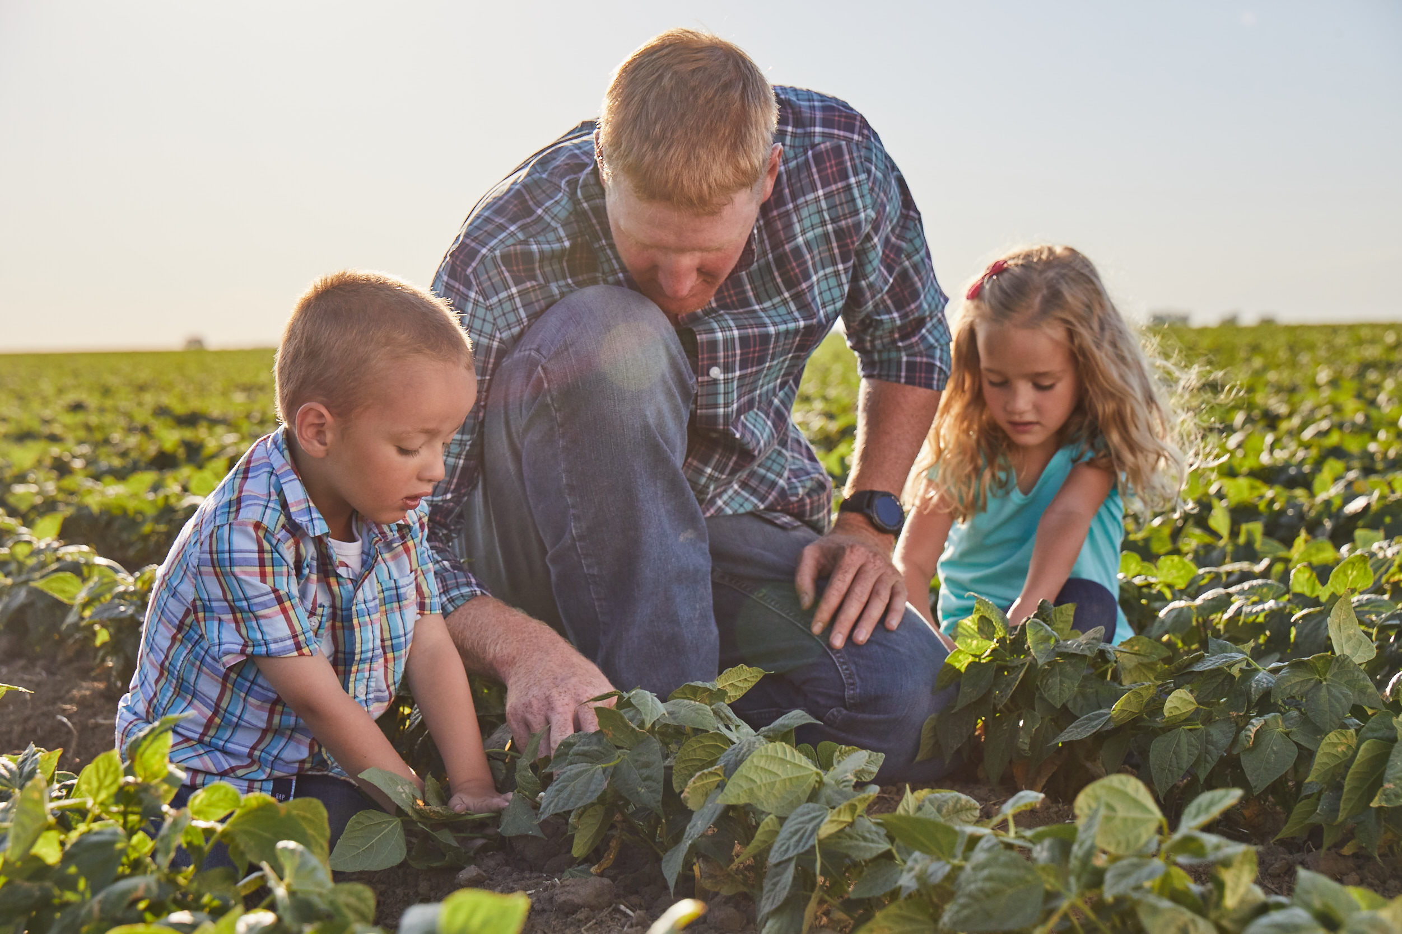
Summary
Pulses are good for the farm and for you!
Pulses are a great addition to any meal!
Support local pulse farmers in Alberta as well as across Canada
Pulses are good for the environment
Pulses are good for our economy
Pulses are good for our health
Notes:
Pulses are a great addition to any meal!
Support local farmers – 6,000 in Alberta and pulse farmers across Canada
Good for the environment – drought tolerant, nitrogen-fixing to make their own fertilizer and improve soil health
Good for the economy – significant contribution to Alberta and Canada’s gross domestic product
Good for our health - high fibre and protein.
Helps with blood sugar control for people with diabetes as pulses are a low glycemic index food
lowers LDL cholesterol and total cholesterol levels as well as blood pressure for heart disease
Gluten free for people with Celiac disease or gluten sensitivity

Slide 23
Visit albertapulse.com for more information

