Slide 1
Today’s Agenda
Day 2
It’s game time! Do you know your legumes from nuts and seeds?
Exploring legumes and pulses
Let’s Cook! Mighty Marinara Sauce with Pasta or Pasta e Fagioli
Canadian and Alberta grown pulses and legumes

Slide 2
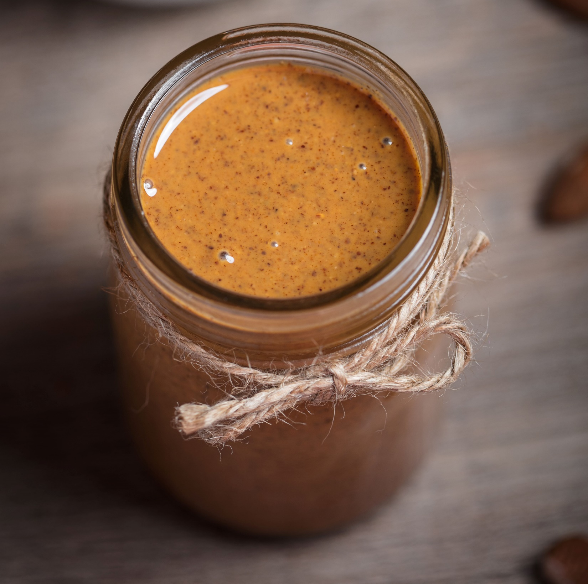
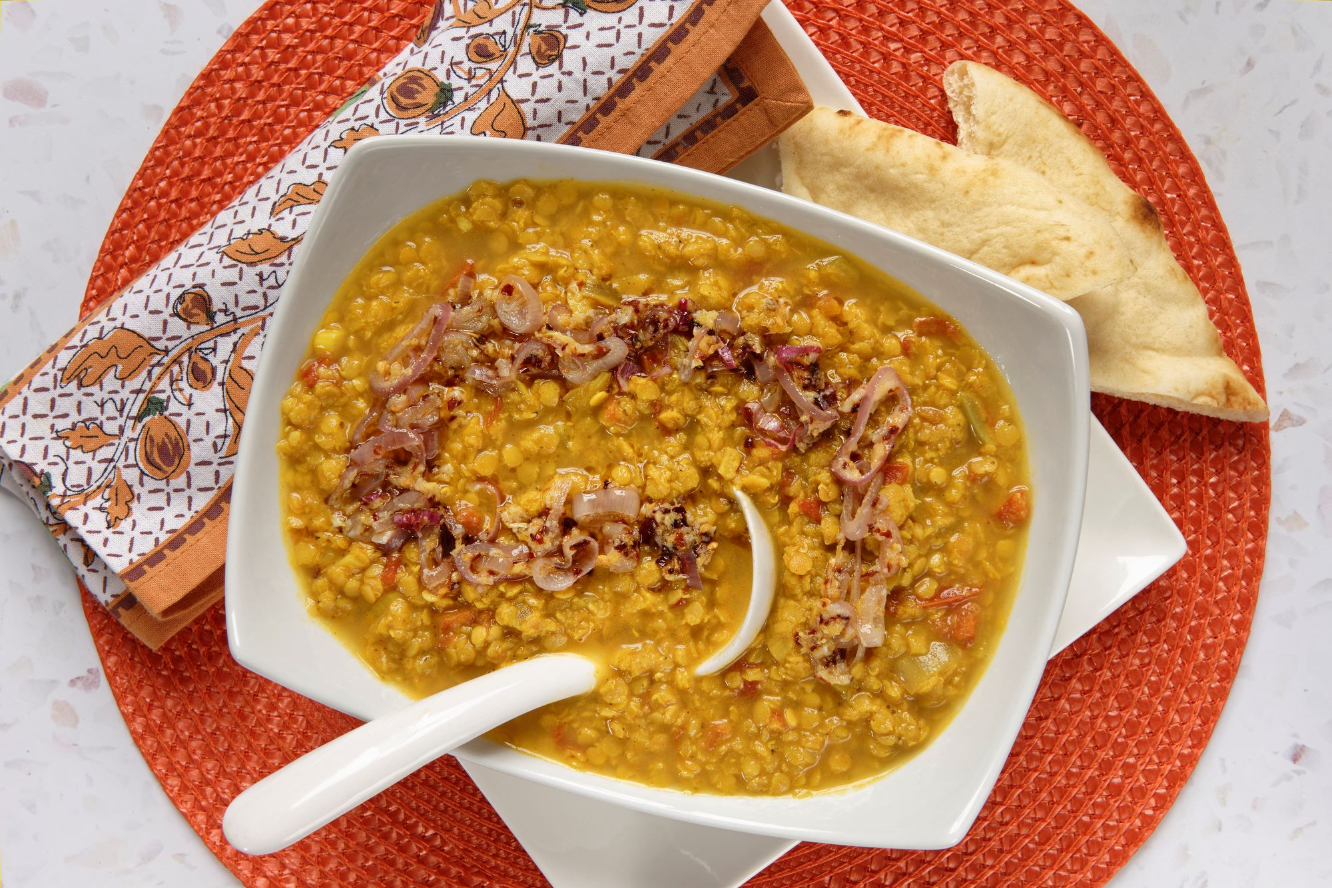
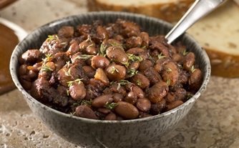
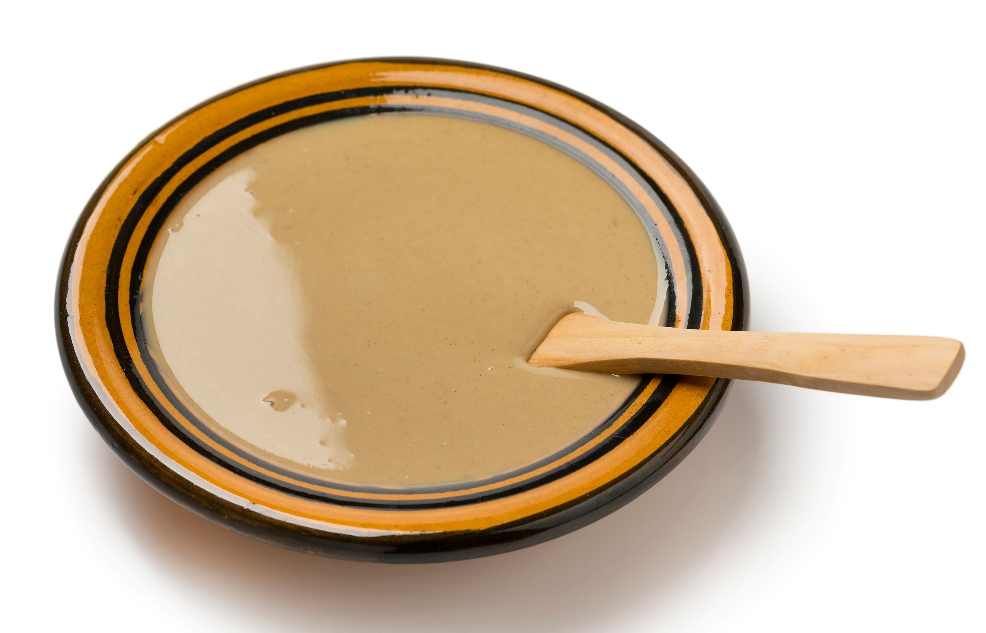
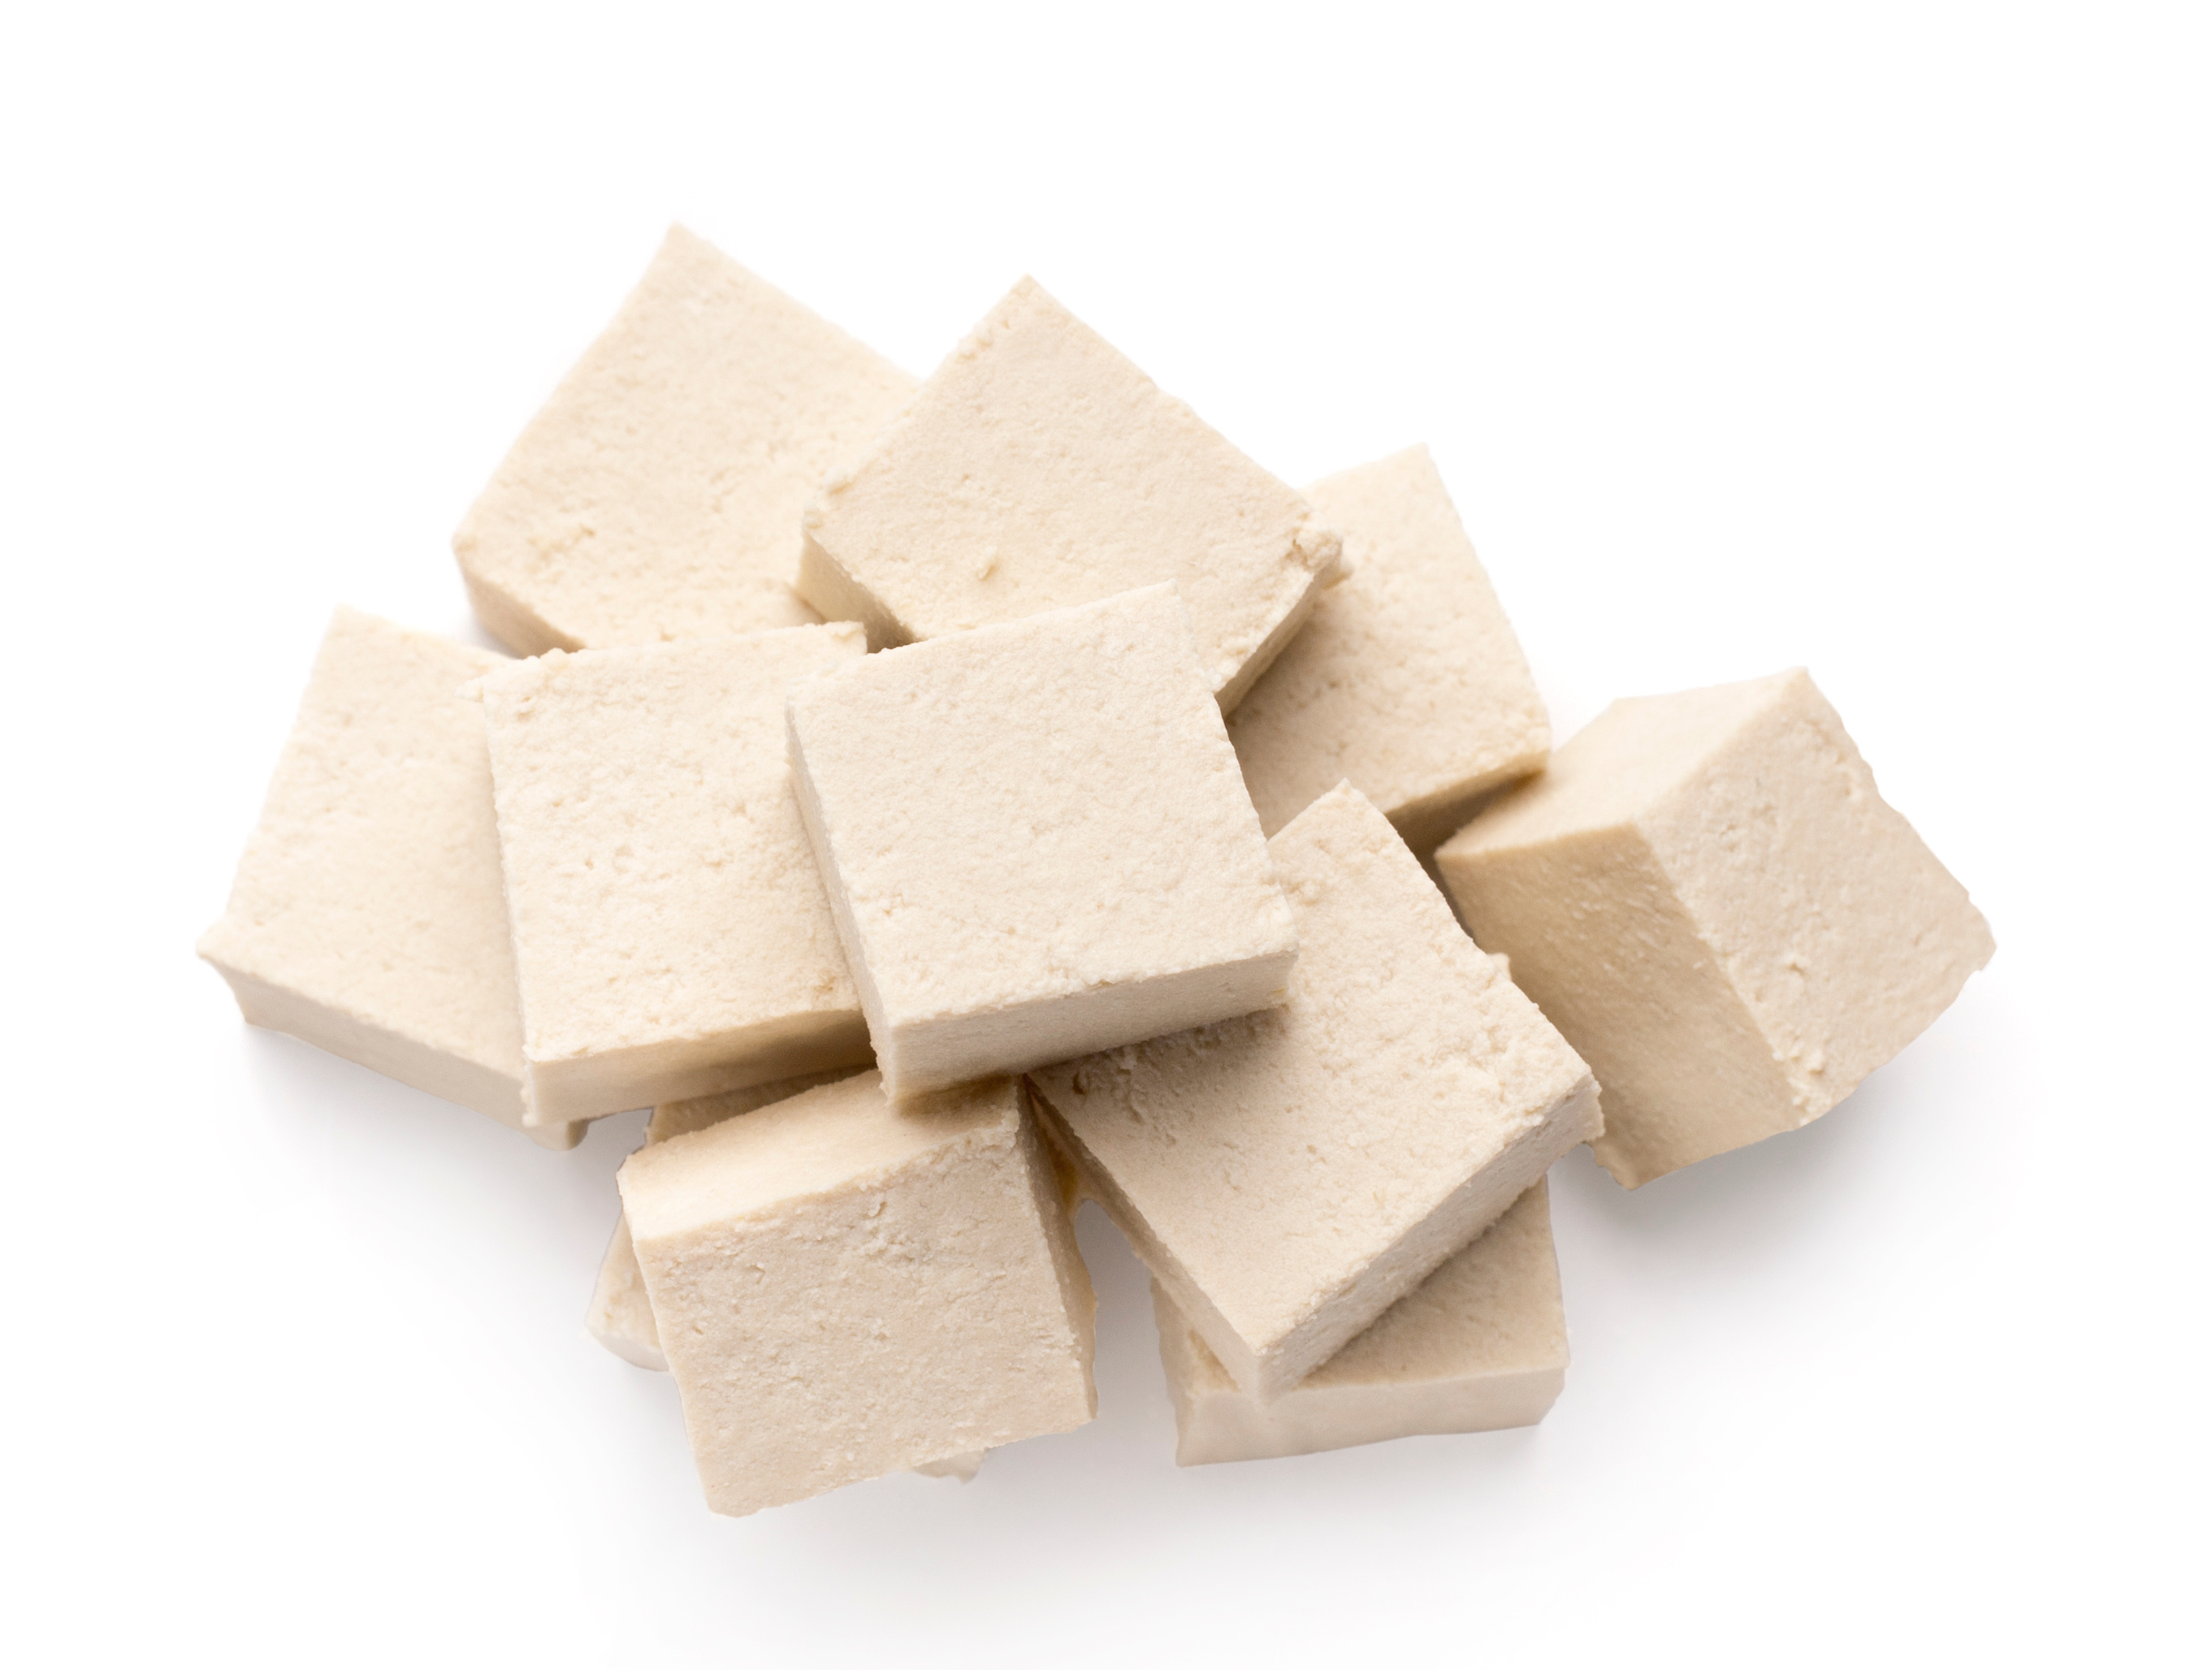
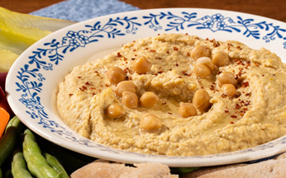
Test Your Knowledge!
Almond Butter | Dahl
Baked Beans | Tahini
Tofu | Hummus
How well do you know your legumes, nuts and seeds?
Look at the food items in the chart - which is made from a legume, nut or seed?
Split the room into 3 zones, nuts, seeds and legumes and treat the game as a 4 corners with students.
OR students can stay at their desk and just play along by raising their hand or setting up a kahoot to get their answers.
Notes:
Almond Butter – made from almonds which are a nut
Dahl – made from red split lentils which are a pulse and part of the legume family
Baked Beans – made from navy or white pea beans which are a pulse and part of the legume family
Tahini – made from sesame seeds which are seeds
Tofu – made from soybeans which are a legume
Hummus – made from chickpeas which are a pulse and part of the legume family

Slide 3
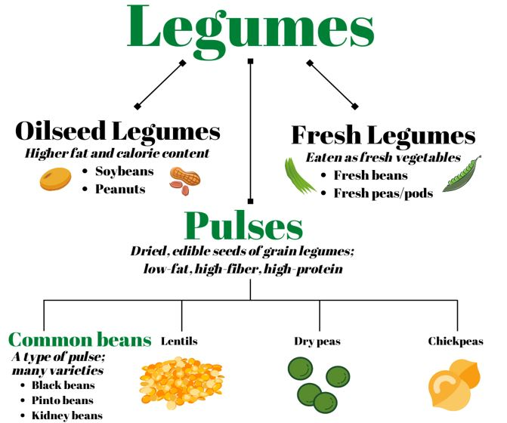
Legumes
Legumes
Includes any plant from the Fabaceae family which would include its leaves, stems, and pods.(a)
Also known as bean, legume, or pea family.(a)
Fun Fact!
Whole legume plants are often used as a cover crop, livestock feed and fertilizers!(c)
(b)
Notes:
Information Retrieved September 25, 2024 from Legumes and Pulses – The Nutrition Source (harvard.edu)
Image Retrieved September 25, 2024 from Pulse Crops and their Key Role as Staple Foods in Healthful Eating Patterns - 0.313 - Extension (colostate.edu)
Information Retrieved September 25, 2024 from Legumes and Pulses – The Nutrition Source (harvard.edu)
Definition of a Cover Crop (see below) – quoted directly from the Cover Crops for Sustainable Crop Rotations – SARE) – retrieved January 16, 2025
“A cover crop is a plant that is used primarily to slow erosion, improve soil health, enhance water availability, smother weeds, help control pests and diseases, increase biodiversity and bring a host of other benefits to your farm.”
“Cover crops have also been shown to increase crop yields, break through a plow pan, add organic matter to the soil, improve crop diversity on farms and attract pollinators.”

Slide 4
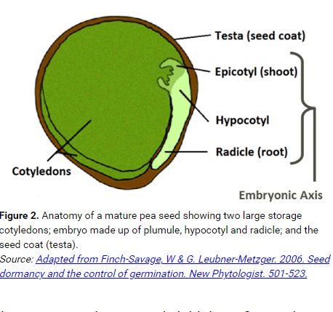
An Example of a Legume
Parts of Pea Seed | Function
Testa (Seed Coat) | Outer layer of seed. Rich in dietary fibre and calcium.
Epicotyl (Shoot) | The shoot of the plant that grows upwards and goes on to produce leaves and reproductive parts of the plant.
Hypocotyl | Helps the radicle grow down into the soil.
Radicle (Root) | Is the root of the plant.
Cotyledons (seed leaves) | Provides plant embryo with nutrition to germinate. Rich in protein, starch, vitamins and minerals. Also provides fibre from the cotyledon cell wall.
Notes:
Retrieved October 16, 2024 from: https://saskpulse.com/resources/understanding-protein-in-pulses/

Slide 5
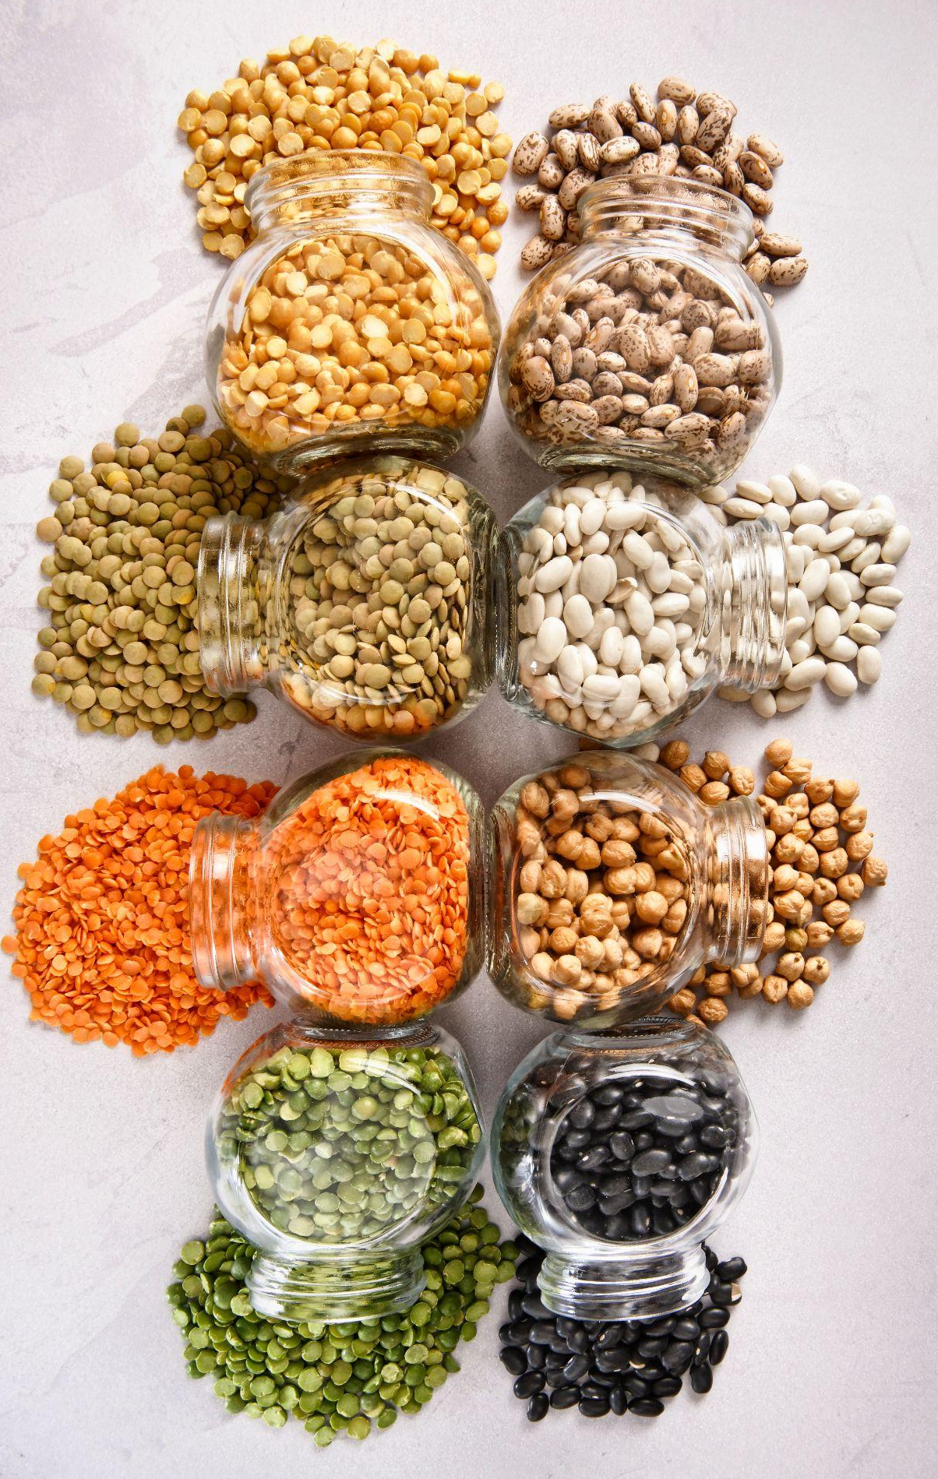
Pulses
Pulses
Dry edible seed of pod plants of the legume family. (a)
Pulse crops are also known as grain legumes (when strictly harvested for dried seeds and are technically a grain). (b)
FYI, all pulses are legumes, but not all legumes are pulses!
Notes:
a. Information Retrieved September 25, 2024 from Legumes and Pulses – The Nutrition Source (harvard.edu)
b. Information Retrieved September 25, 2025 from Pulse Crops and their Key Role as Staple Foods in Healthful Eating Patterns - 0.313 - Extension (colostate.edu)

Slide 6
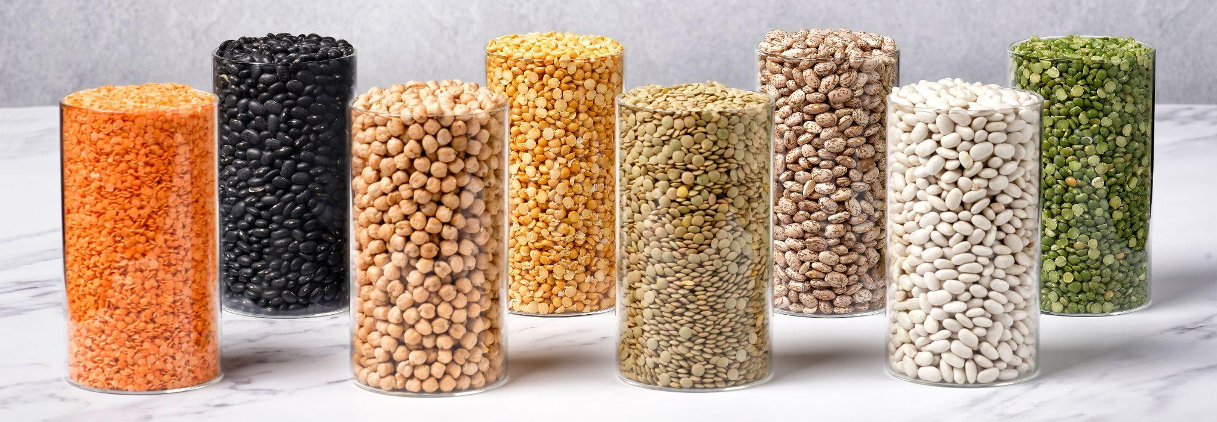
Pulses
Some Facts About Pulses
They’re an ancient plant species that has existed for millions of years.
The word pulse comes from the Latin word puls meaning thick soup!
Can be grown in many conditions and regions around the world.
Pulses include dry field peas, chickpeas, lentils and dry beans.
Notes:
Information courtesy Alberta Pulse Growers.
DID YOU KNOW:
Pulses have a long, rich history of nourishing cultures all over the world. The first evidence of pulses comes from 11,000 years ago in the Fertile Crescent, a region in the Middle East which was home to some of the earliest human civilizations.
Along with the early cereal grains, pulses were among the first crops cultivated as far back as 11,000 years ago.
Pulses are healthy, nutritious and easy to cook with. Growing pulses also promotes sustainable agriculture, as pulse crops help decrease greenhouse gases, increase soil health, and use less water than other crops.

Slide 7
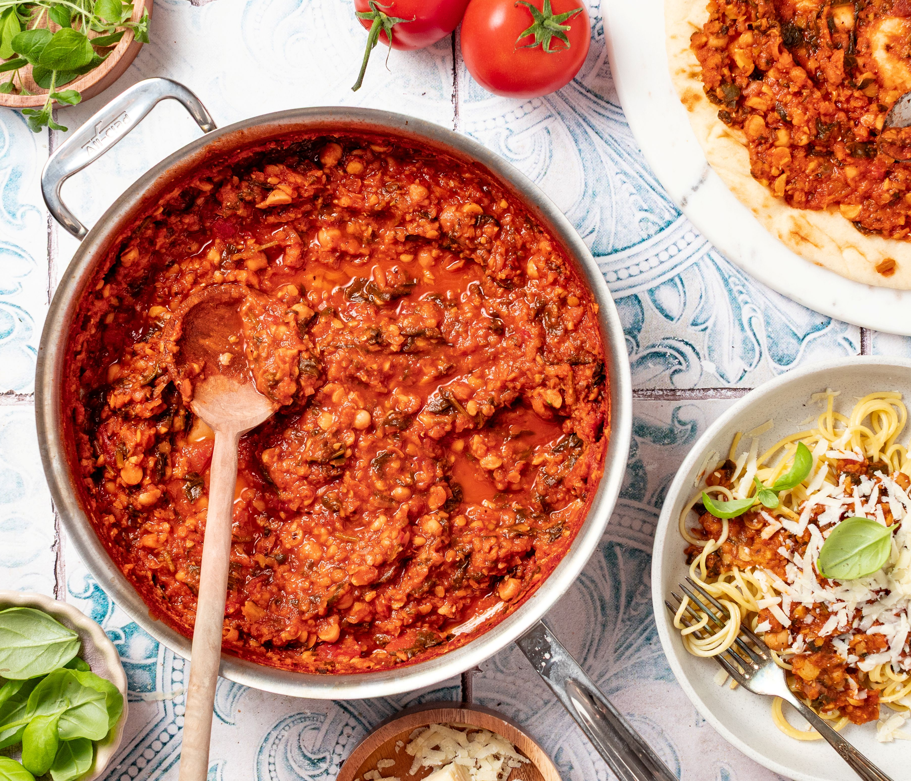
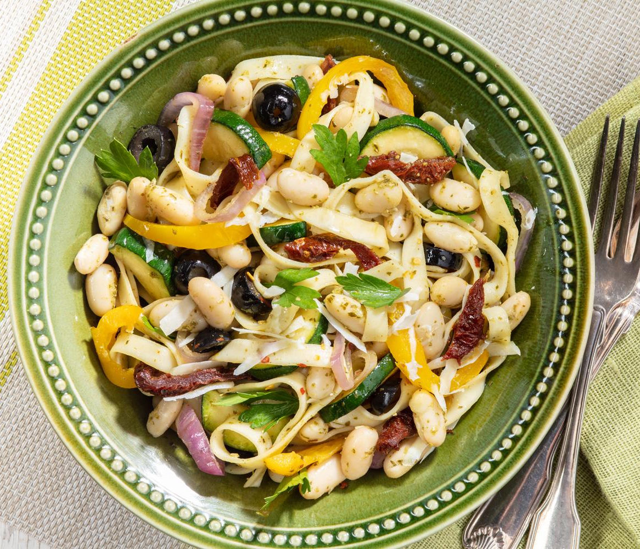
Let’s Cook Some Pasta!
Check out these vegetarian pasta recipes featuring pulses!
Mighty Marinara Sauce that we will pair with spaghetti
Pasta e Fagioli with fettuccine.
Both recipes have been created by Alberta Pulse Growers.
After making the pasta(s), complete the Recipe Reflections evaluation.

Slide 8
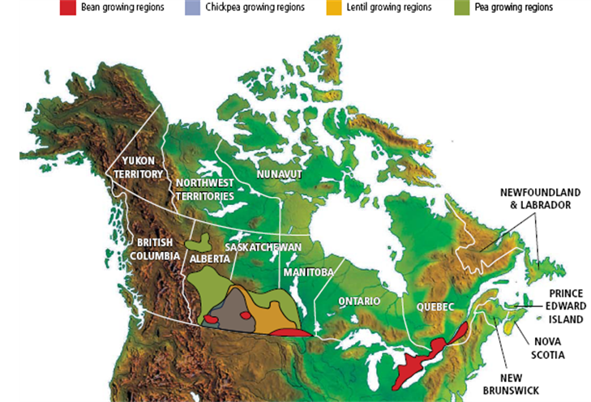
Pulses Grown in Canada
Notes:
Pulses in Canada
Pulses are primarily grown in AB, SK, MB and ON with a bit in PQ.
Canada represents 35% of the global pulse trade.
Canada is the world’s largest producer and exporter of lentils & dry peas.
Canada exports ~70% of the pulses it produces to countries around the world
5th largest crop overall in Canada
Pulse crops have $2.5 billion in farmgate receipts and $3.4 billion in exports in 2016
Production of dry peas, lentils and chickpeas, is concentrated in mostly Saskatchewan and Alberta while dry bean production is mostly located in Manitoba, Ontario and Alberta.

Slide 9
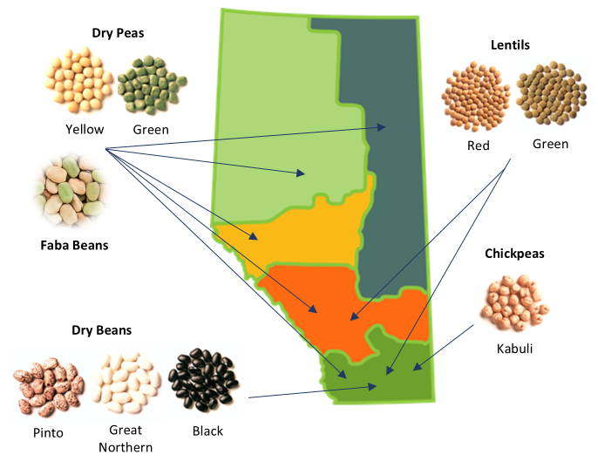
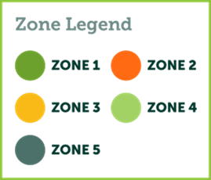
Pulses Grown in Alberta
Notes:
Pulses in Alberta
2011 – 1 million seeded acres
2023 - ~ 1.8 million seeded acres
APG – represent the 6,000 pulse farmers in Alberta. Alberta farmers grow a variety of pulses, depending on where their farm is located in the province.
Alberta is divided into five growing zones that reflect the commonality of pulse crops and production methods between areas, as well as the direction of trade of pulses. Alberta’s pulse growing zones also align with established growing zones of the barley, wheat, and canola commissions.

Slide 10
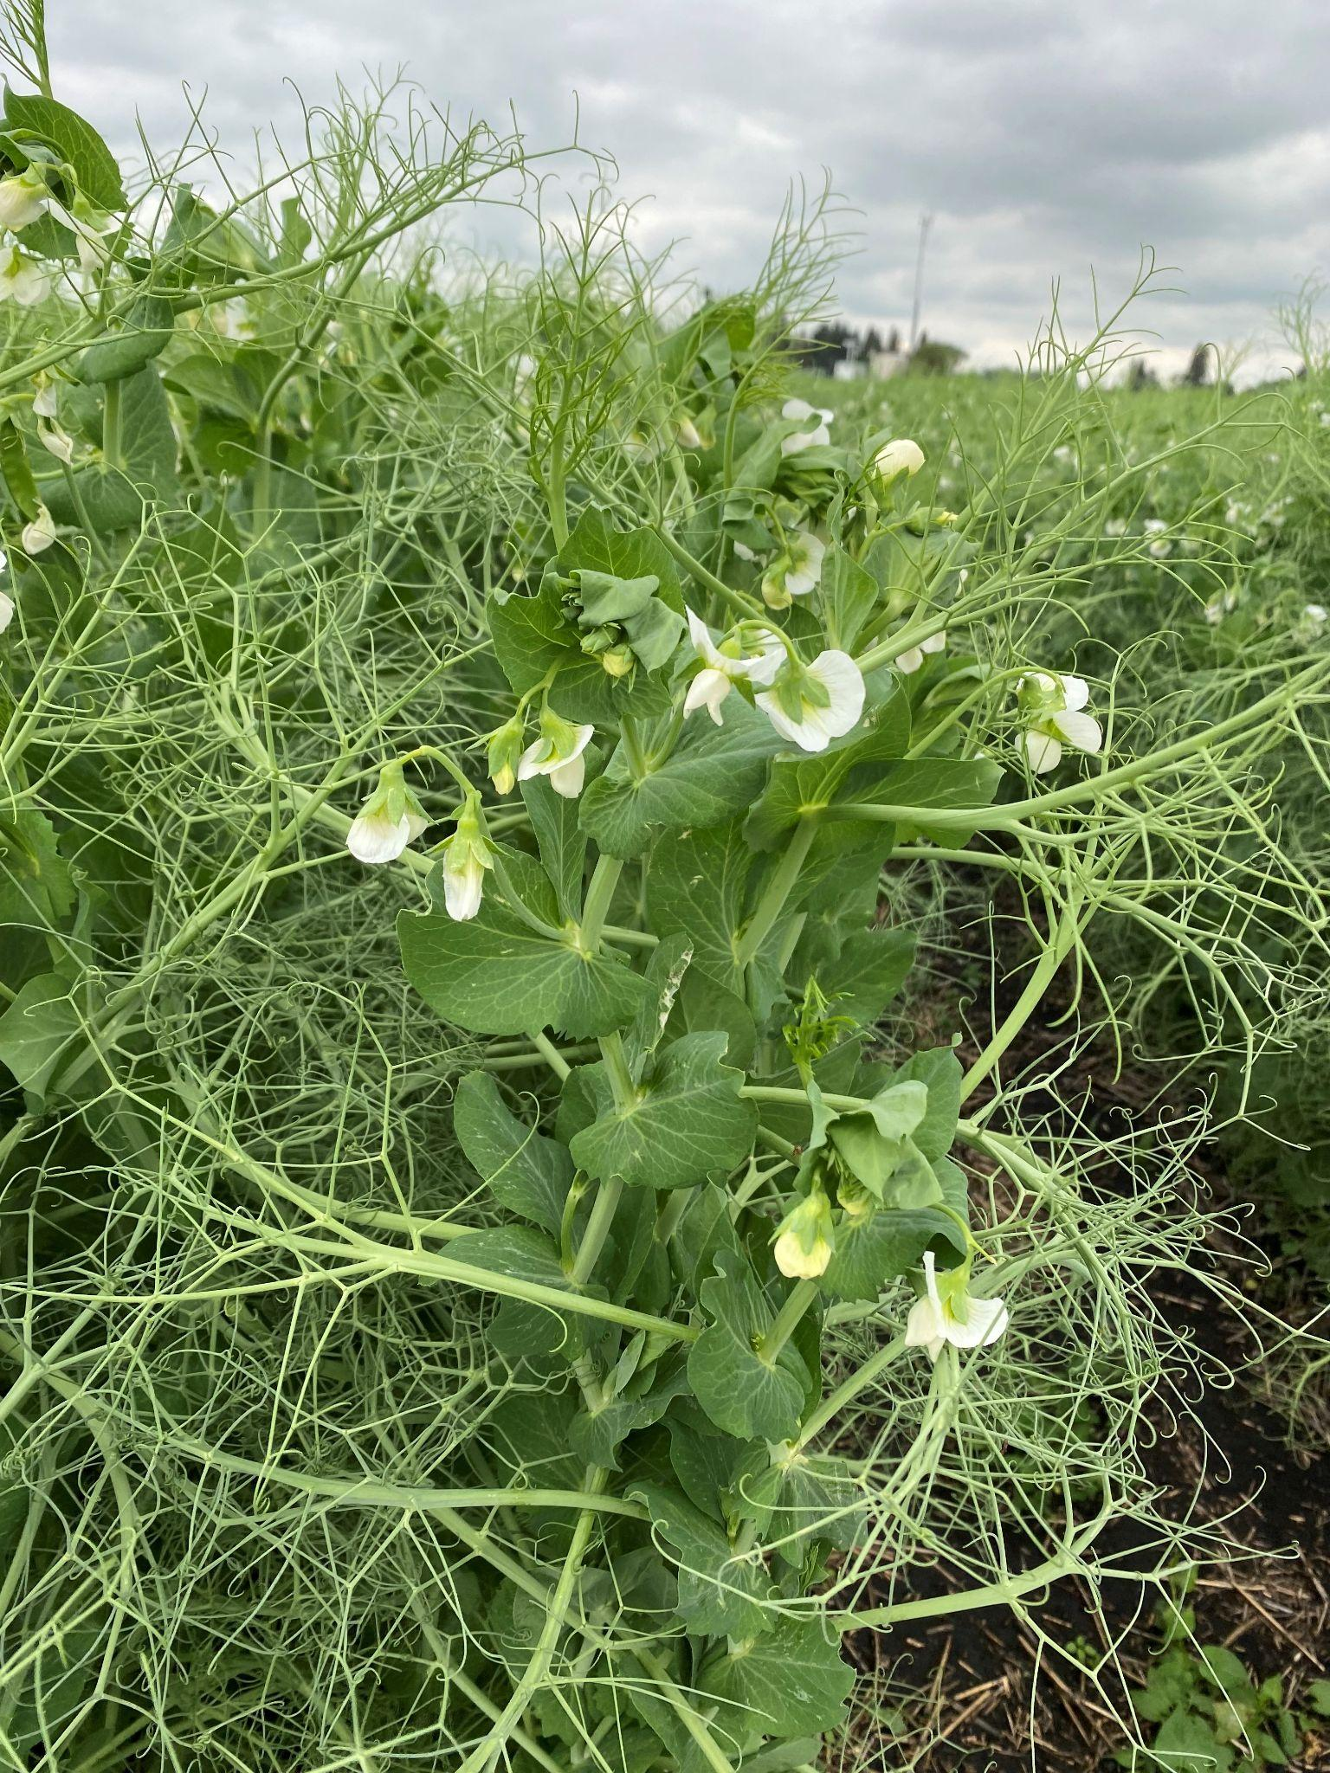
Fun Check!
What plant is this?
Is it a pulse or a legume?
(Hint there may be more than 1 right answer!)
Notes:
Photo courtesy of Alberta Pulse Growers.

Slide 11
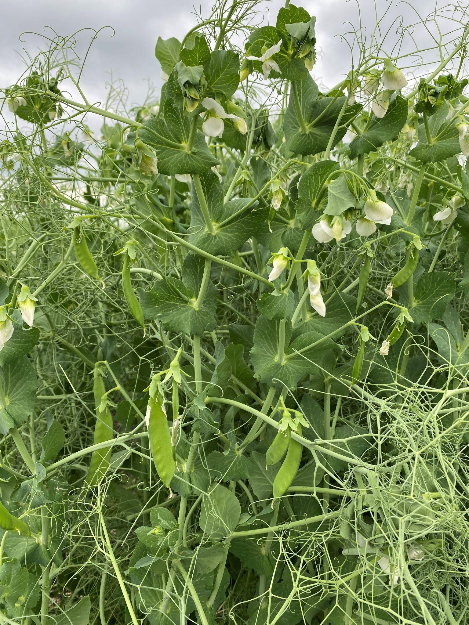
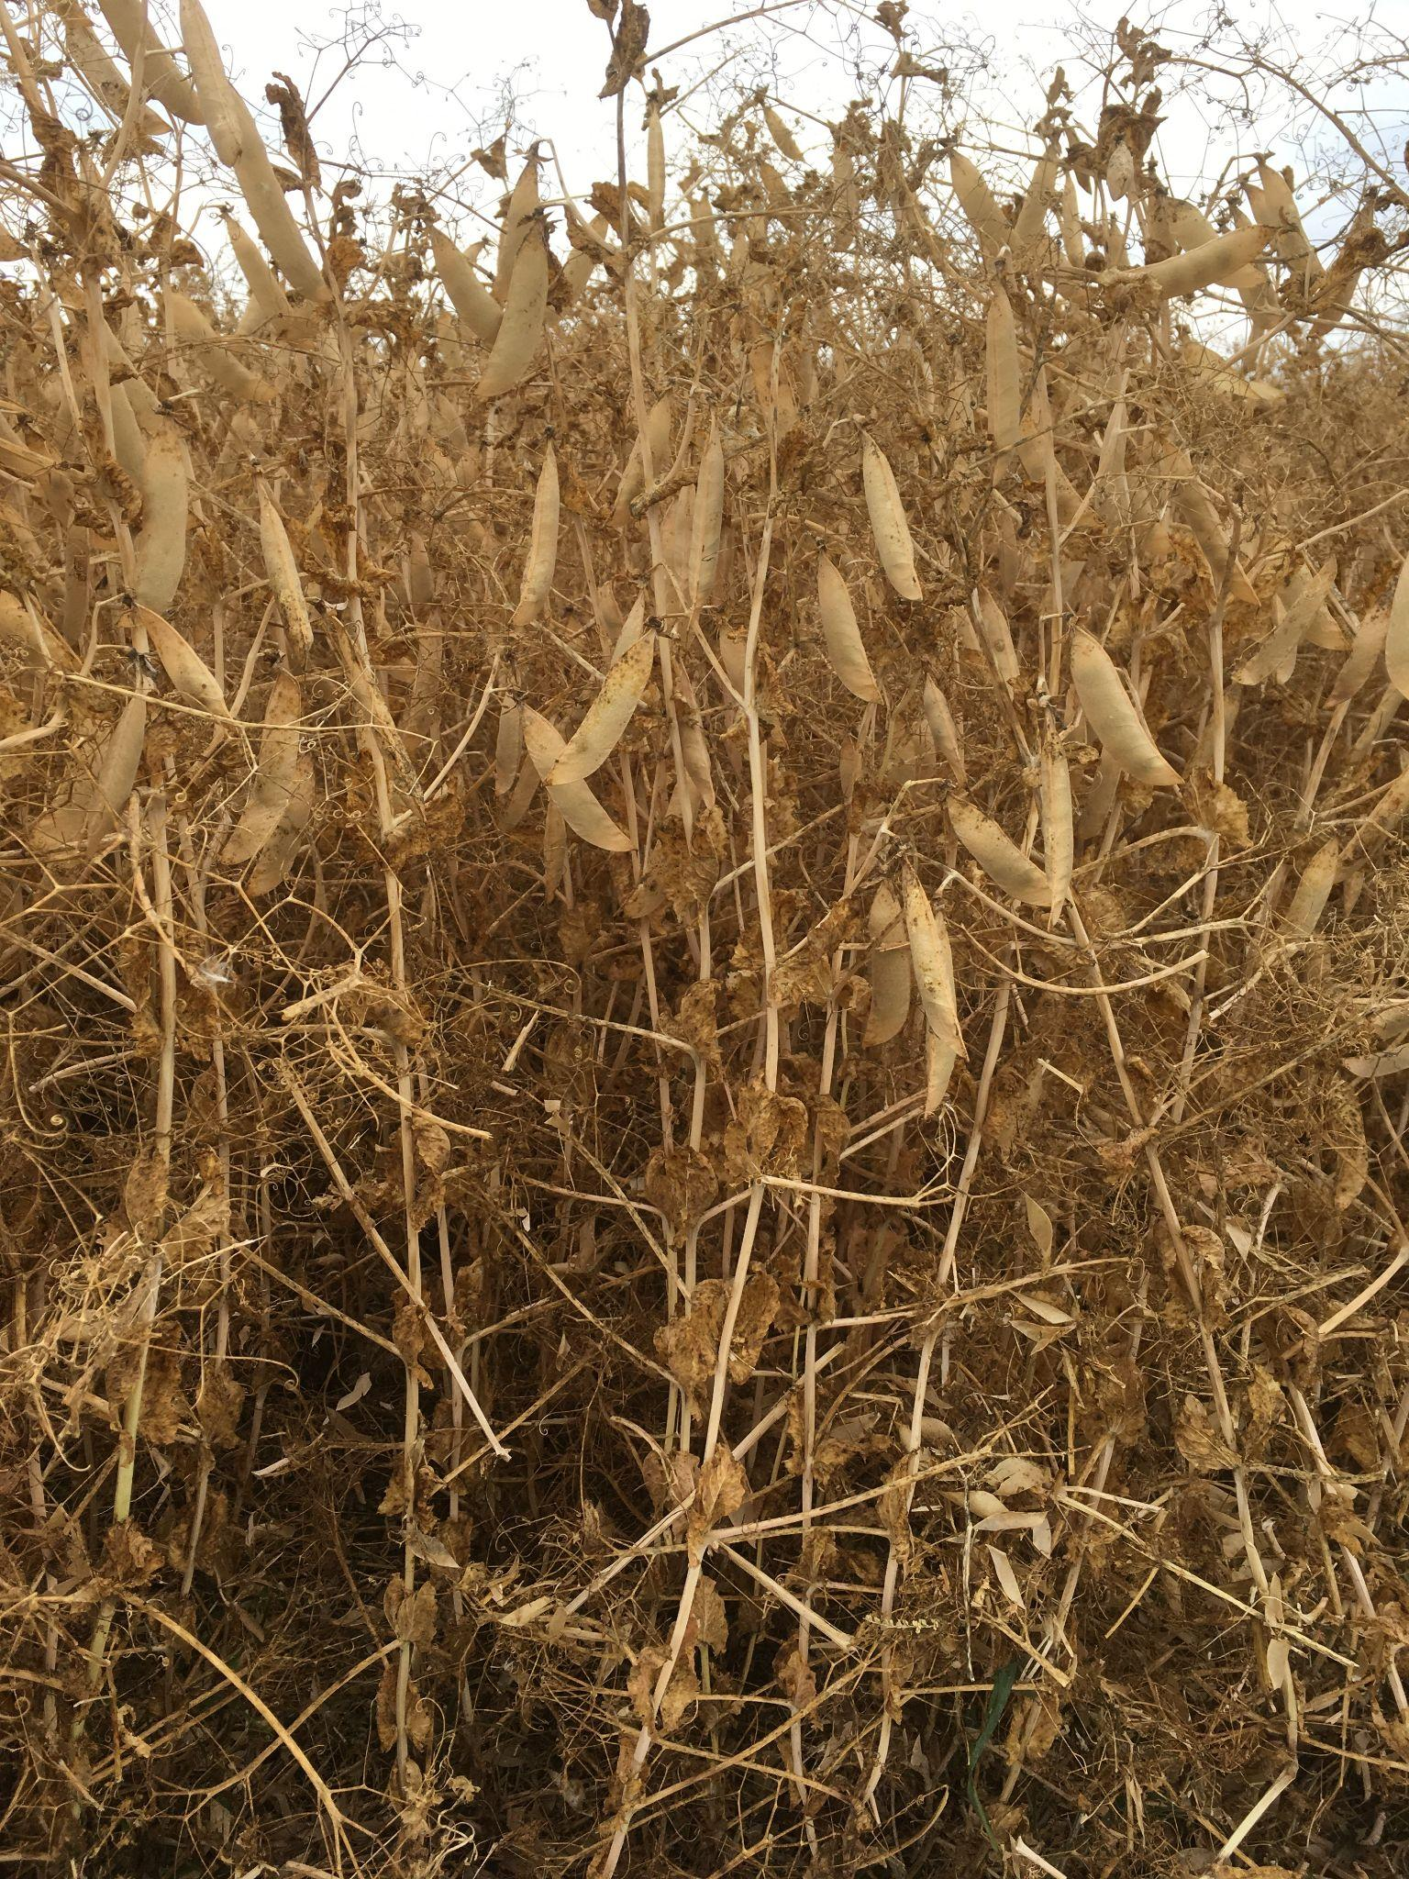
Fun Check!
This plant is both a legume and a pulse!
The pea plant, whether green or dry, is a legume, but only the dry seeds in the pod are a pulse!
This is a flowering field pea plant.
Some pods have formed, and the white flowers will also become pods!
This is pea crop that is almost ready to harvest.
Pulse crops dry in the field and are then harvested by the farmer.
Notes:
Photos courtesy of Alberta Pulse Growers.

Slide 12
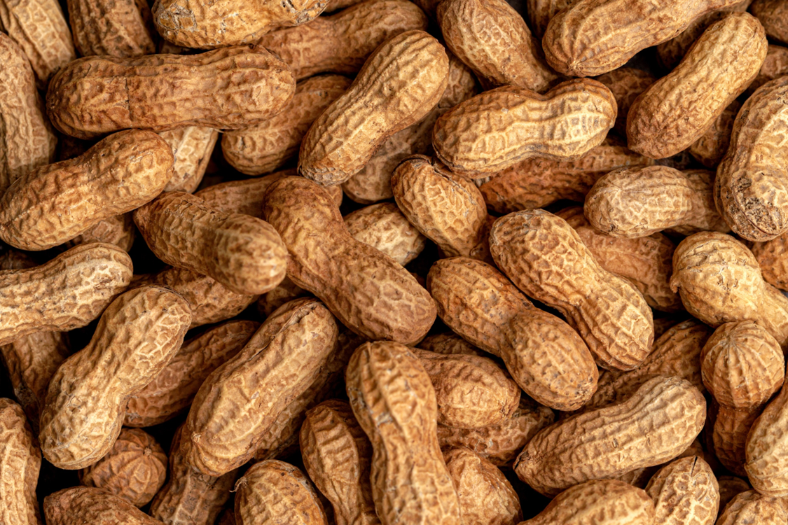
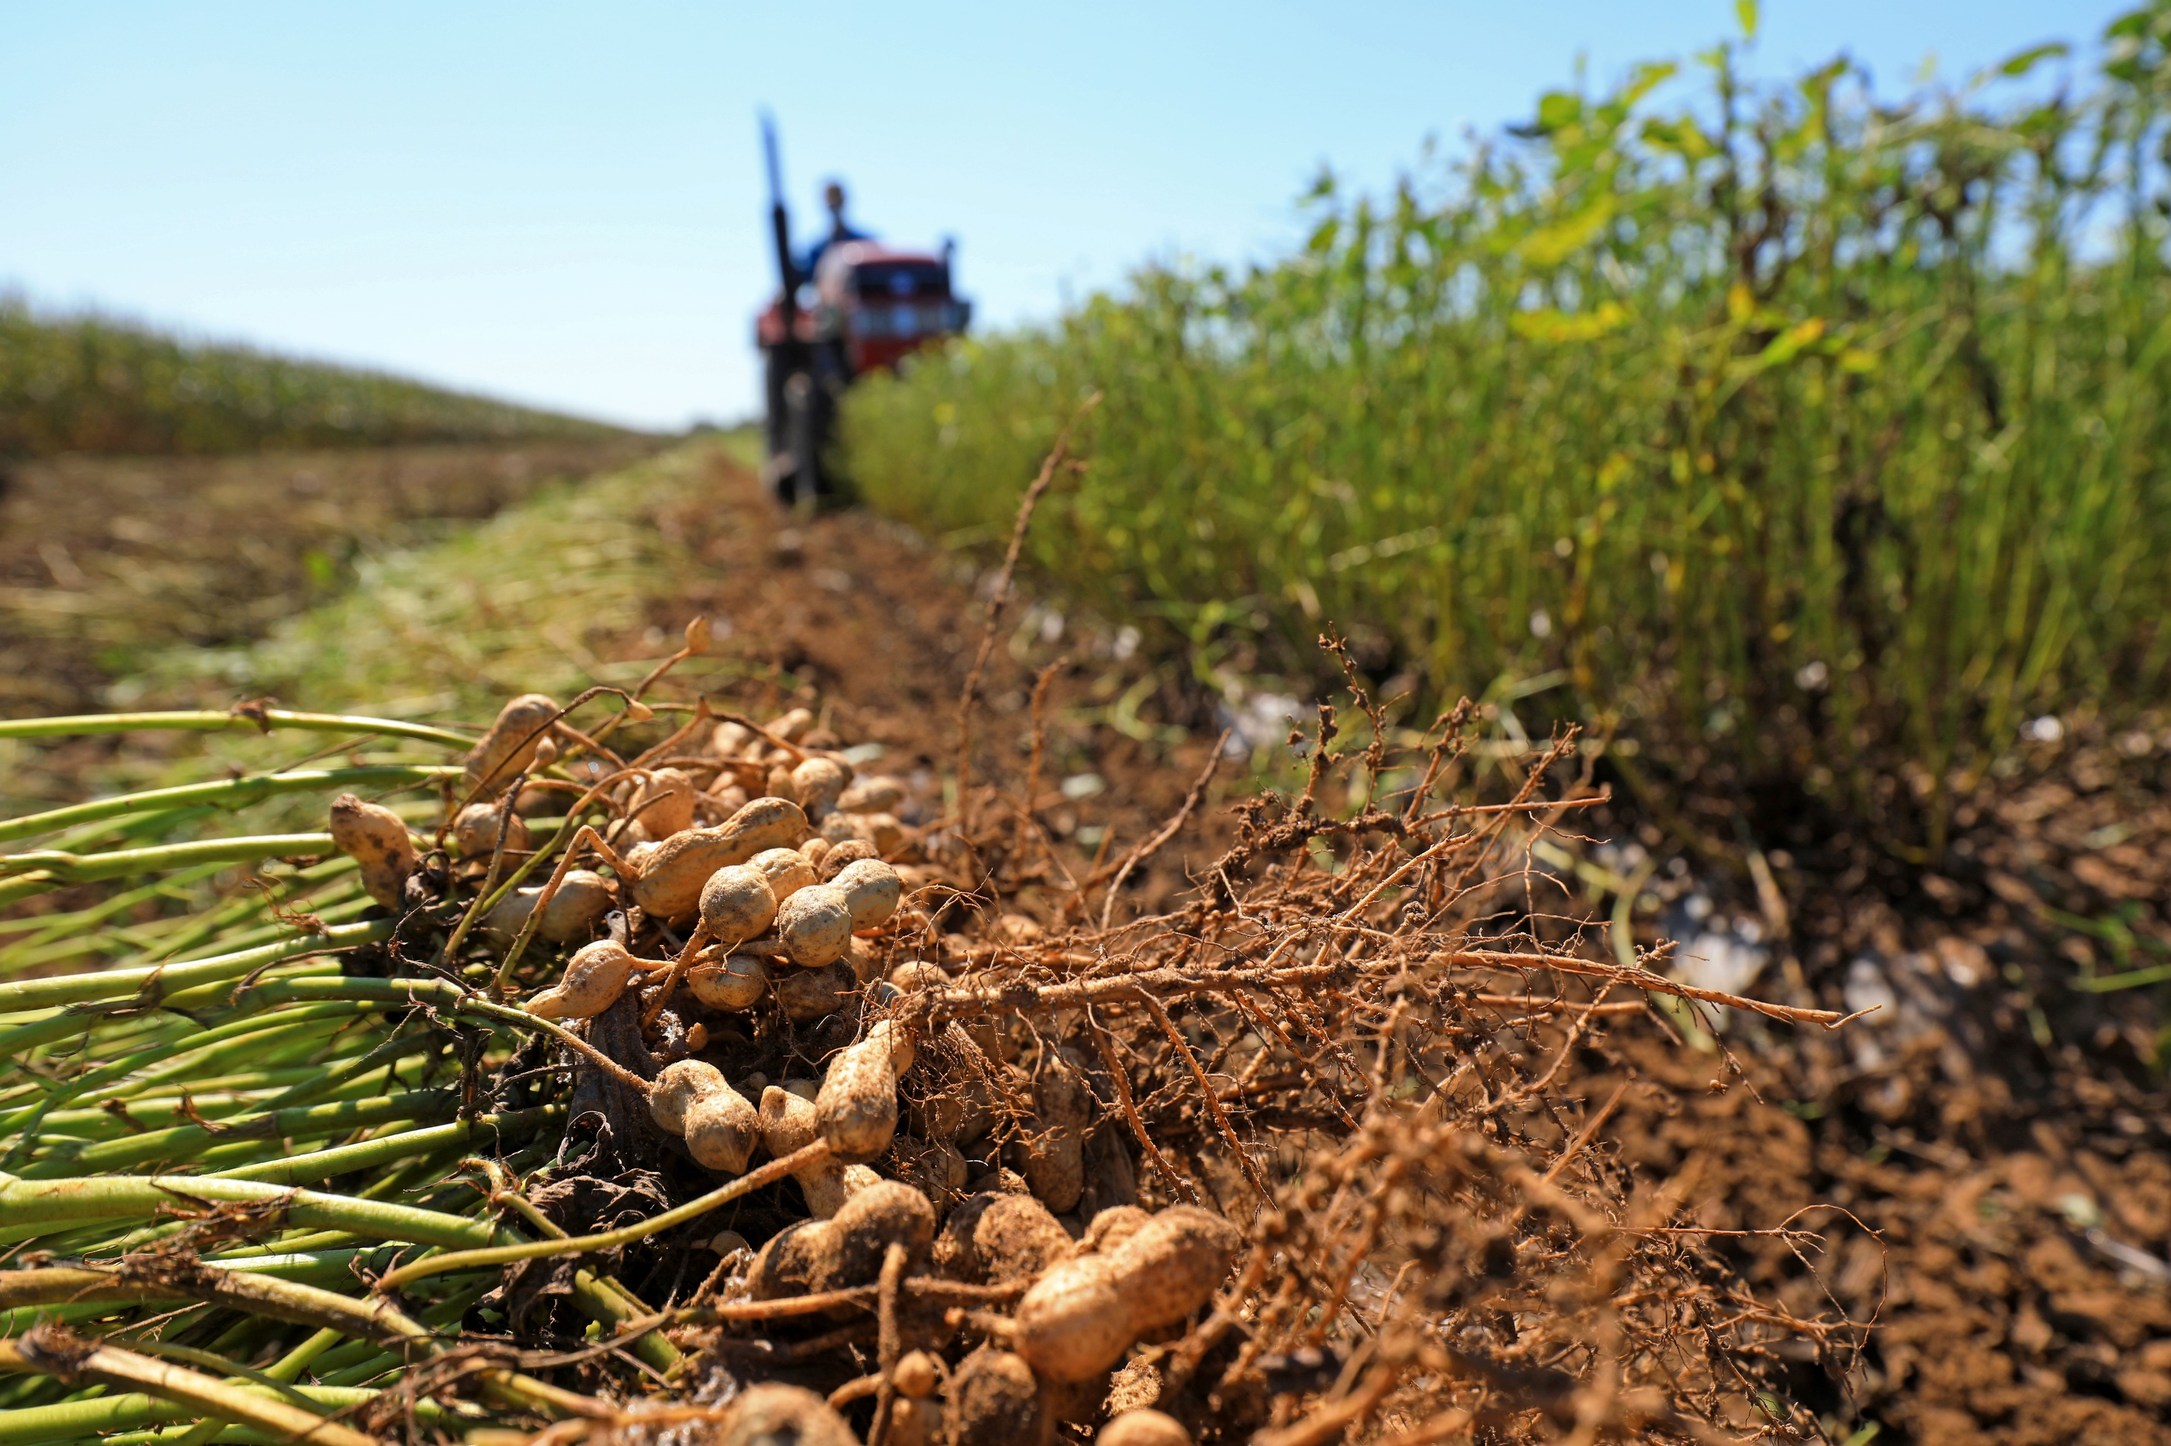
Fun Check!
What is a peanut? A pulse, legume, nut, or seed? Why?
Notes:
Stock image of peanuts and Adobe Stock image of peanut crop/field.

Slide 13
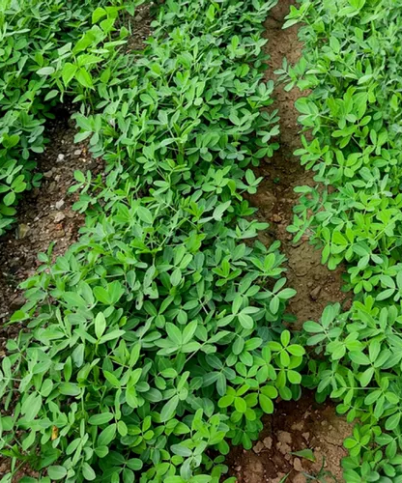
What is a peanut?
It’s a legume and seed!
In the botanical sense, peanuts are not nuts, despite their name!
Peanuts grow underground, in a pod like peas and lentils. This means it is classified as a legume, not a nut. This is reflected in the ‘pea’ part of the name as it is part of the Pea family.
Peanut plants also fix nitrogen like other legume plants.
Peanut plant photo from The Spruce at
https://www.thespruce.com/peanut-plant-profile-4797389
Notes:
Information supported by Difference between nuts and seeds - Woodland Trust (Retrieved September 25, 2024) and How to Grow and Care for Peanut Plants – The Spruce (https://www.thespruce.com/peanut-plant-profile-4797389 )

Slide 14
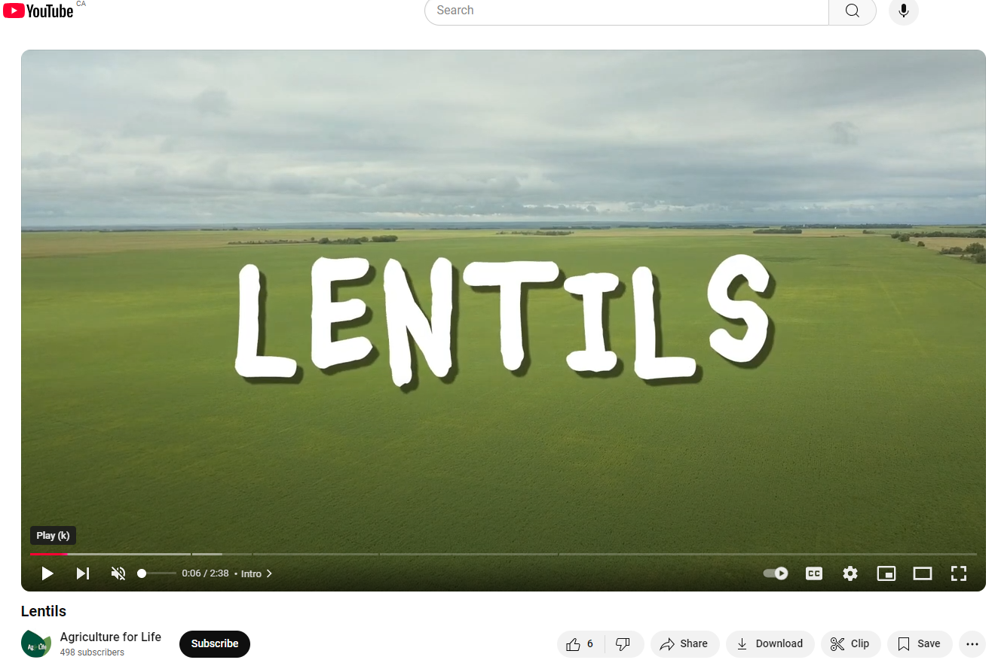
Lentils
Check out this short video from Agriculture for Life
What’s in the Field? Lentils
https://www.youtube.com/watch?v=M_DqNcKd36I

Slide 15
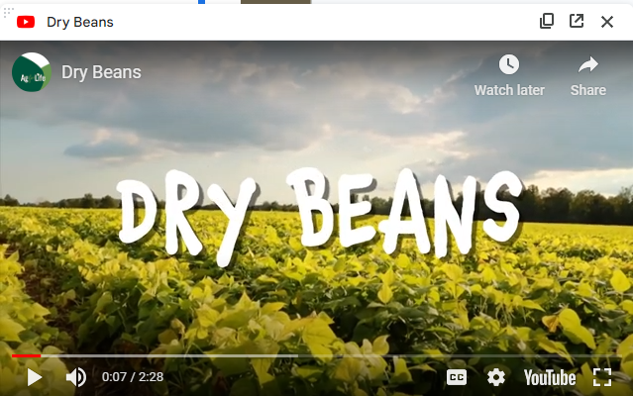
Dry Beans
Check out this short video from Agriculture for Life
What’s in the Field? Dry Beans
https://www.youtube.com/watch?v=WyQurM7ysmM

Slide 16
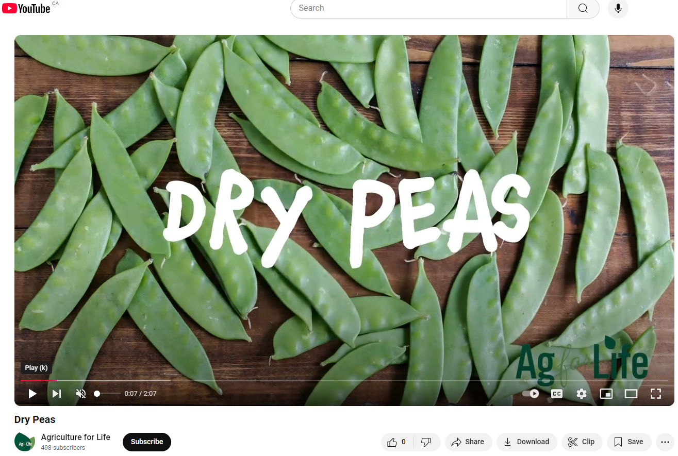
Dry Peas
Check out this short video from Agriculture for Life
What’s in the Field? Dry Peas
https://www.youtube.com/watch?v=Y09A3t3abv0

Slide 17
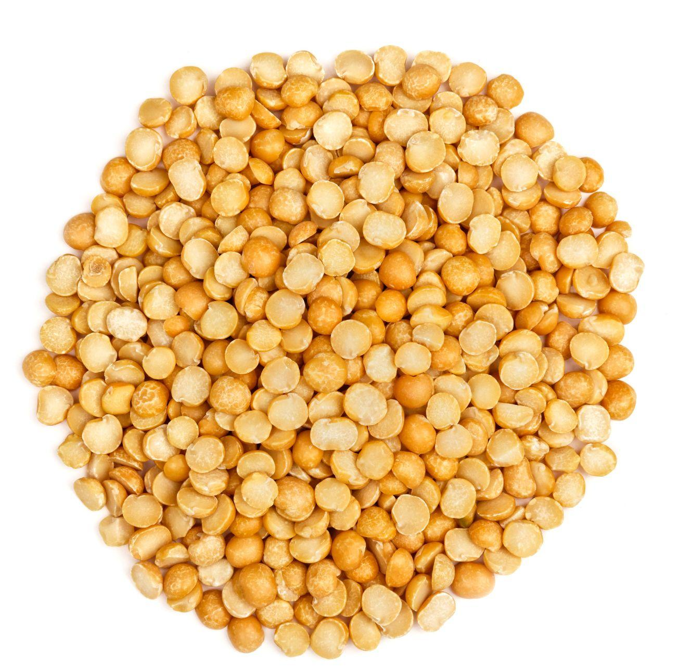
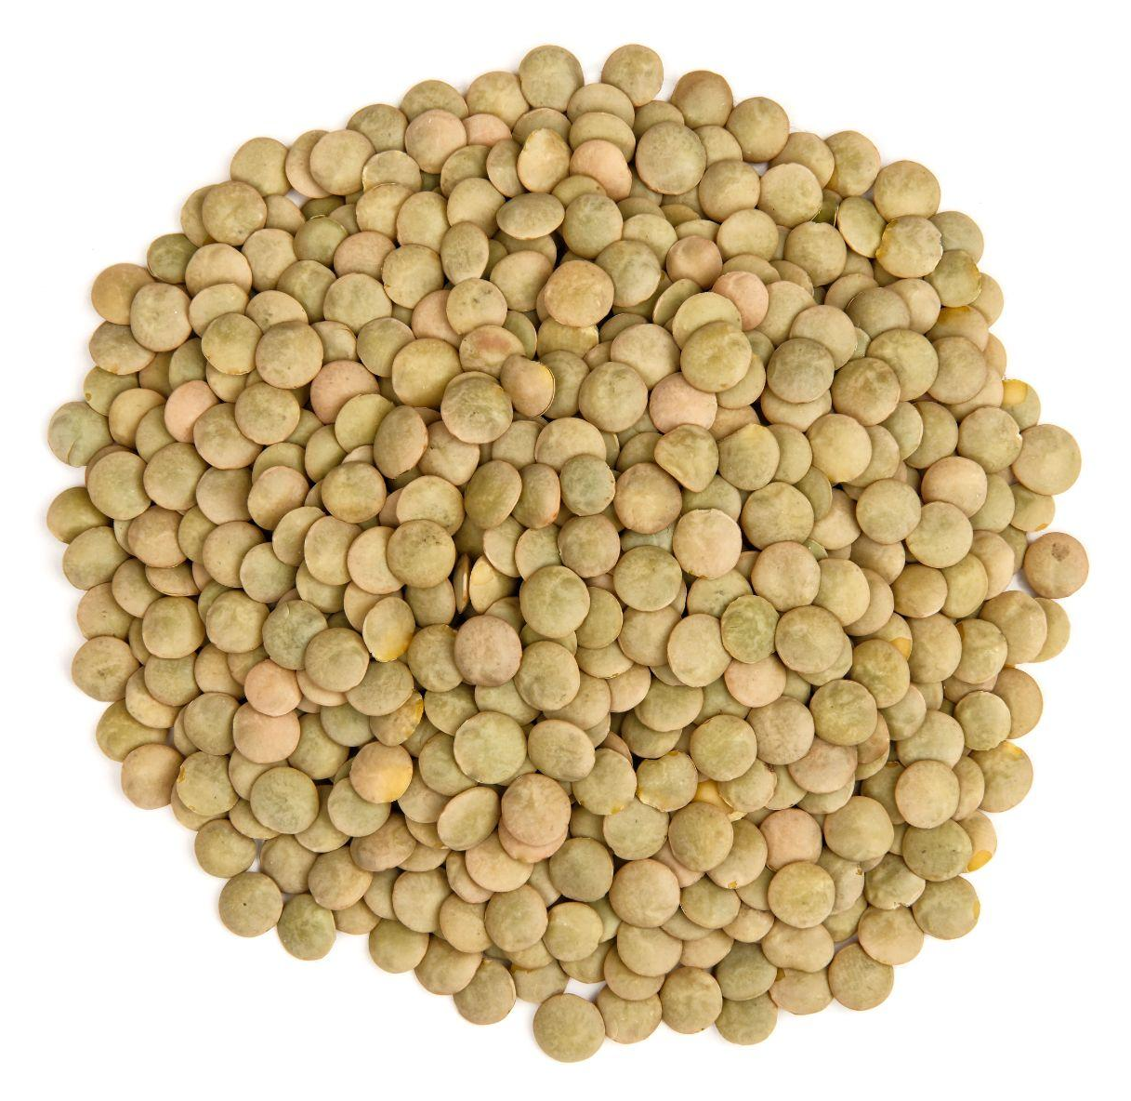
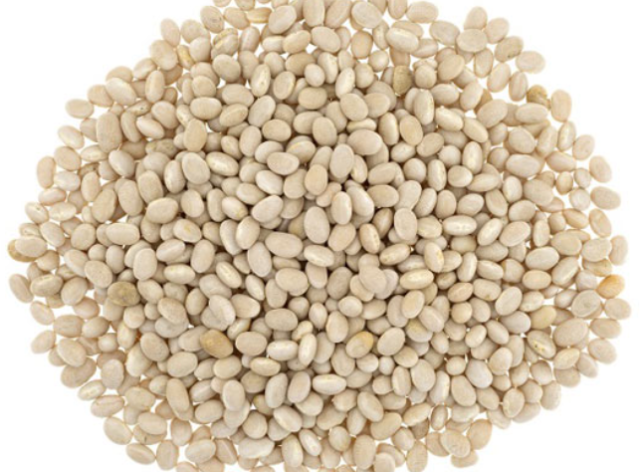
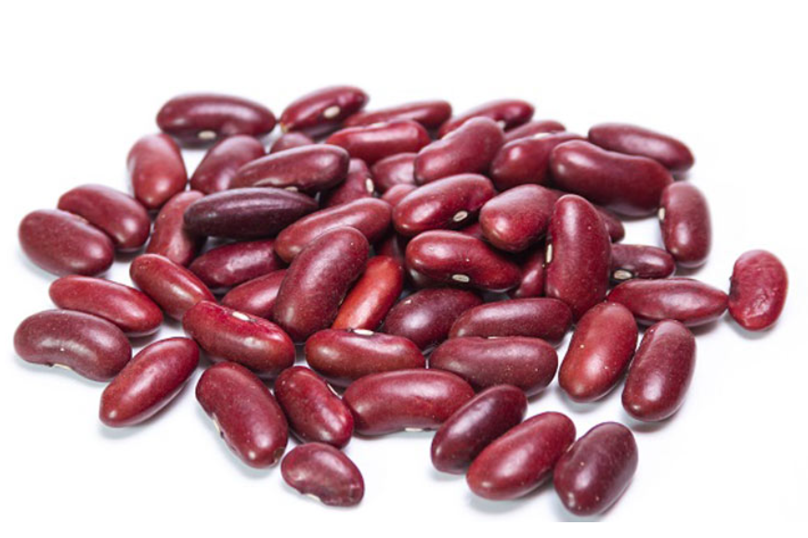
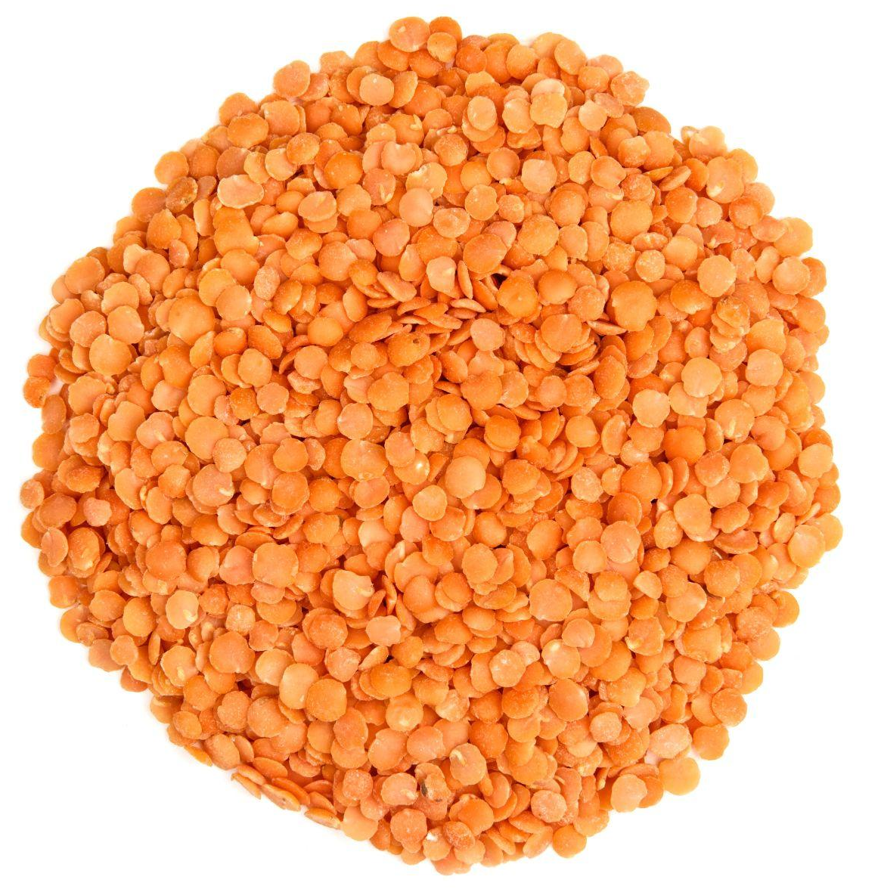
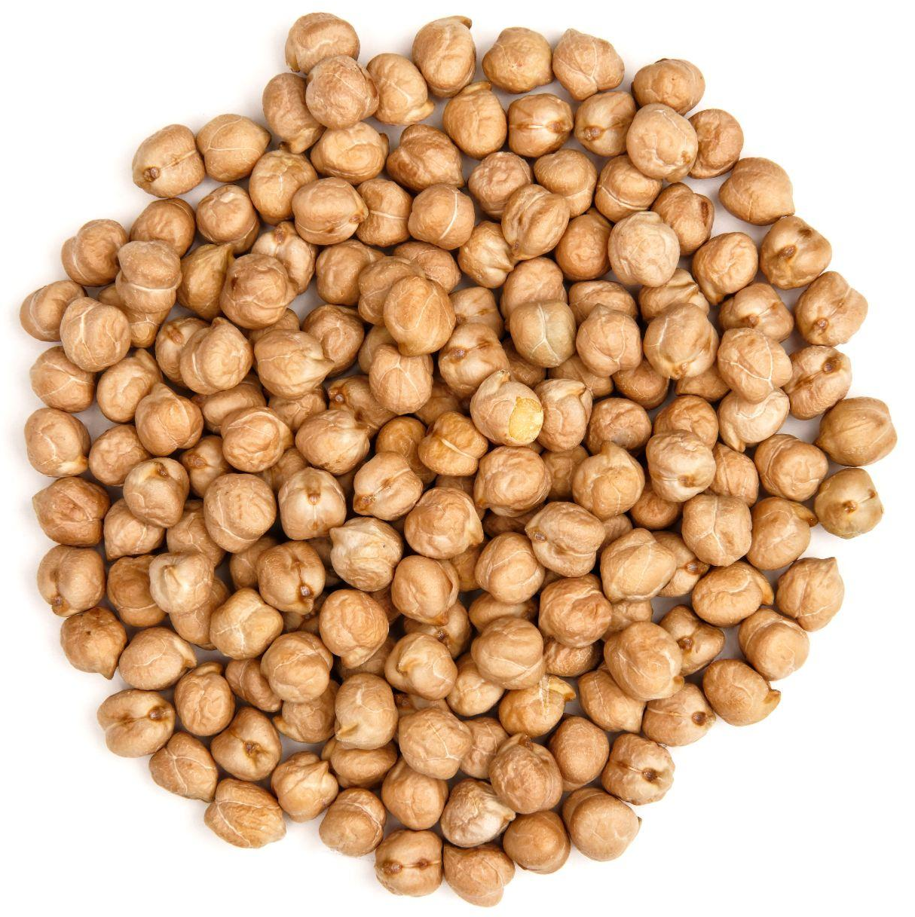
Common Pulses Grown in Canada
Match the pulses!
chickpeas
red split lentils
navy beans (white pea beans)
yellow split peas
kidney beans
green lentils
1 | 4
2 | 5
3 | 6
Did You Know?
Chickpeas got their name because they resemble a chicken’s beak! (a)
Notes:
Answers:
Yellow Split Peas
Navy Beans
Red Split Lentils
Green Lentils
Kidney Beans
Chickpeas
a. Information Retrieved October 25, 2024 from: https://www.teachersuperstore.com.au/assets/files/uploads/ch9-pages-from-food-for-you-3ed-book-1-4pp-10-web.pdf

