Slide 1
Today’s Agenda
Day 3
Why are grains, legumes, nuts & seeds so popular?
Historical Trivia Time
Let’s Cook! Bean Enchiladas
Cultural use of grains, legumes, nuts and seeds

Slide 2
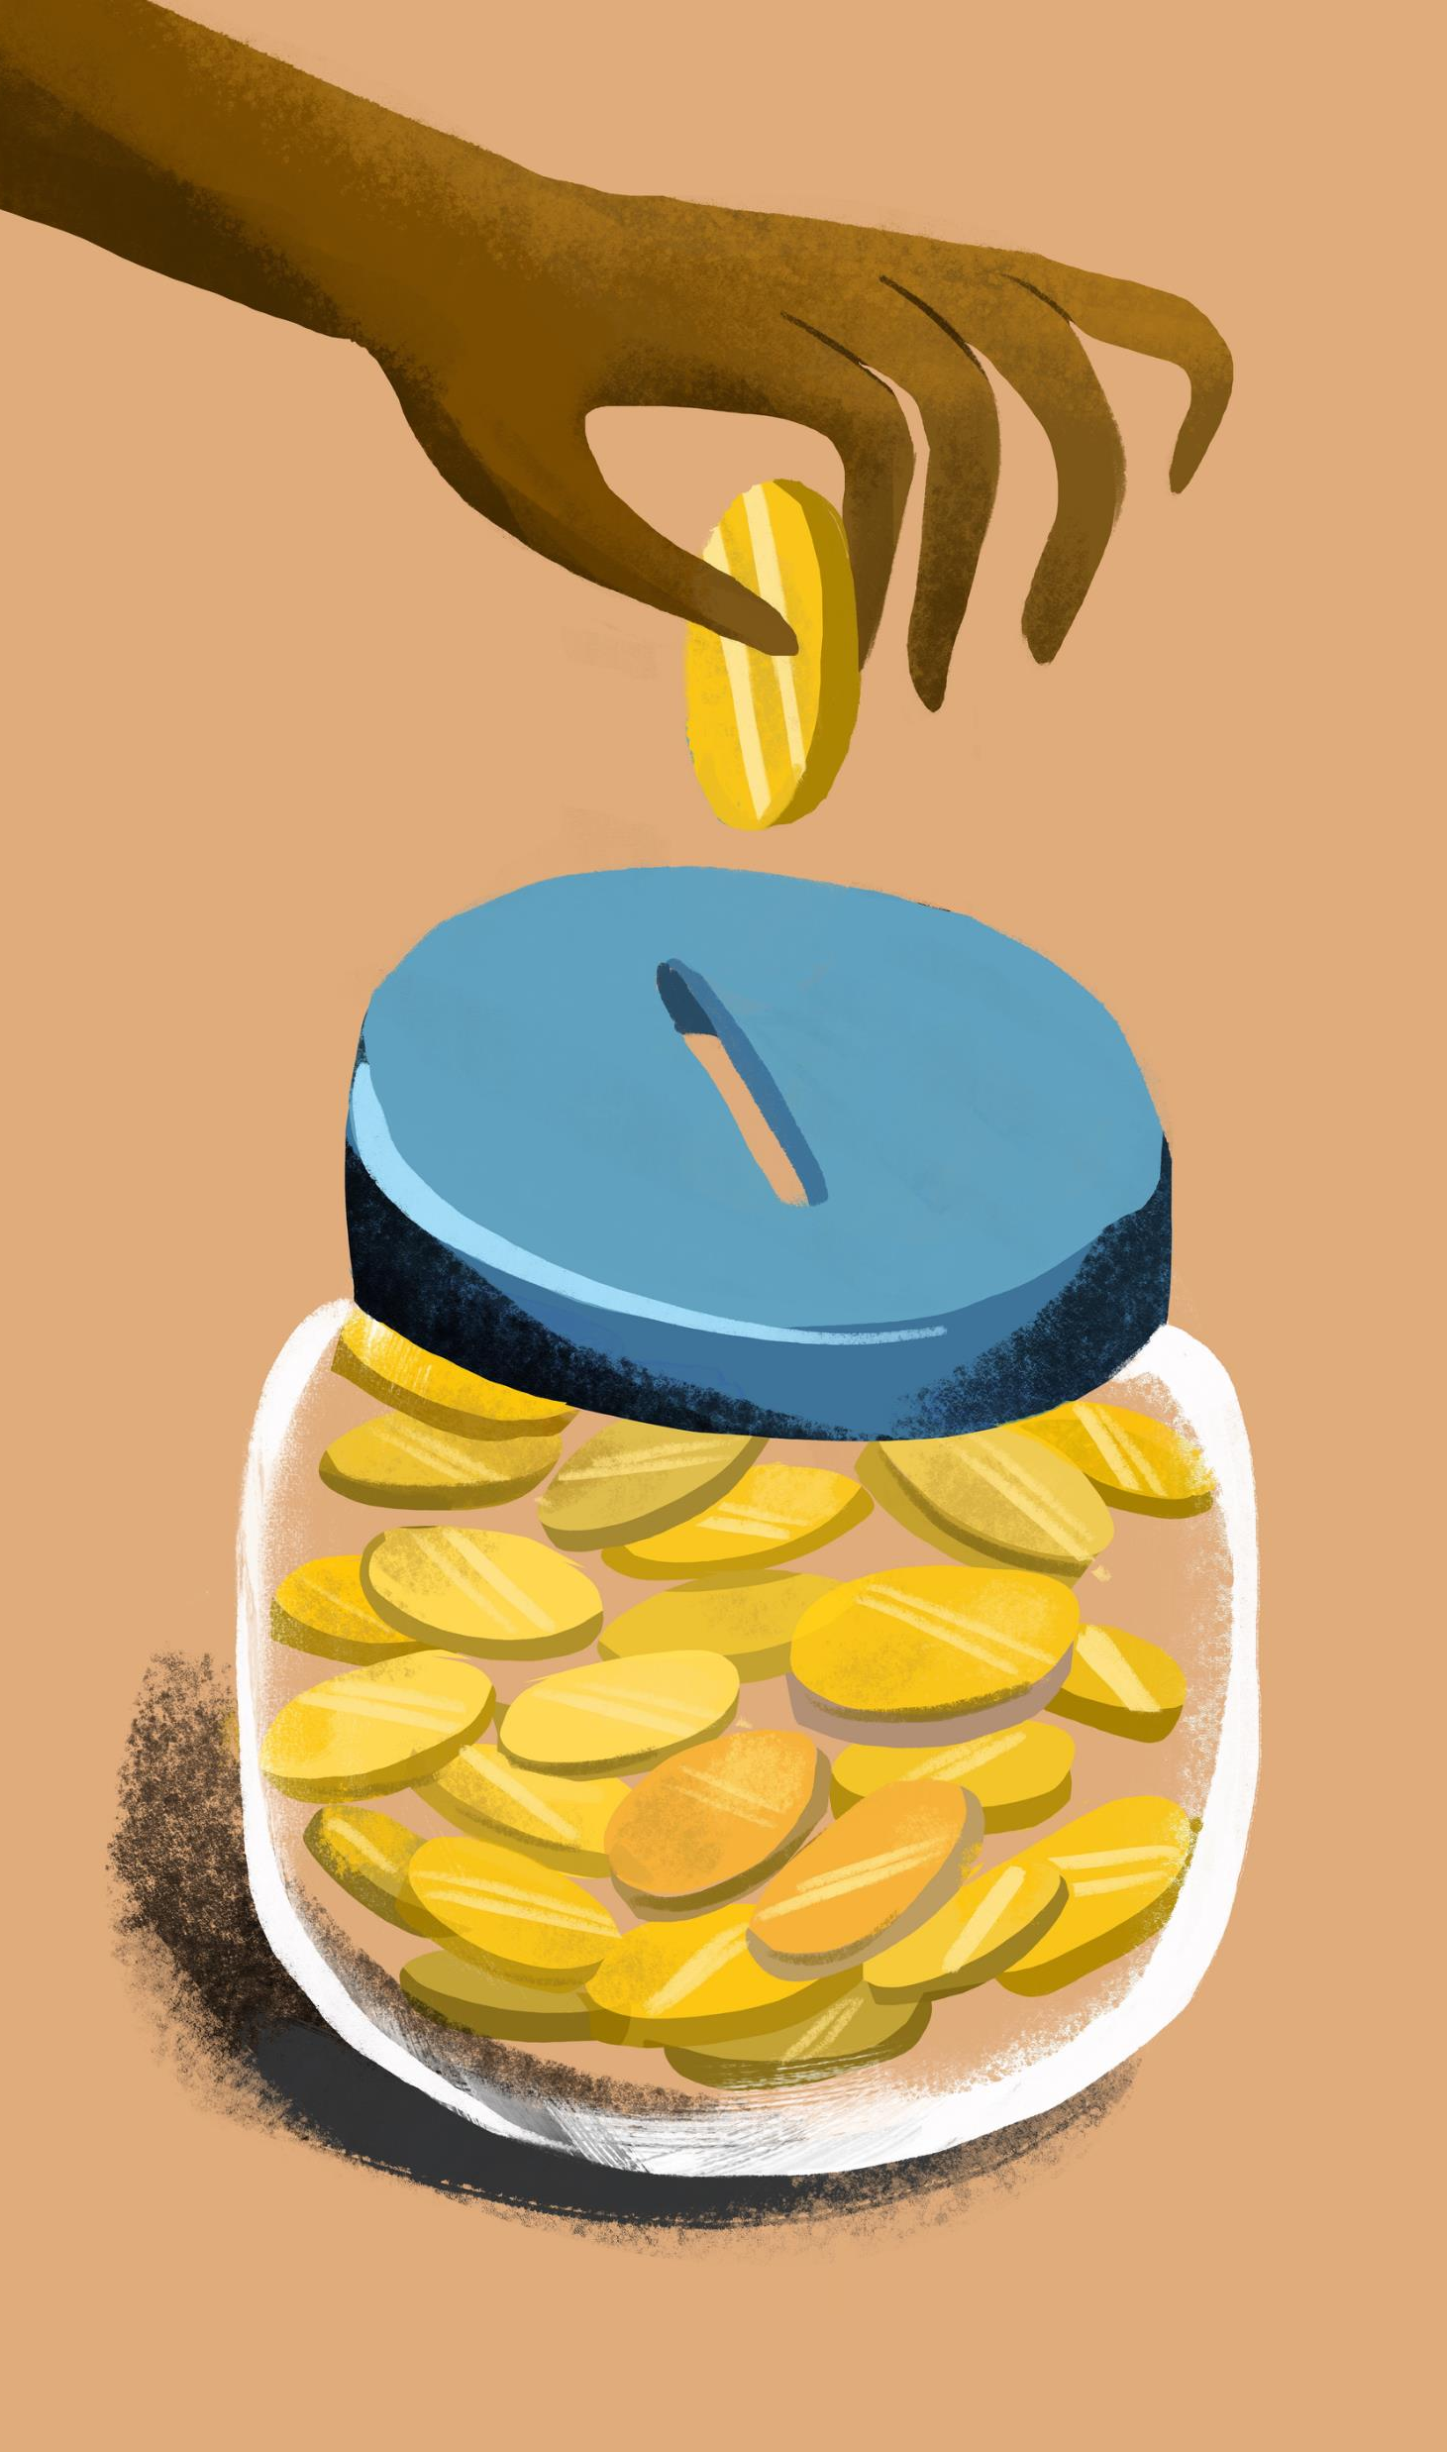
Why are Grains, Legumes, Nuts and Seeds so Popular?
Economical and Available!
Economical to produce
Affordable to purchase
Considered staple foods and available globally
grains are a staple carbohydrate
legumes, nuts, and seeds are the main source of protein in third world countries
Check out: https://www.nationalgeographic.com/what-the-world-eats/ to see how grains are part of the everyday diet compared to other macronutrients.
Notes:
Information supported by: ch9-pages-from-food-for-you-3ed-book-1-4pp-10-web.pdf (teachersuperstore.com.au)
Information Retrieved October 17, 2024 from https://oldwayspt.org/blog/whole-grains-are-part-your-heritage/
Information Retrieved October 25, 2024 from https://www.nationalgeographic.com/what-the-world-eats/

Slide 3

Why are Grains, Legumes, Nuts and Seeds so Popular?
Easy to Prepare and Store and Very Versatile!
Easy to prepare and can be used in a variety of recipes and meals.
Easy to store and have long shelf life!
Both dry legumes and dry grains can be stored at room temperature for months.
Store in an airtight container in a dark place.
If whole grain, store container in the fridge to prevent rancidity.
Unopened, canned legumes do not need refrigeration until opened.
Nuts are easy to store but have a shorter shelf life due to their fat content.
Store in an airtight container in a cool place or refrigerator to prevent rancidity.
Notes:
Information supported by: ch9-pages-from-food-for-you-3ed-book-1-4pp-10-web.pdf (teachersuperstore.com.au)
Information Retrieved October 17, 2024 from https://oldwayspt.org/blog/whole-grains-are-part-your-heritage/

Slide 4
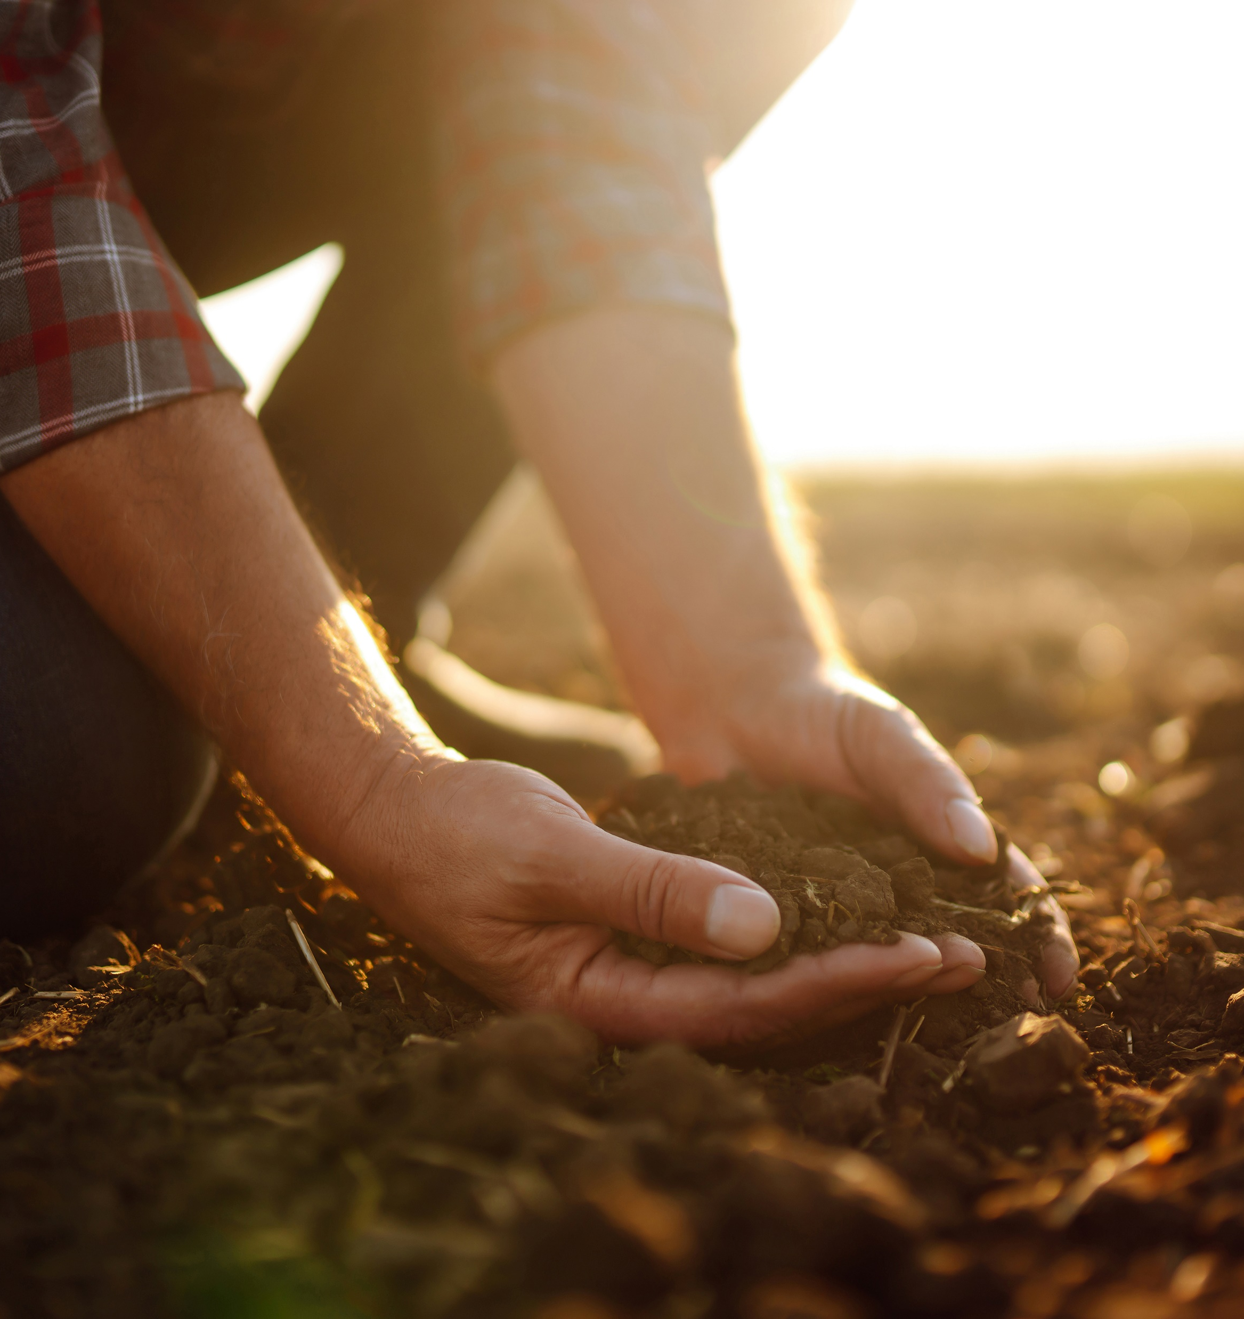
Why are Grains, Legumes, Nuts and Seeds so Popular?
Good for the environment!
Can use recyclable materials for packaging
Sustainably produced through farming practices like crop rotation, zero till cultivation and precision agriculture.
Whole grains use a lower amount of water when growing and are considered environmentally friendly.
Did you know? Farmers need only 1,250 litres to produce 1 kilogram of lentils! (a)
Notes:
Information supported by: ch9-pages-from-food-for-you-3ed-book-1-4pp-10-web.pdf (teachersuperstore.com.au)
Information Retrieved October 17, 2024 from https://oldwayspt.org/blog/whole-grains-are-part-your-heritage/
a. FYI: Water requirements
Pulses are highly water efficient – to produce 1 kg of lentils farmers need only 1250 litres.
information retrieved January 16, 2025 from United Nations – World Pulses Day website: https://www.un.org/en/observances/world-pulses-day#:~:text=Pulses%20are%20highly%20water%20efficient,of%20beef%20requires%2013%2C000%20liters.

Slide 5
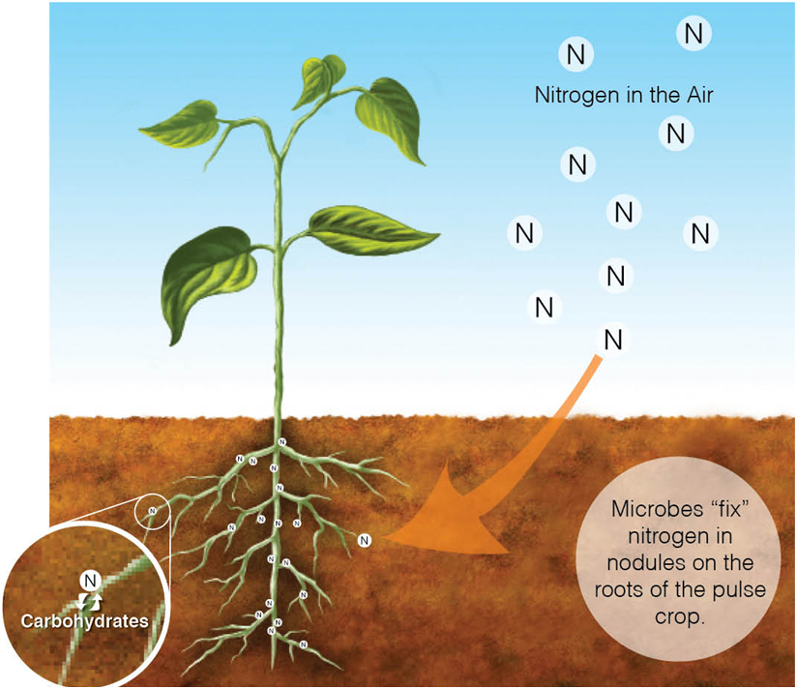
Why are Grains, Legumes, Nuts and Seeds so Popular?
Legumes and pulses are environmentally sustainable crops.
They develop nodules on their roots to partner with soil bacteria to take atmospheric nitrogen and convert it into a form of nitrogen that enriches the soil and helps the plant grow.
Less to zero synthetic nitrogen fertilizer is then used on a pulse/legume crop with this process.
Check out this short video from Alberta Pulse Growers on Environmental Sustainability https://albertapulse.com/videos/environmental-sustainability/
Notes:
Productivity & Environmental Sustainability
Pulse production plays an integral role in sustaining the health of the environment. Incorporation of pulses into a field crop rotation will reduce greenhouse gas emissions, maintain soil health and biodiversity.
They have a low carbon footprint
Greenhouse gas emissions from agriculture largely come from nitrogen fertilizers. Pulses only require a small amount of fertilizer to grow because they partner with Rhizobium bacteria in the soil. These bacteria infect the pulse root to form root nodules and create a symbiotic relationship. The pulse plant provides the bacteria with energy for respiration and the bacteria convert the nitrogen in the air into a form of nitrogen that the pulse plant can absorb. This relationship that pulses have with soil bacteria reduces the need for nitrogen fertilizers, which means that farmers need to add little to no nitrogen fertilizer to their pulse crop.
Water efficient source of protein
Pulses use 1/2 to 1/10 of the water used by other sources of protein. Pulses can also help farmers adapt to climate change, because different types of pulses can be grown in almost any farming system and in almost any type of climate – wet or dry, and in cold or hot regions of the world.
Enrich the soil where they are grown
Pulses are full of nutrients that are good for the soil. They produce different compounds that feed microorganisms in the ground. This process improves soil health, which benefits other crops that grow in rotation with pulses. After pulse crops are harvested, they leave behind nitrogen-rich crop residues that provide extra nutrients for the next crop that is grown, so crops like wheat often grow better when they are planted after a pulse crop.

Slide 6
Historical Trivia
Lentils believed to be the first food grown and harvested by humans
Mexico cultivated first kidney, pinto and black beans.
China is famous for soy and adzuki beans.
Lentils have been found in tombs of Egyptian Pharaohs to eat in the next world.
Notes:
Information supported by: ch9-pages-from-food-for-you-3ed-book-1-4pp-10-web.pdf (teachersuperstore.com.au)

Slide 7
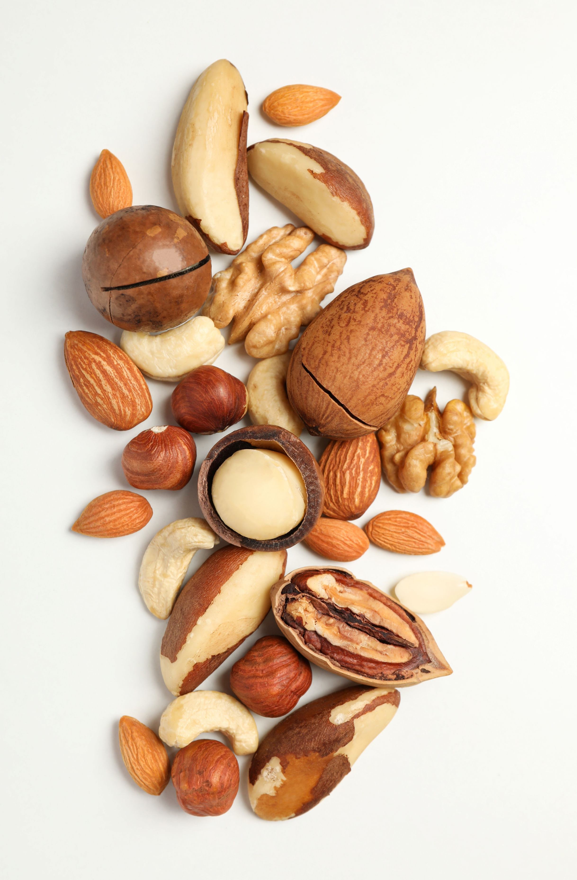
Historical Trivia
Nuts were original snack food for humans!
Humans hunted and gathered food
Nuts are easy to access, store, are nutritious and tasty
Food For Thought…
Why are legumes, nuts and seeds common in a vegetarian diet?
Notes:
Information supported by: ch9-pages-from-food-for-you-3ed-book-1-4pp-10-web.pdf (teachersuperstore.com.au)
Answer: Major source of protein

Slide 8
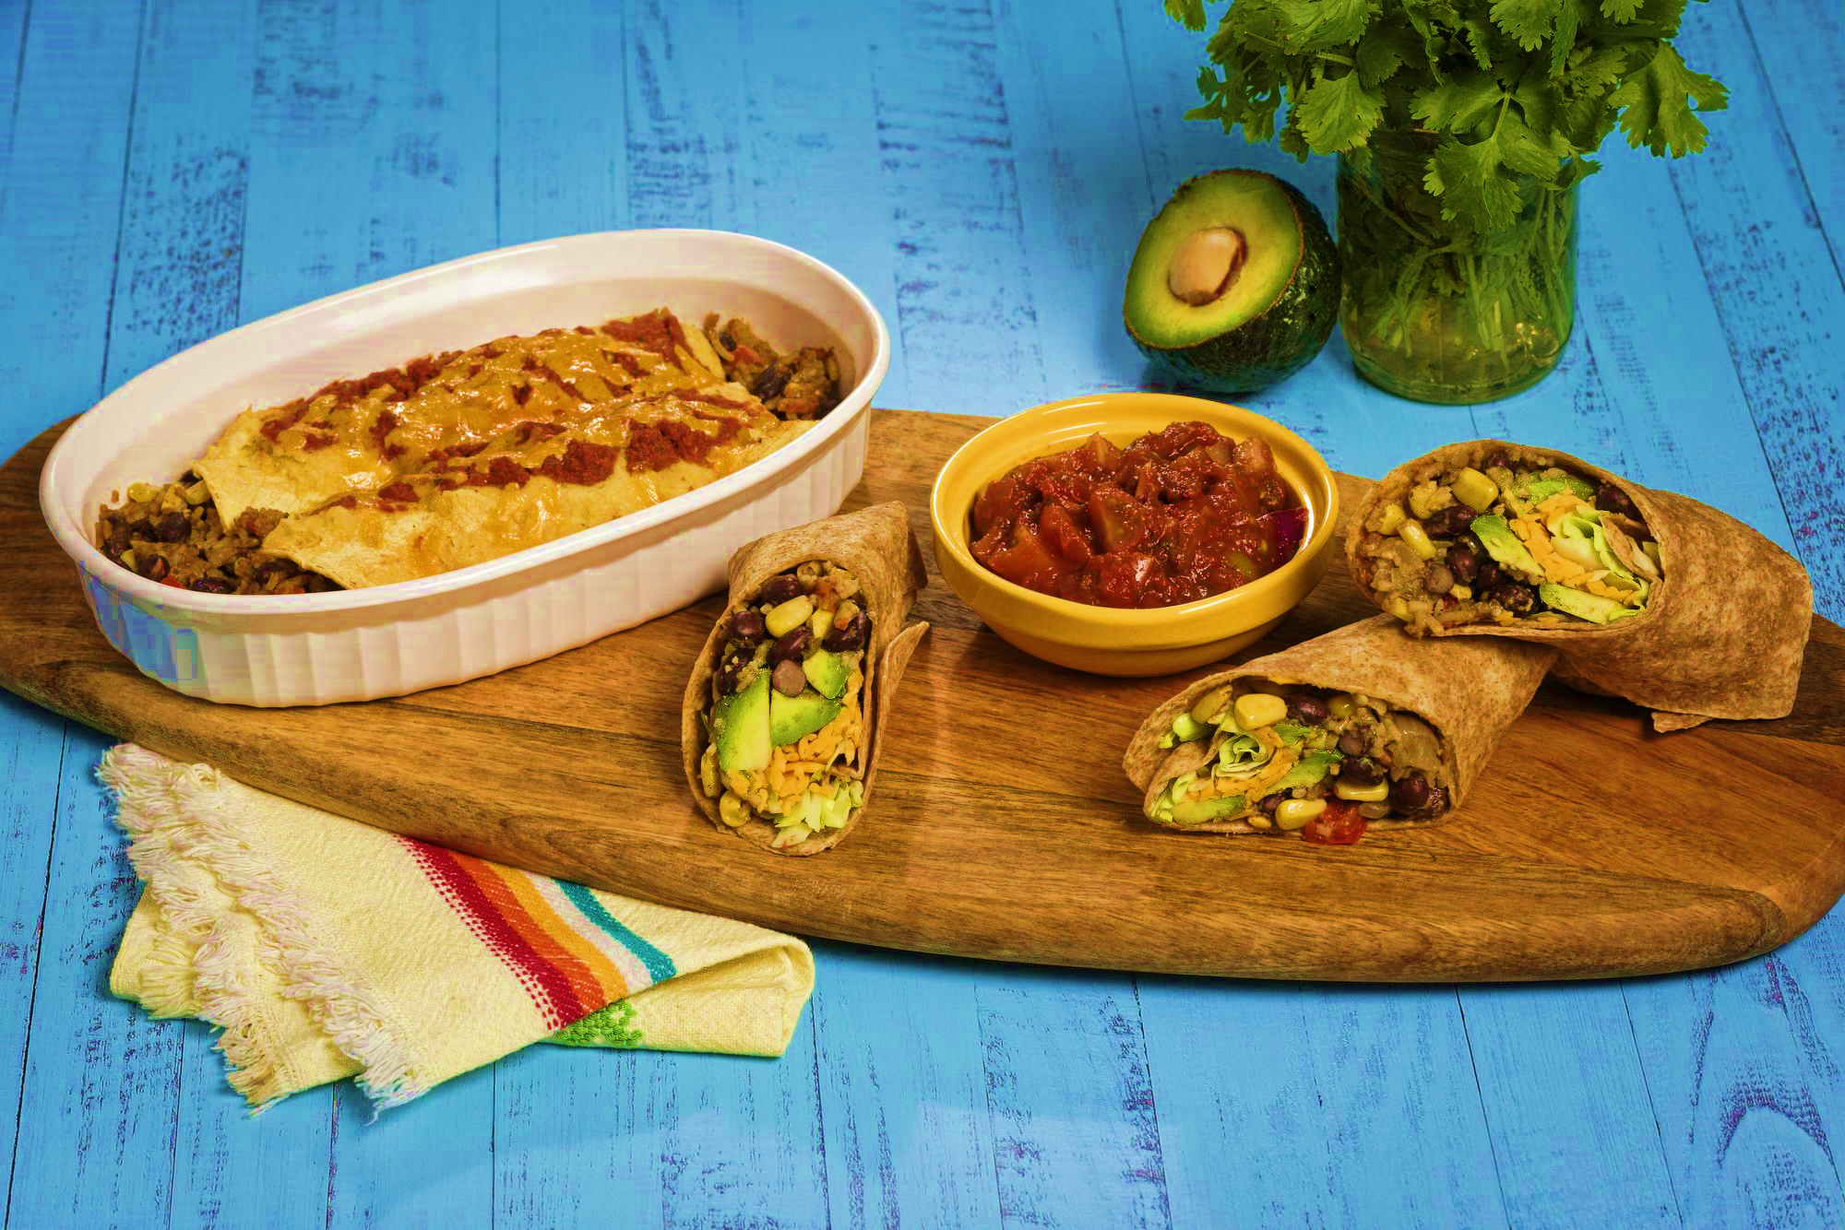
Let’s Cook Some Enchiladas!
Check out this fun Bean Enchiladas recipe from Alberta Pulse Growers!
The bean & rice filling is very versatile - use it to make the Bean Enchiladas or Bean Burritos
After making the enchiladas, complete the Recipe Reflections evaluation

Slide 9
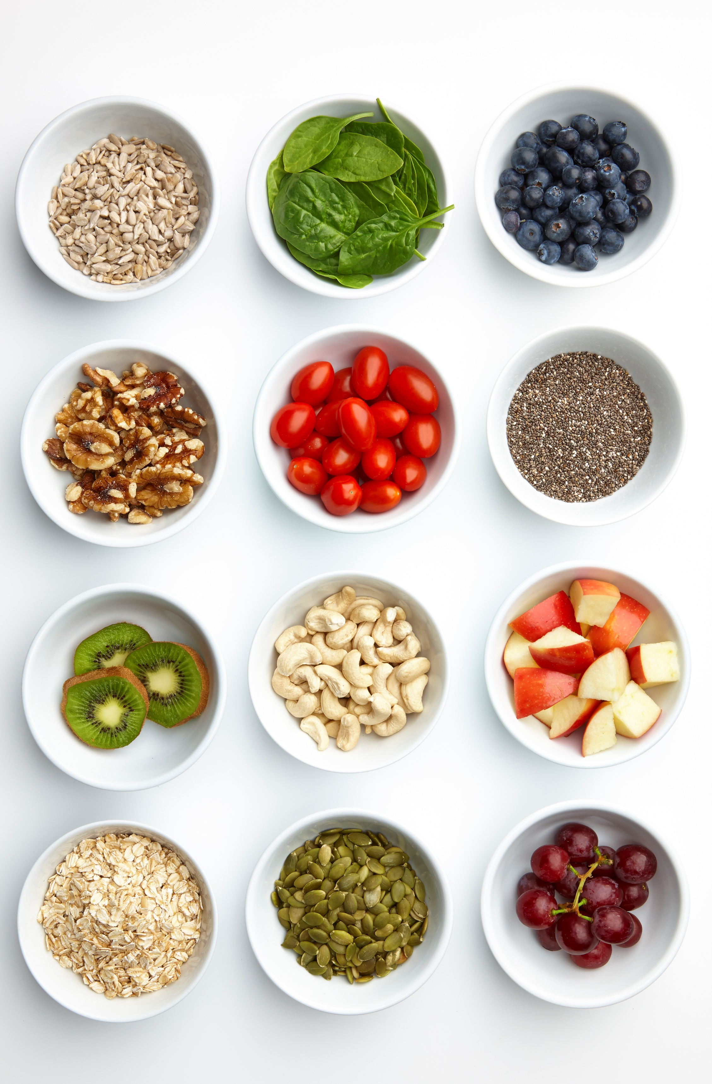
Grains, Nuts, Legumes, Pulses, Seeds Used in Various Cultures
Before modern technology, people primarily consumed whole foods that were readily available.
Whole grains, nuts and seeds were also the backbone of early culinary cuisine and what was produced and consumed, was affected by our heritage and geographical area.
Notes:
Information supported by: ch9-pages-from-food-for-you-3ed-book-1-4pp-10-web.pdf (teachersuperstore.com.au)
Information Retrieved October 17, 2024 from https://oldwayspt.org/blog/whole-grains-are-part-your-heritage/

Slide 10
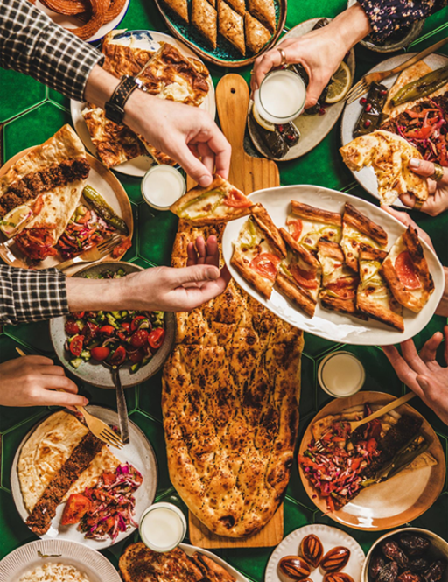
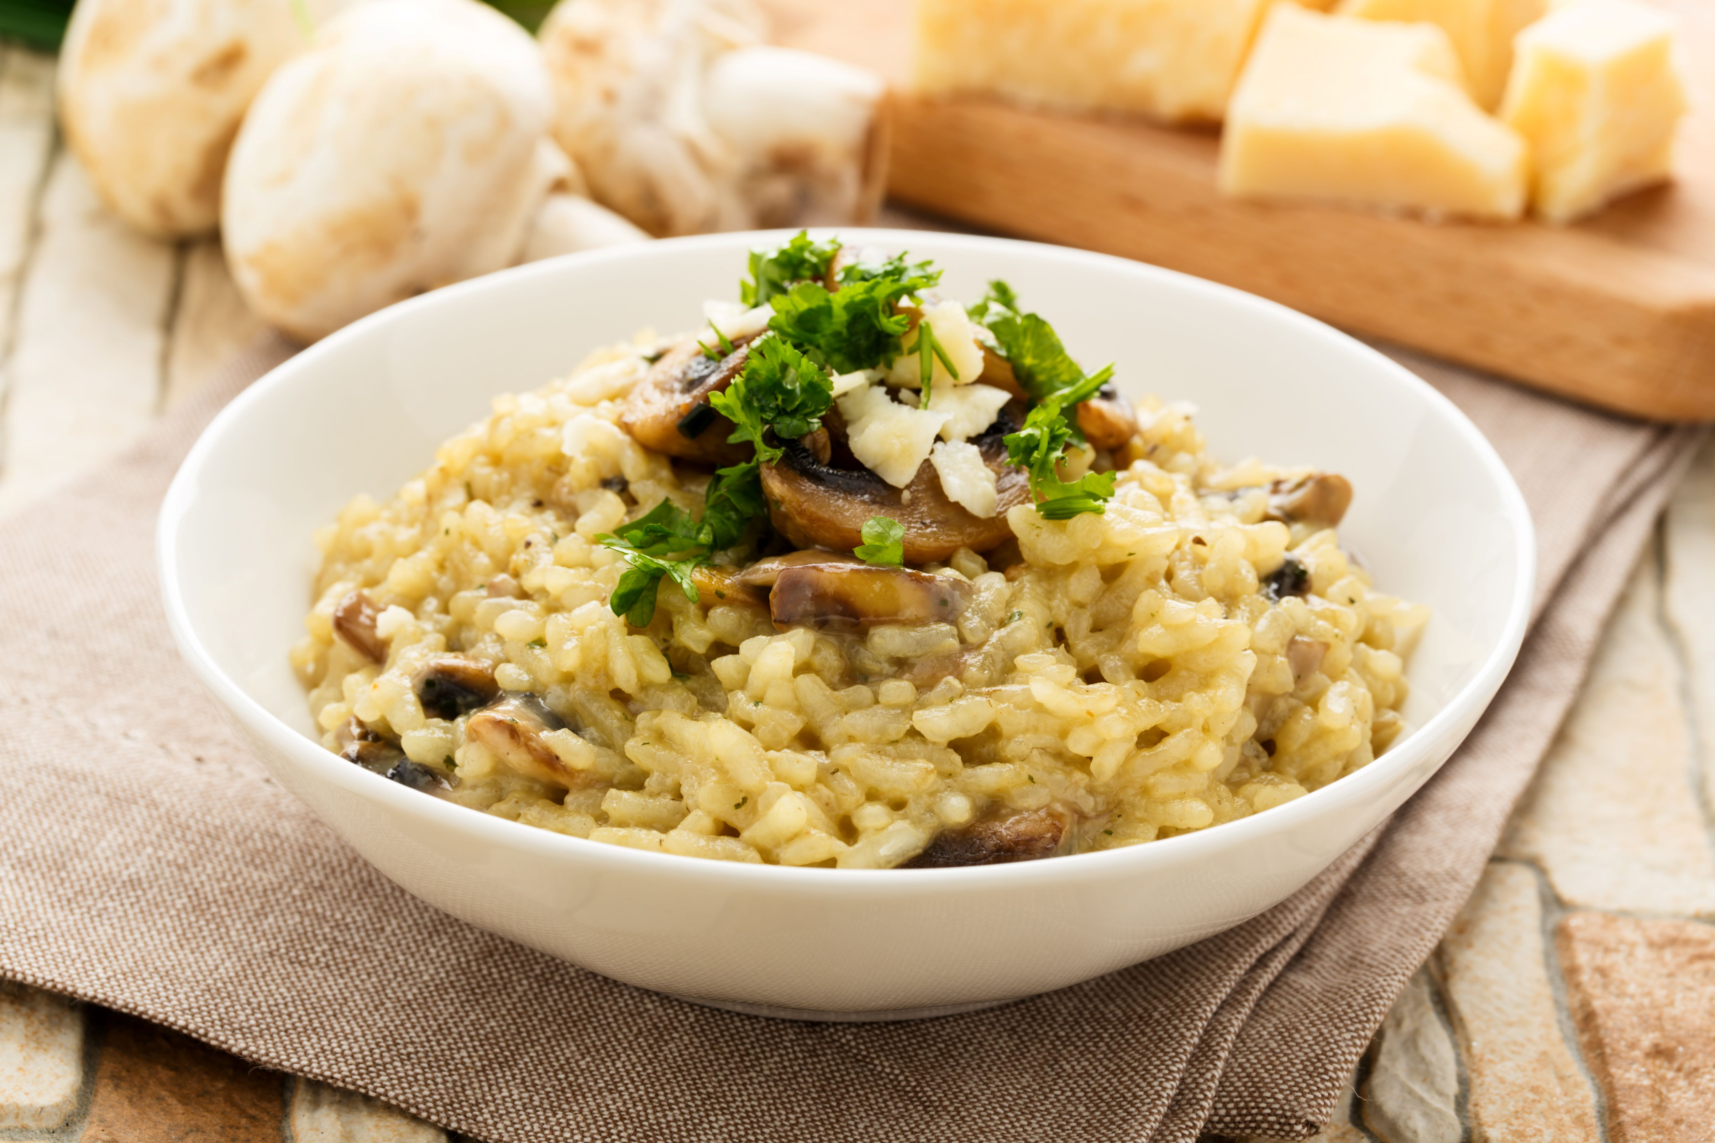
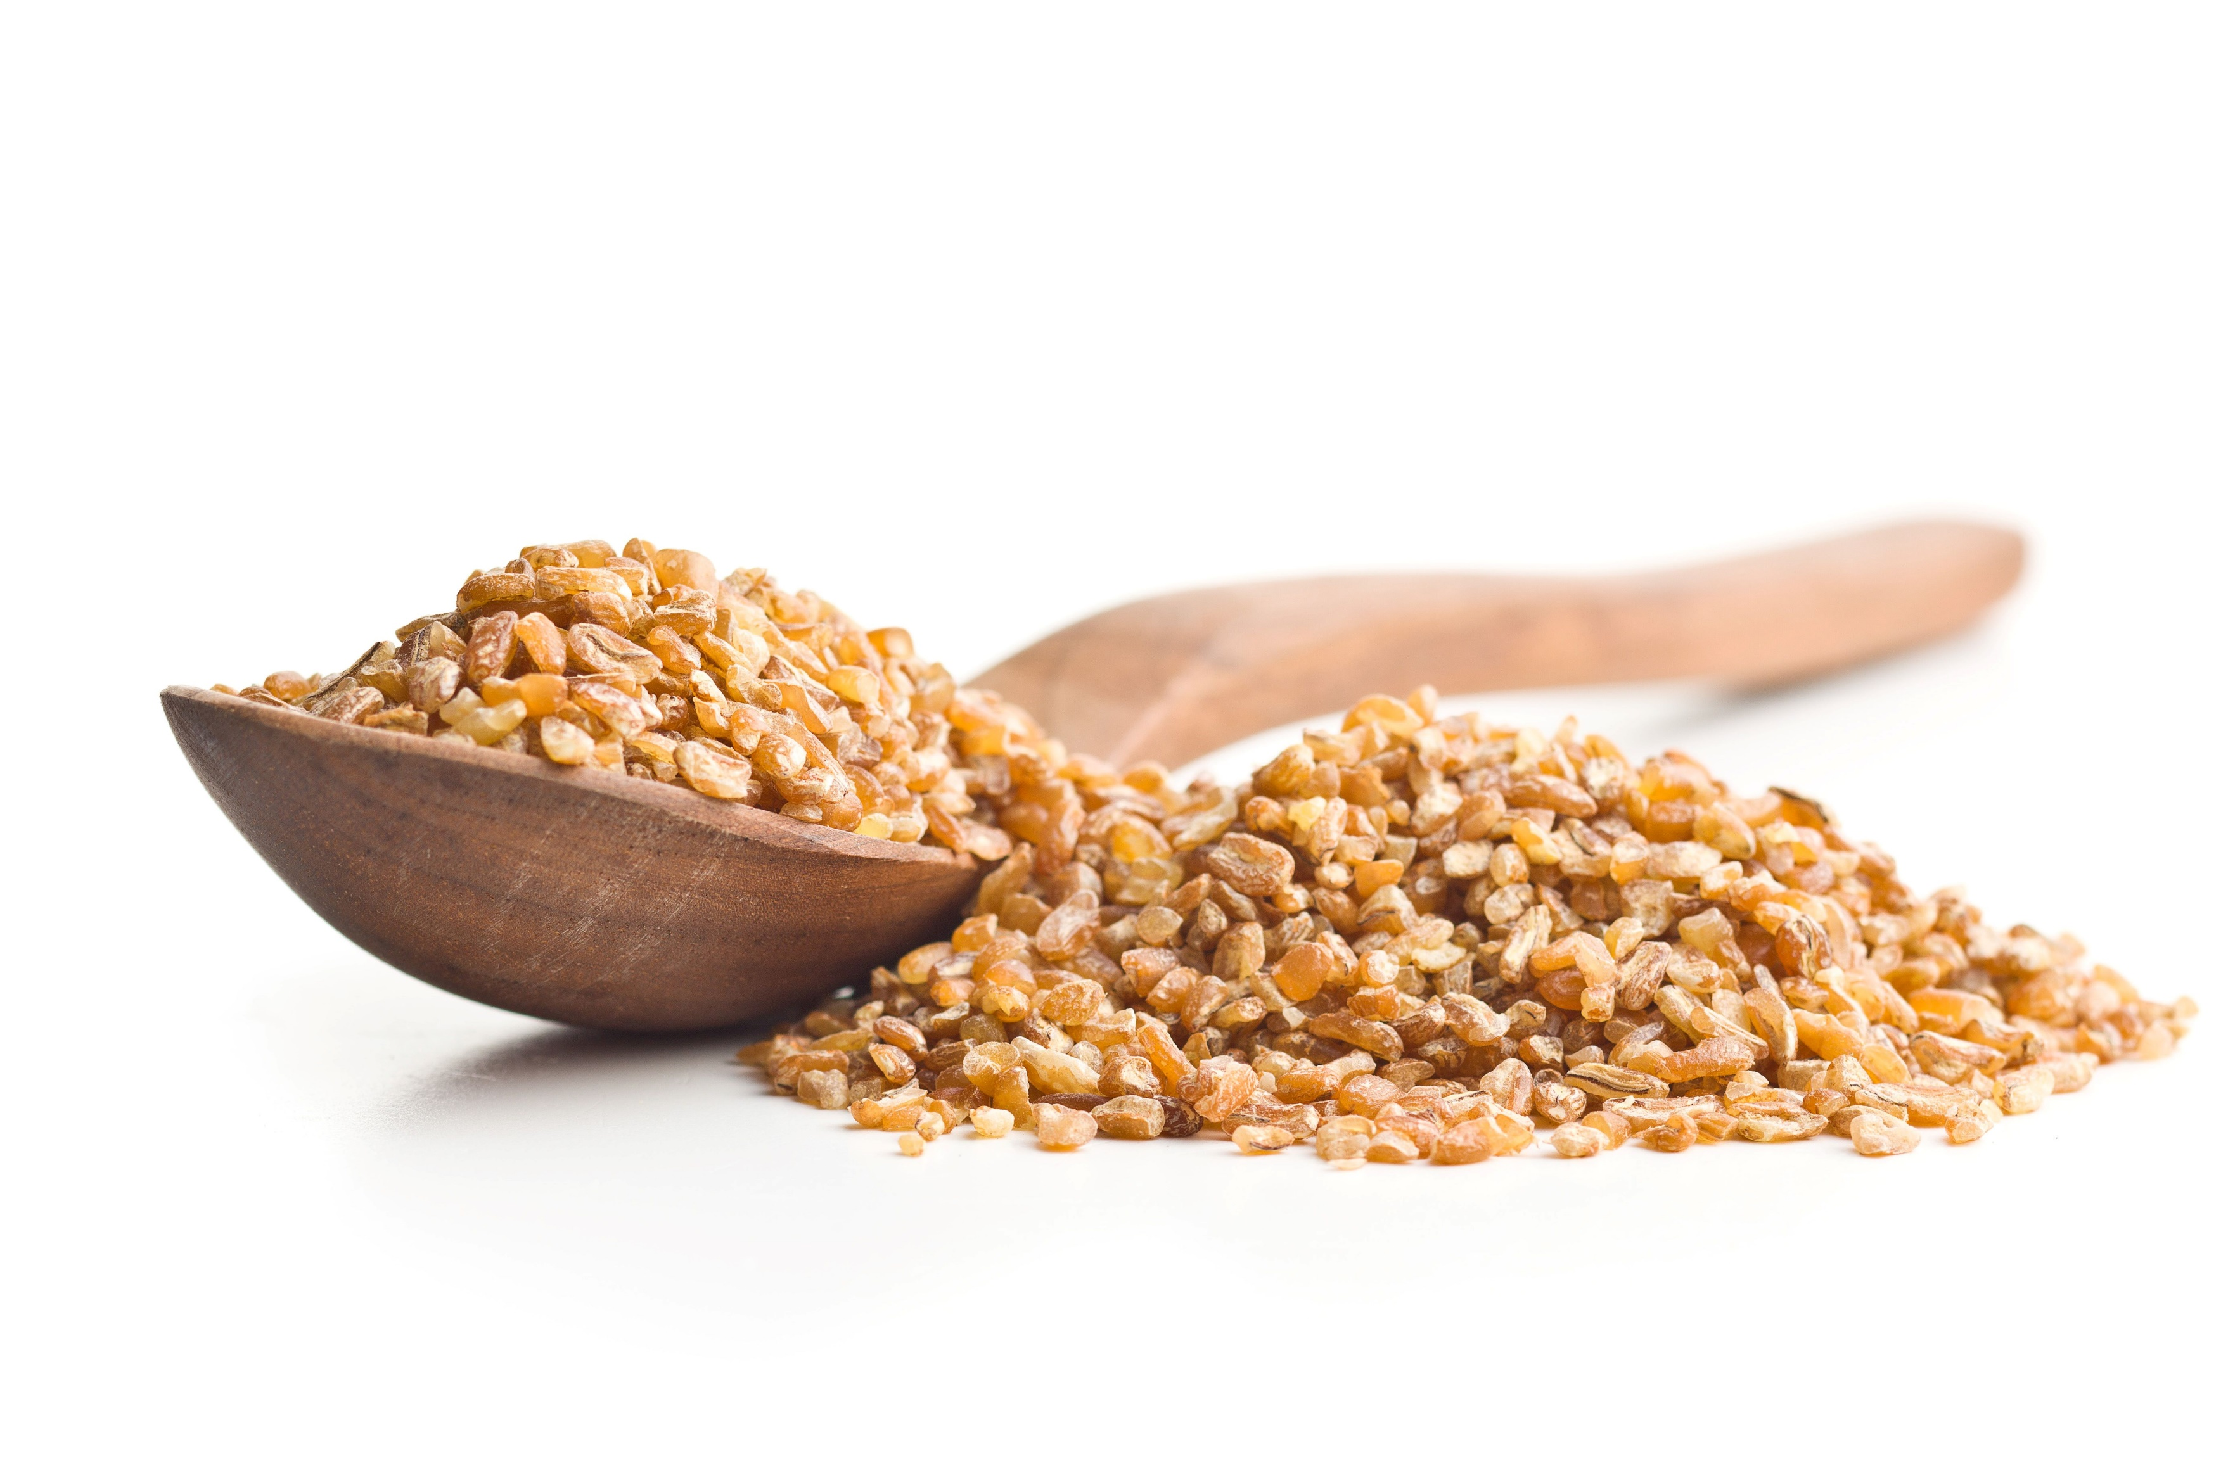
Mediterranean Sea Region
This region includes the 21 countries that share the coastline along with Mediterranean Sea.
The countries are Albania, Algeria, Bosnia and Herzegovina, Croatia, Cyprus, Egypt, France, Greece, Israel, Italy, Lebanon, Libya, Malta, Monaco, Montenegro, Morocco, Slovenia, Spain, Syria, Tunisia, and Turkey
In this region, you will see:
Grains - barley, rye, and ancient wheats like emmer, farro, and spelt, bulgar
Nuts – almonds, cashews, pine nuts, hazelnuts
Seeds – sesame seeds, pumpkin seeds
Pulses – cannellini beans, chickpeas, lentils, fava (faba) beans
What foods or recipes do you think of when you think of Mediterranean cuisine?
Notes:
Information Retrieved January 16, 2025 from United Nations Development Programme
Information Retrieved October 25, 2024 from: https://oldwayspt.org/blog/whole-grains-are-part-your-heritage/
Information Retrieved October 25, 2024 from: https://pmc.ncbi.nlm.nih.gov/articles/PMC9710409/#:~:text=Legumes%20such%20as%20alfalfa%2C%20green,many%20world%2Dfamous%20diet%20plans .
Cooking demonstration videos: https://oldwayspt.org/blog/video-types/cooking-demos/
Foods like - Spanish Paella, Lebanese Tabbouleh, Greek Tzatziki, Risotto, falafel, hummus, shish kebabs, shawarma and baklava
Have students guess the foods in the photos:
Bulgar
Risotto

Slide 11
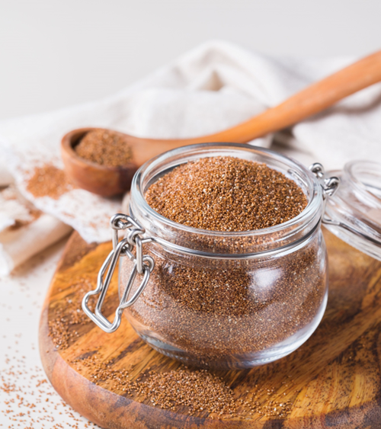
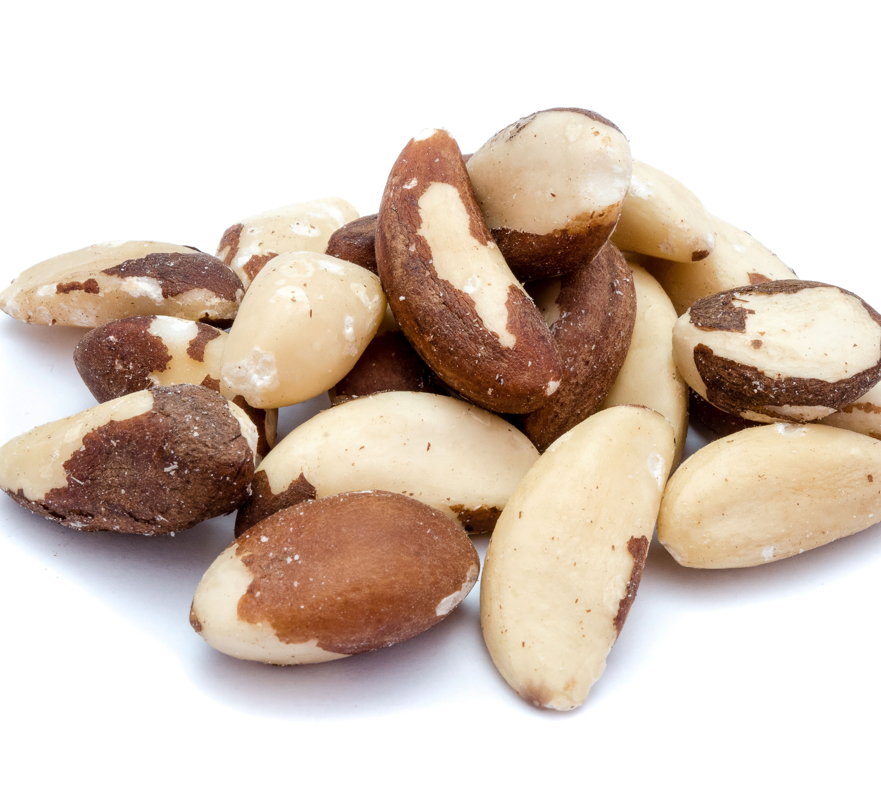
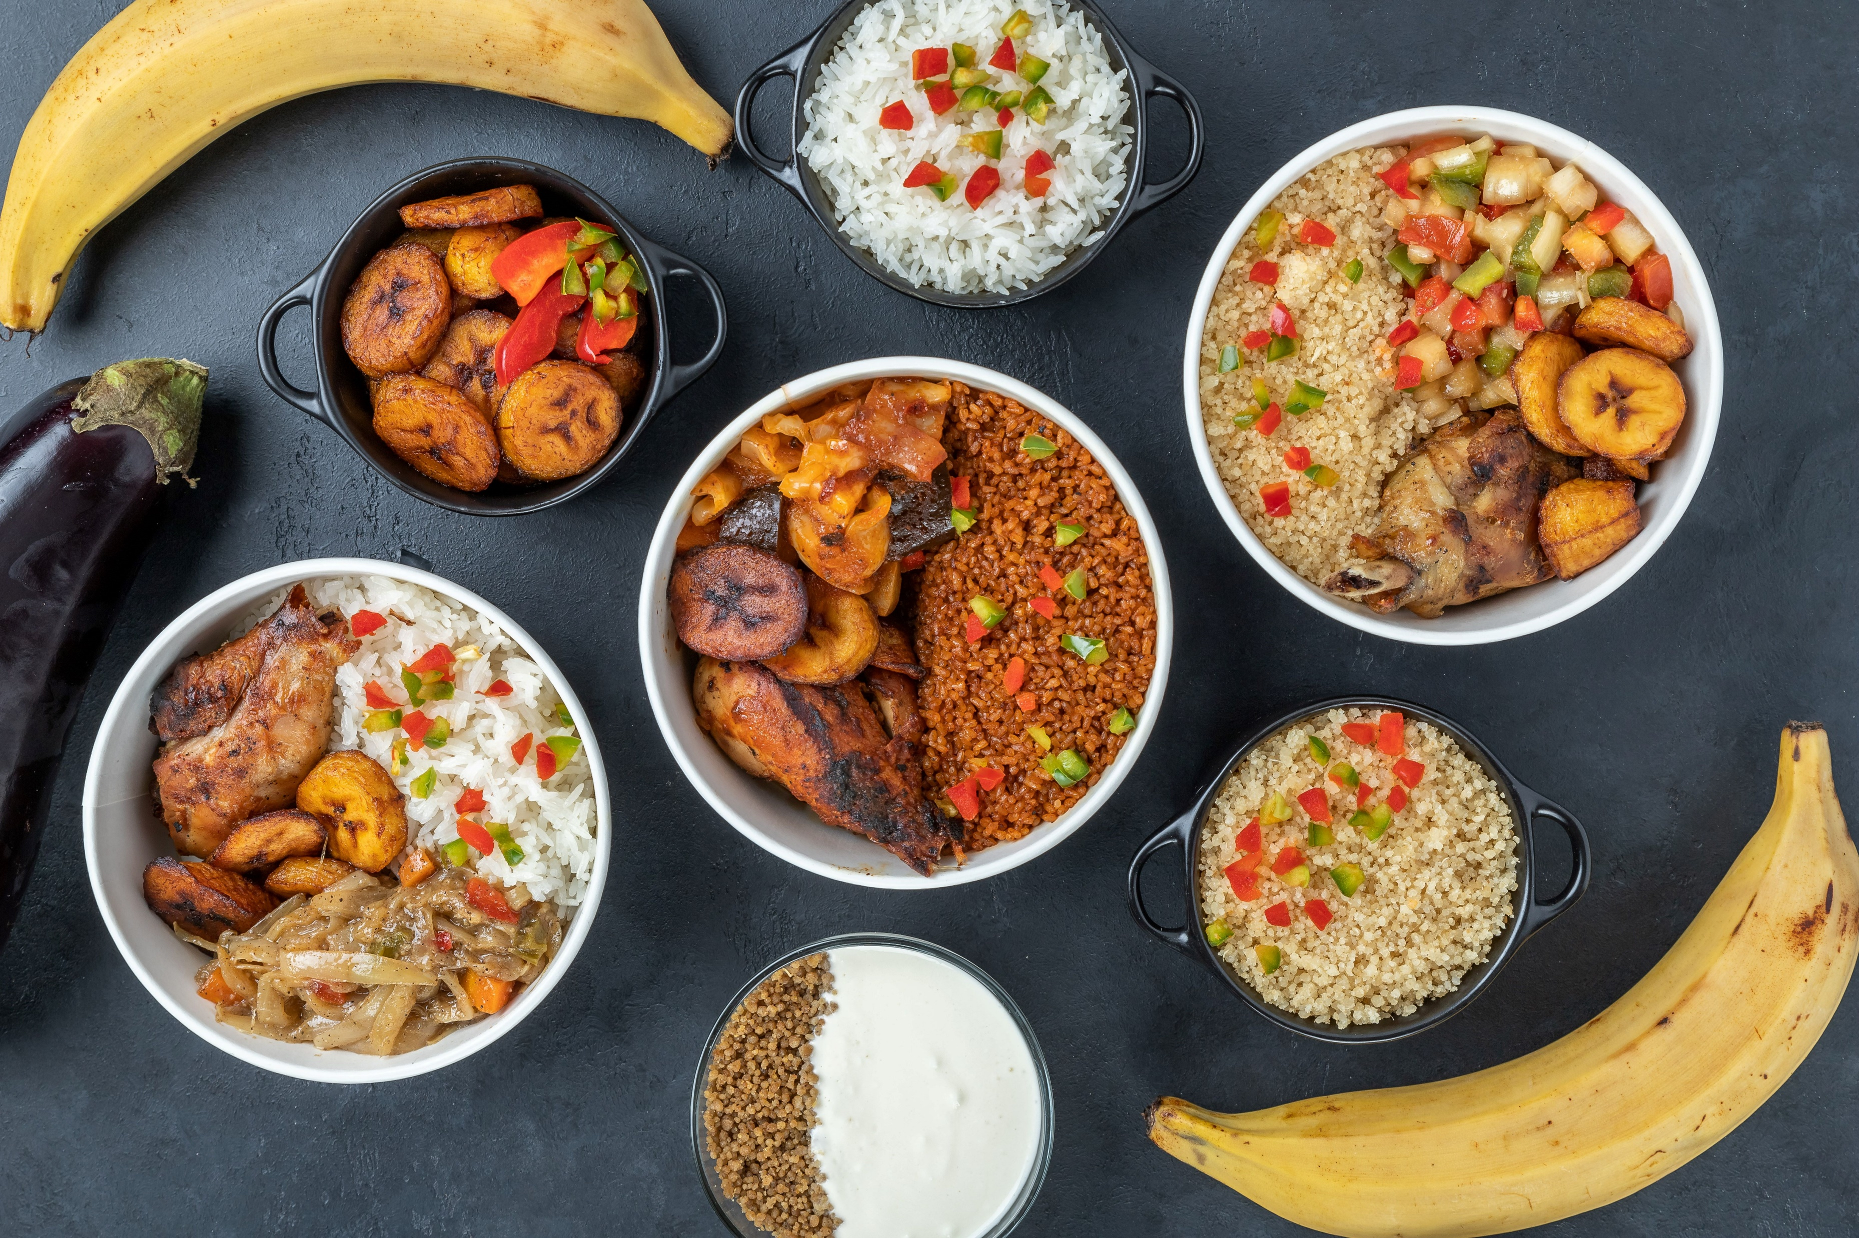
Africa
This region includes 54 countries with the 10 largest being Algeria, Democratic Republic of the Congo, Sudan, Libya, Chad, Niger, Angola, Mali, South Africa, Ethiopia.
In this region, you will see:
Grains – sorghum, millet, teff, amaranth, barley, couscous, fonio, injera, Kamut, maize/corn, millet (pearl, finger), rice, wild rice
Nuts - Brazil nuts, cashews, coconuts, dika nuts, groundnuts, pecans
Seeds – benne seeds, pumpkin seeds, sunflower seeds
Pulses & Legumes – peanuts, black-eyed peas, broad beans, butter beans, chickpeas, cowpeas, kidney beans, lentils, lima beans, pigeon peas
What foods/recipes do you think of when you think of African cuisine?
Notes:
Information Retrieved January 16, 2025 from Study.com https://study.com/learn/lesson/africa-countries-regions-map.html#:~:text=Top%2010%20by%20Land%20Area,Mali%2C%20South%20Africa%2C%20Ethiopia .
Information Retrieved October 25, 2024 from: https://oldwayspt.org/blog/whole-grains-are-part-your-heritage/
Information Retrieved October 25, 2024 from: https://oldwayspt.org/wp-content/uploads/2023/10/AHH-CommonFoods_0.pdf
FYI: : sorghum, millet, and teff are all crops that grow well in dry climates and in drought conditions.
Have Students guess the foods in the individual pictures:
Brazil Nuts
Ancient Grain Teff

Slide 12
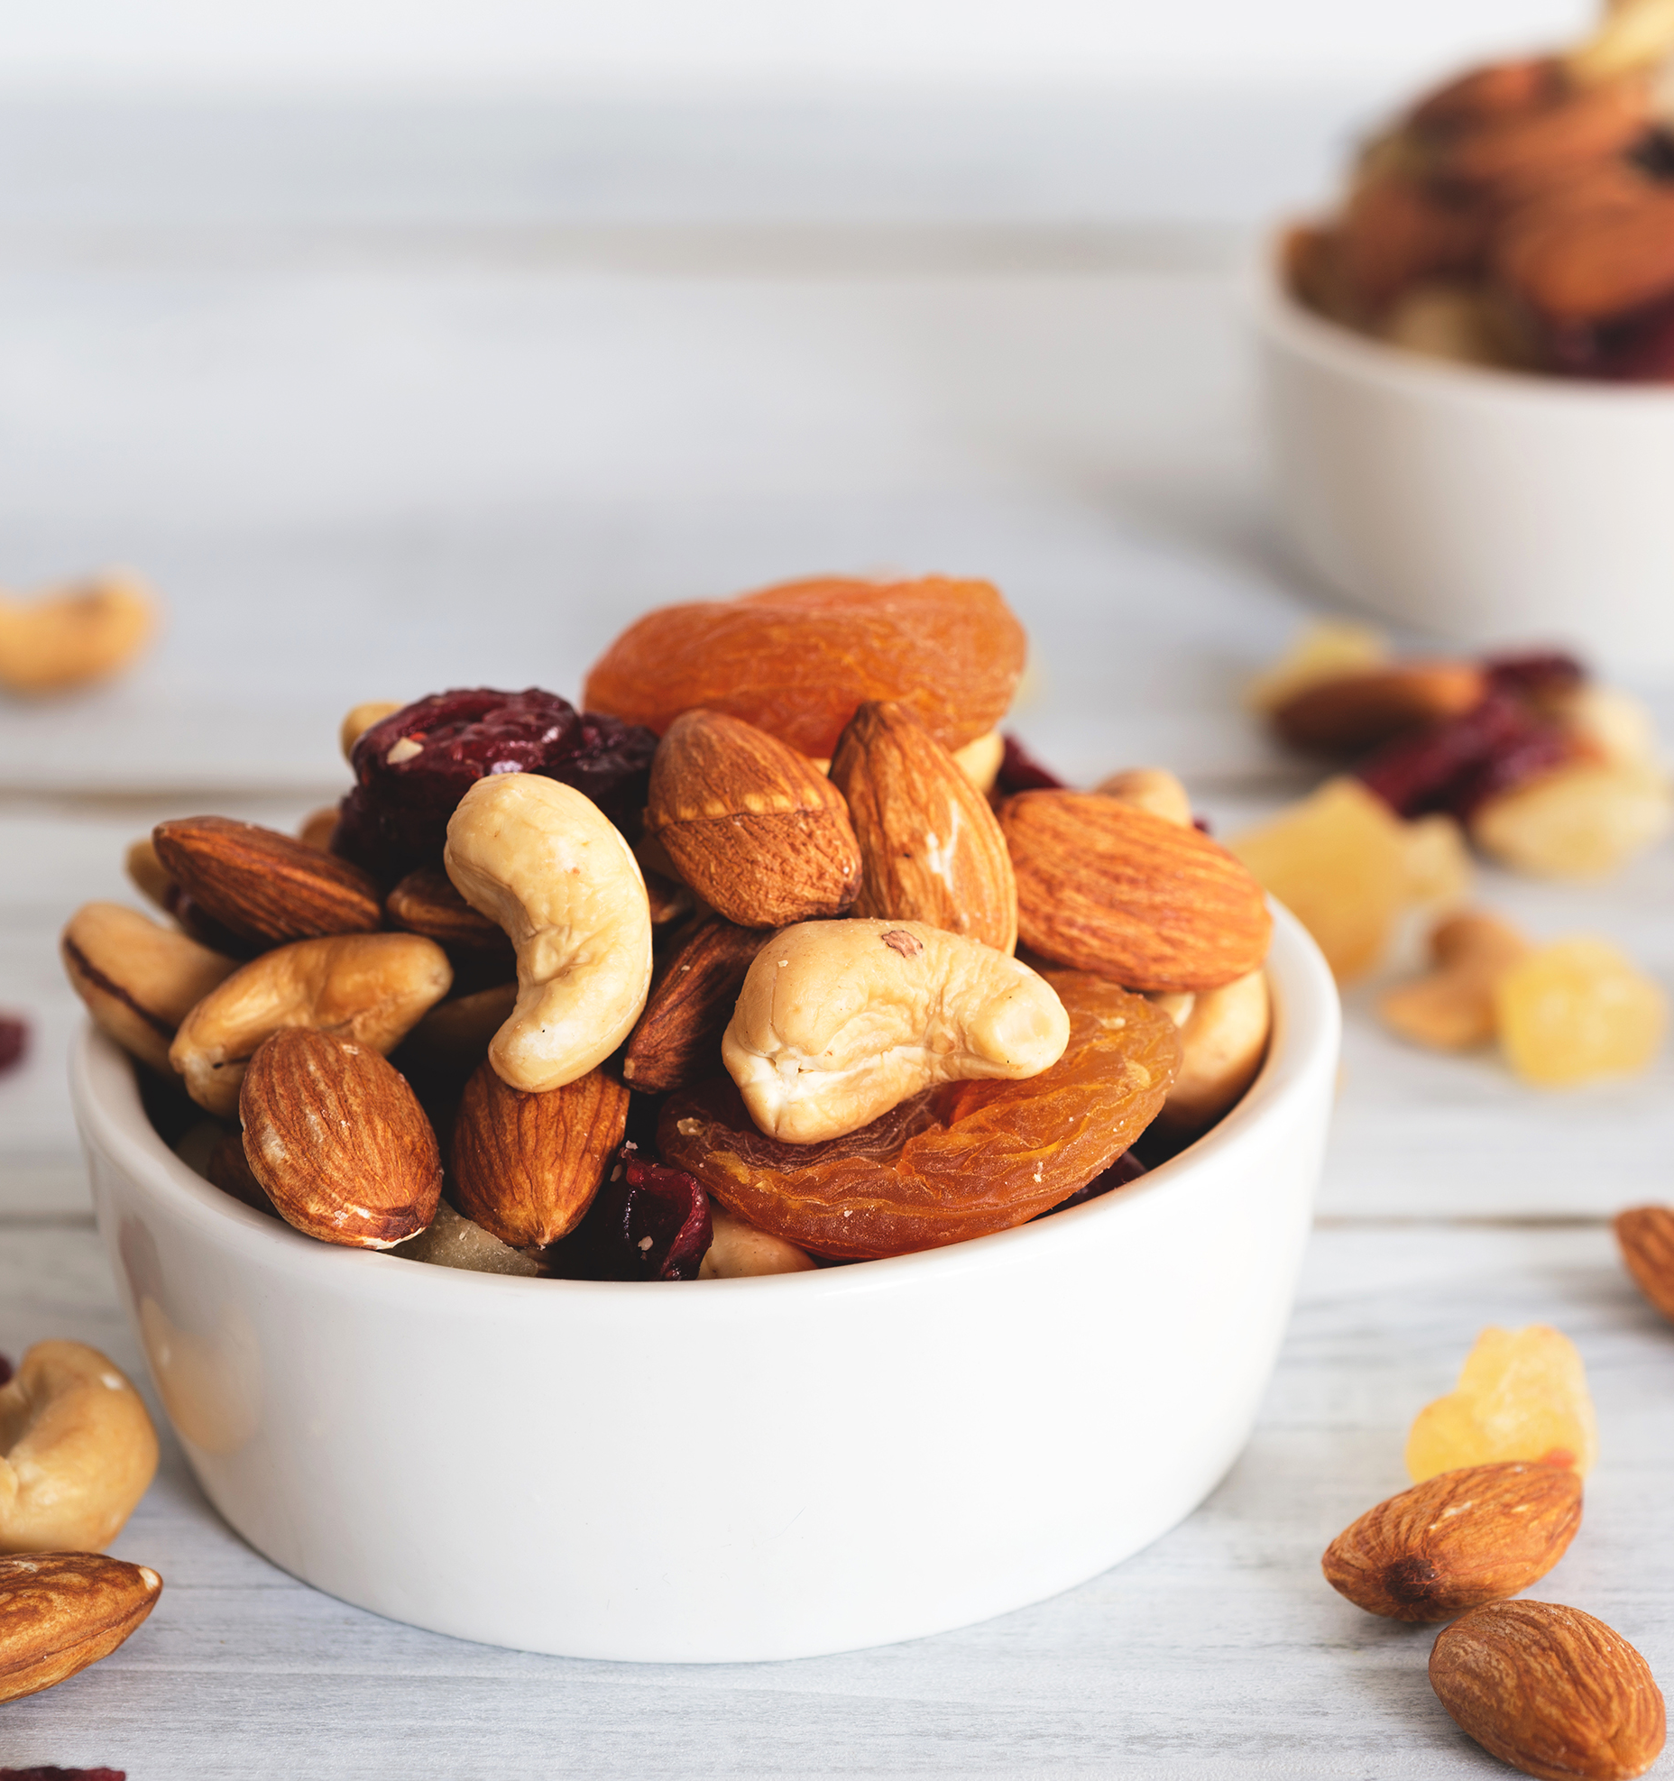
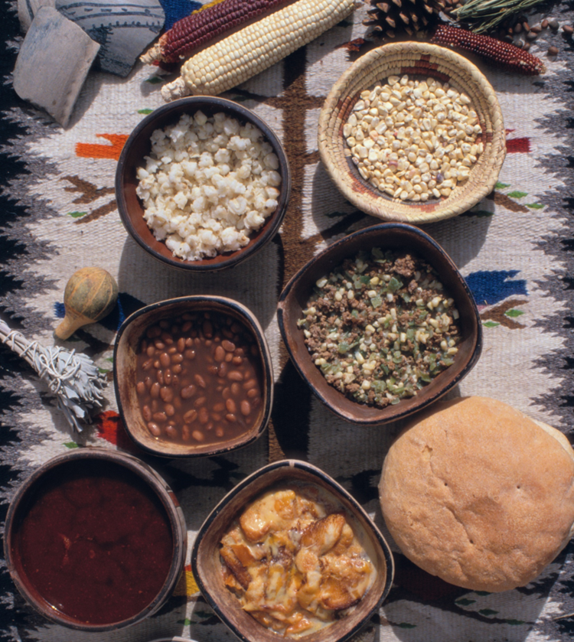
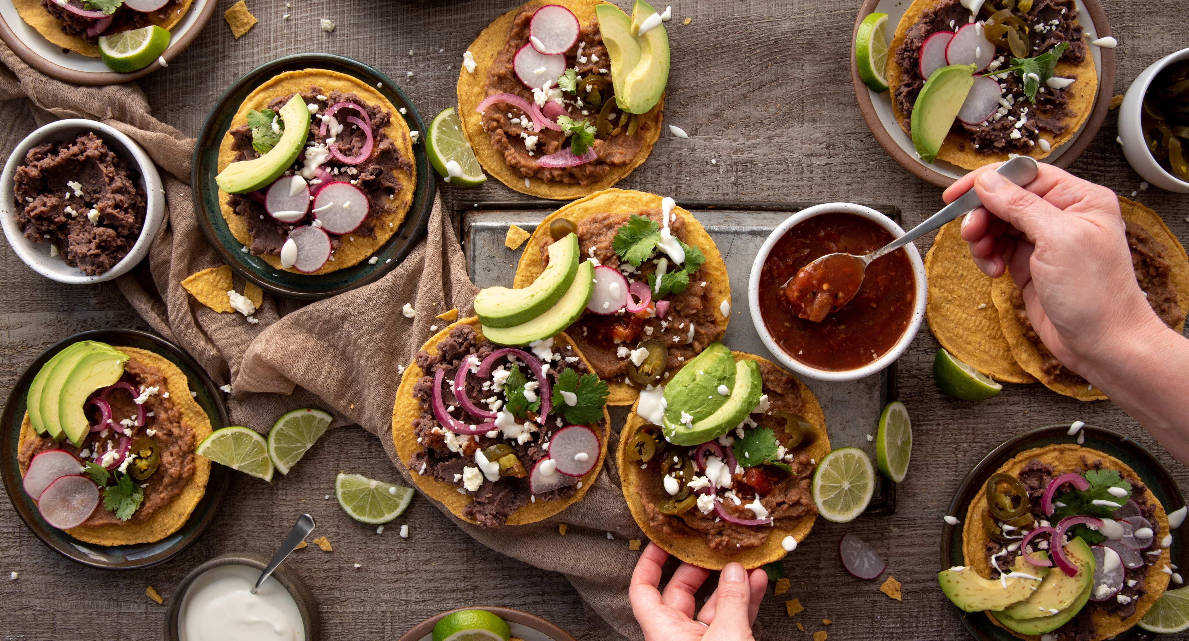
Latin America
This region includes 33 countries in North, Central and South America and the Caribbean.
In this region, you will see:
Grains – corn, amaranth, rice, quinoa
Nuts – almonds, Brazil nuts, cashews, pine (piñon) nuts, pecans
Seeds – pumpkin seeds (pepitas)
Pulses – black, pinto, kidney beans, chickpeas
What foods/recipes do you think of when you think of Latin American cuisine?
Notes:
Information Retrieved October 25, 2024 from: https://oldwayspt.org/blog/whole-grains-are-part-your-heritage/
Information Retrieved October 25, 2025 from: https://oldwayspt.org/wp-content/uploads/2023/10/LAH-CommonFoods.pdf
Looking for more recipes? Check out: The Spruce Eats at https://www.thespruceeats.com/middle-east-main-dishes-4162480
Have students identify the nuts, seeds, grains, legumes/pulses from the photos
Cashews
Almonds
Black beans
Corn tortillas
rice

Slide 13
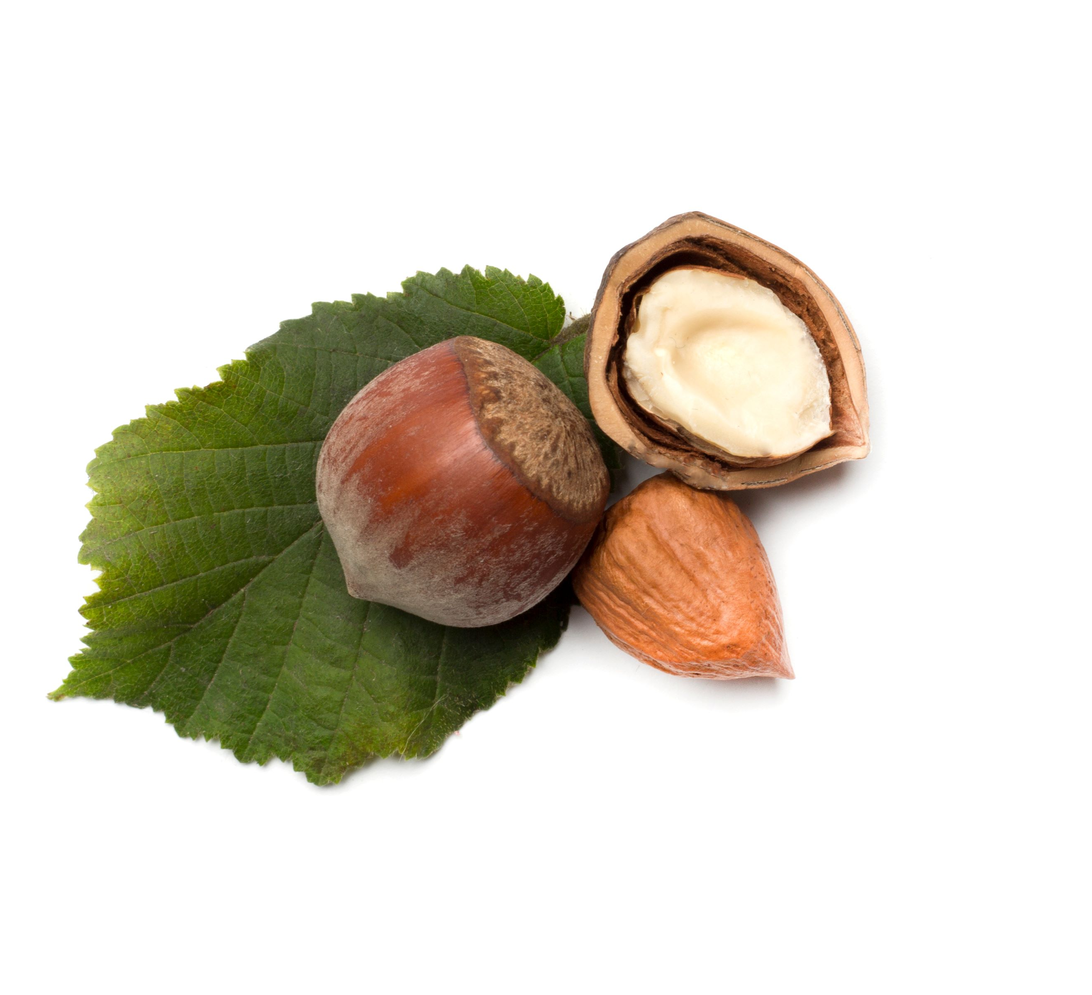
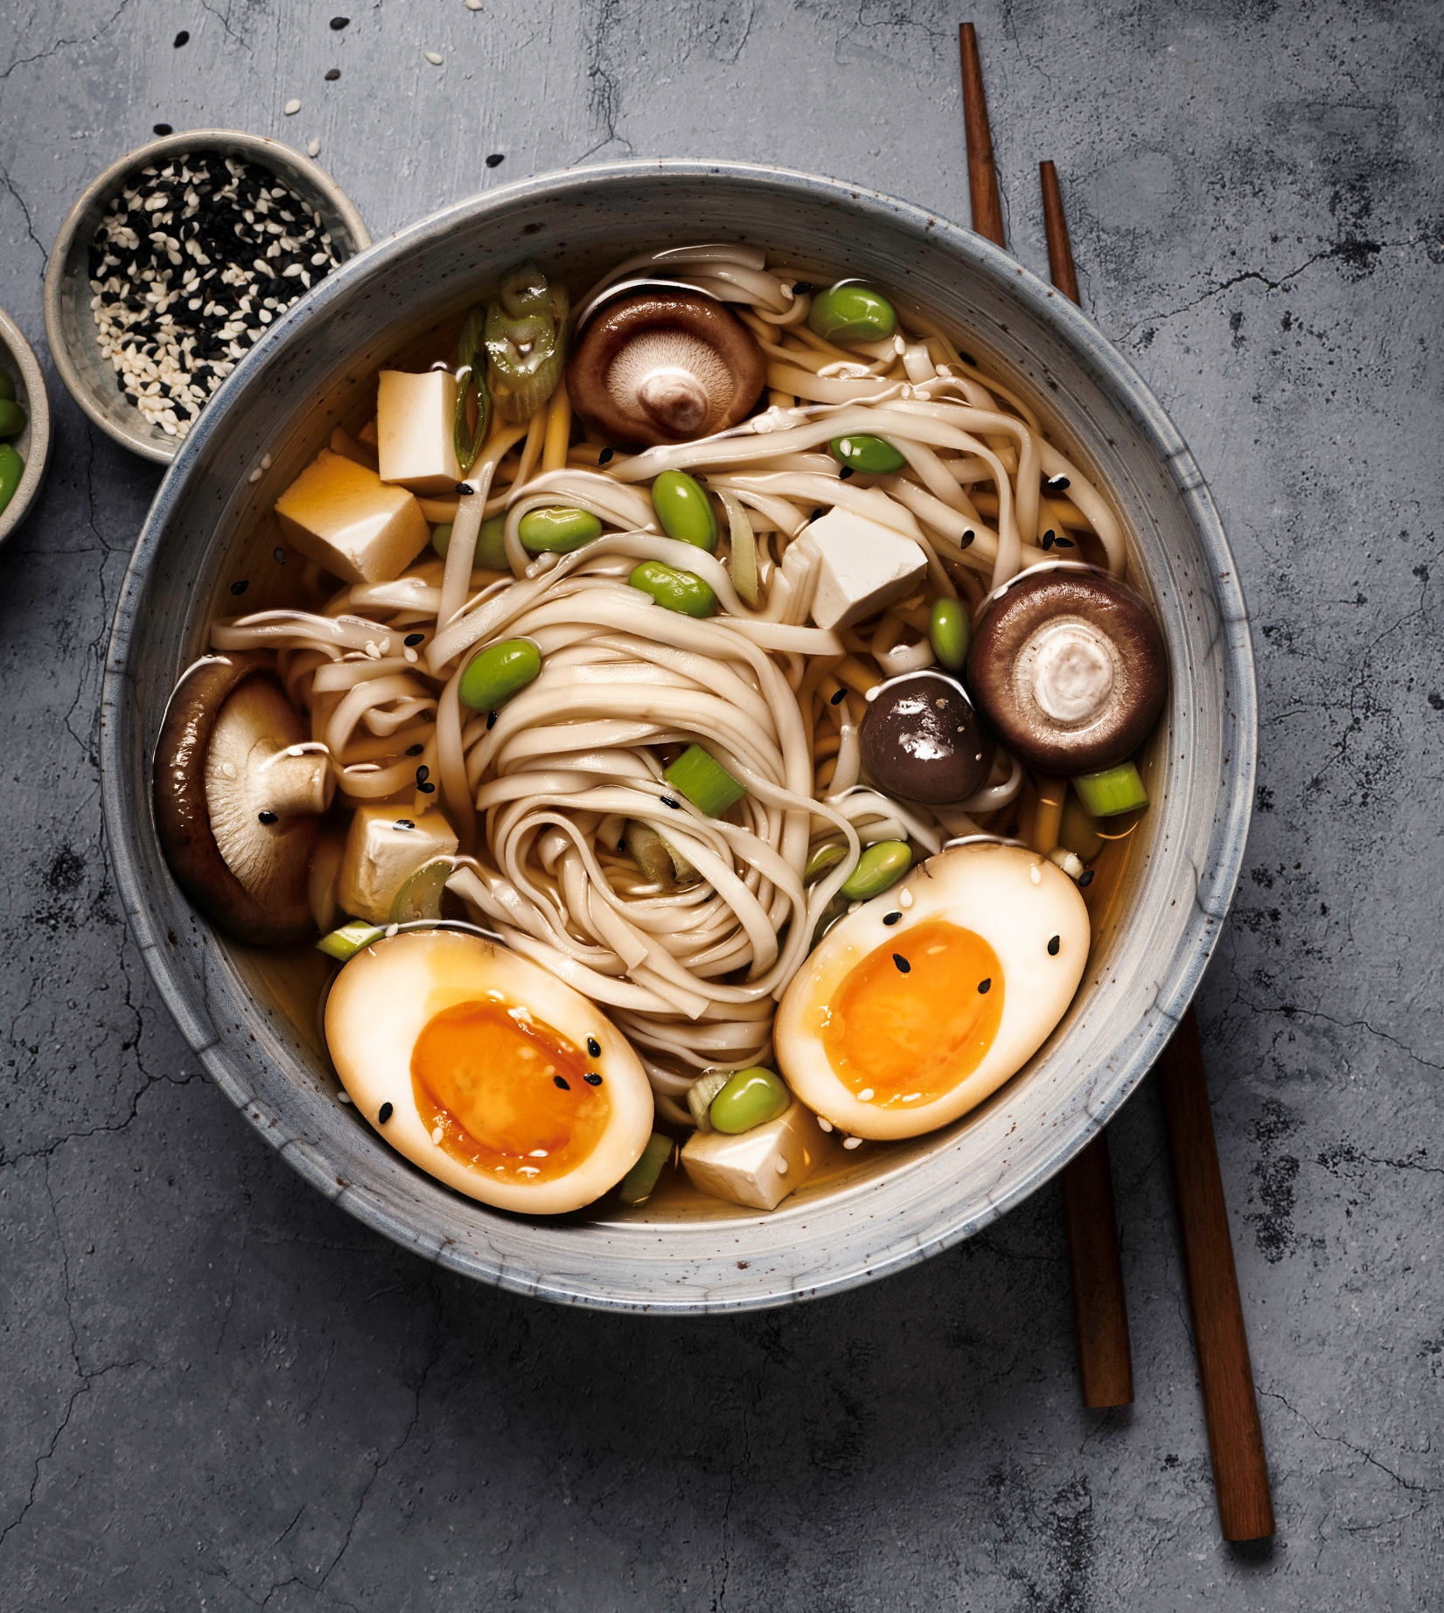
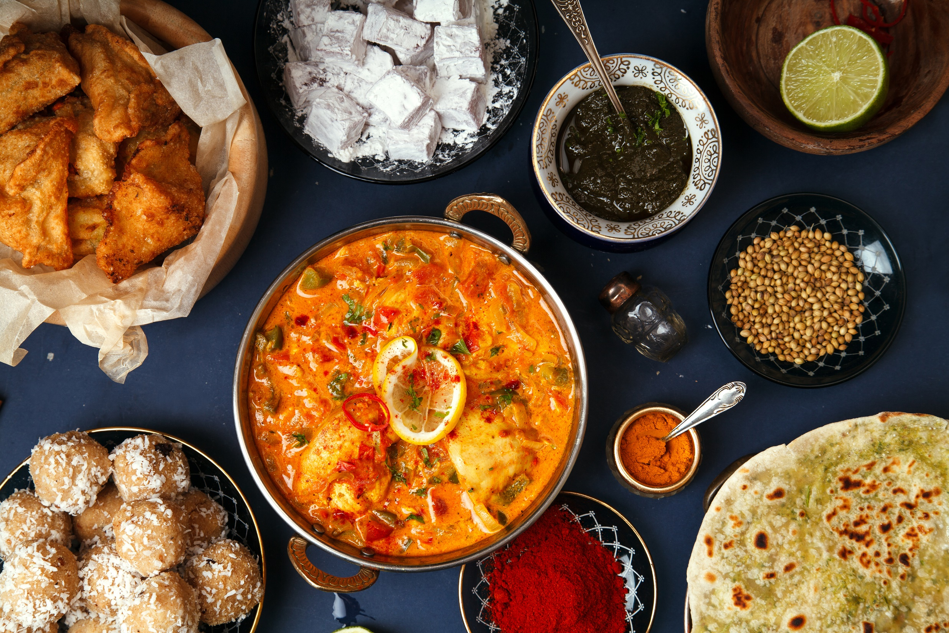
Asia
This region includes 48 countries ranging from Japan, China, South Korea, North Korea in the east; Turkey, Saudi Arabia, Israel, Syria, State of Palestine in the west; India, Pakistan, Sri Lanka, Bangladesh, Afghanistan in the south; and Indonesia, Philippines, Thailand, Singapore, Vietnam in southeast Asia
In this region, you will see:
Grains – millet, buckwheat noodles (soba), barley porridges, brown, black and red rice
Nuts – almonds, cashews, hazelnuts,
Seeds – sesame seeds,
Pulses & Legumes – peanuts, soy (beans, miso, tempeh, tofu, edamame), adzuki beans, mung beans, lentils
What foods/recipes do you think of when you think of Asian cuisine?
Notes:
Information Retrieved October 25, 2024 from:
https://oldwayspt.org/blog/whole-grains-are-part-your-heritage/
https://oldwayspt.org/wp-content/uploads/2023/10/ASIAN-CommonFoods.pdf
https://www.teachersuperstore.com.au/assets/files/uploads/ch9-pages-from-food-for-you-3ed-book-1-4pp-10-web.pdf
Information Retrieved January 16, 2025 from
https://www.worldometers.info/geography/how-many-countries-in-asia/
https://iheartumami.com/types-of-chinese-noodles-and-wrappers/
Recipe ideas at The Spruce Eats: https://www.thespruceeats.com/asian-4162644
Types of foods:
breads (dumplings, chapatis, mantou, naan, roti), noodles (somen, udon)
Have students guess the ingredients in the photos:
Hazel nuts
Edamame (soy/legume)
Buckwheat soba noodles
Roti (wheat)
Samosas (wheat)

Slide 14

North America
In this region, you will see:
Grains – wheat, barley, oats, corn
Nuts – walnuts, pecans, pine nuts
Seeds – hemp seeds, flax seeds, pumpkin seeds
Pulses & Legumes – dry beans, dry peas, lentils, chickpeas, soybeans
What foods/recipes do you think of when you think of North American cuisine?
Notes:
Information Retrieved October 25, 2024 from: https://oldwayspt.org/blog/whole-grains-are-part-your-heritage/
Information Retrieved January 15, 2025 from: USDA Forest Service https://www.fs.usda.gov/wildflowers/ethnobotany/food/nuts.shtml#:~:text=In%20botany%20terms%2C%20nuts%20are,definition%20of%20a%20true%20nut .
Do a class word cloud as things pop up and have a discussion about what grains they use at home and to make what with (see Create live word clouds for free - Slido | Slido - Audience Interaction Made Easy )

Slide 15
Which nuts seeds, grains, legumes, pulses do you use at home?
Create a word cloud with the answers!
Create live word clouds for free - Slido | Slido - Audience Interaction Made Easy )
Notes:
ACTIVITY IDEAS
With the whole class participating, create a word cloud with the answers from the question: “Which nuts, seeds, grains, legumes, pulses do you use at home?”
If there is more time:
Divide class into 5 groups and assign a region to each group – have each group produce a list of dishes or recipes that reflect/include the grains/seeds/nuts/legumes from that region.

