Slide 1
Today’s Agenda
Day 4
Tips for buying, storing and preparing grains, legumes, pulses, nuts & seeds
How grains, legumes, pulses, nuts and seeds are produced safely
Optional Let’s Cook: Prairie Black Bean, Lentil & Grain Salad
Cost breakdown activity

Slide 2
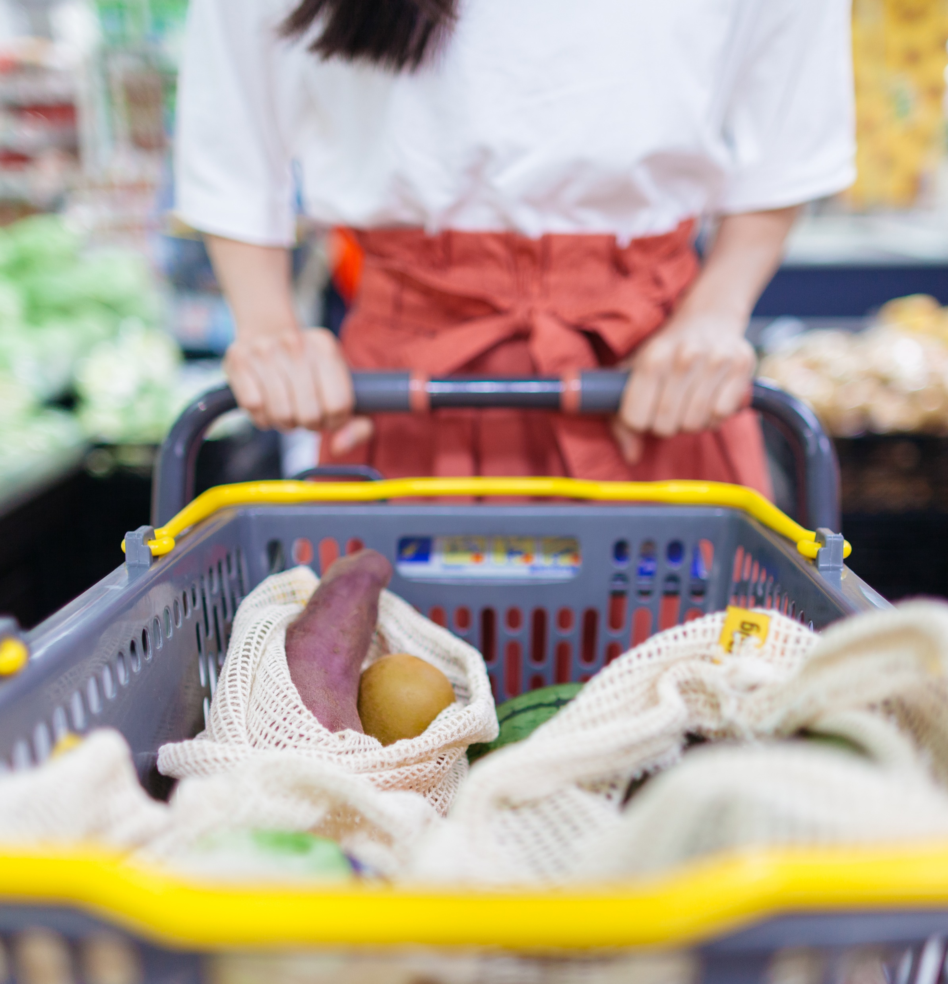
General Tips: Buying Grains, Legumes, Pulses, Nuts & Seeds
In the store, look for:
Packaging should not be damaged.
When buying canned goods, look for cans that are not dented.
Look for appropriate best before date where applicable.
Check item for dirt or discoloration.
Uniform size to prevent uneven cooking time.
Try to buy unsalted or reduced sodium items.
Skin of item should not be wrinkled, and shells should not be cracked or broken.
Notes:
Information Retrieved October 25, 2024 from https://www.teachersuperstore.com.au/assets/files/uploads/ch9-pages-from-food-for-you-3ed-book-1-4pp-10-web.pdf
Information Retrieved October 25, 2024 from Learn Alberta, https://www.learnalberta.ca/ProgramOfStudy.aspx?lang=en&ProgramId=561727#724051
Information Retrieved October 25, 2024 from https://nutritionsource.hsph.harvard.edu/what-should-you-eat/whole-grains/#:~:text=The%20germ%20is%20the%20core,vitamins%2C%20phytochemicals%2C%20and%20antioxidants.

Slide 3
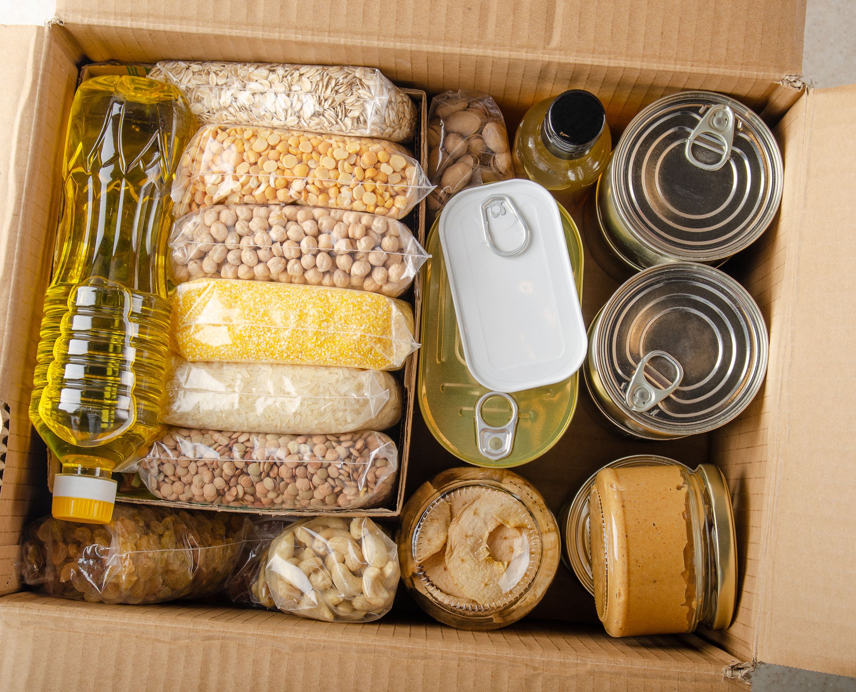
General Tips: Storing Dry Grains, Legumes, Pulses, Nuts and Seeds
Dry Items
Have a long shelf life if stored properly.
Store in a cool dry space with limited exposure to air and light.
Nuts contain fat and can go rancid if not stored in a cool space.
Dry pulses and legumes do not need refrigeration until cooked.
Dry pulses will lose their colour and continue to dry if stored in the light and open to the air, but nutrition content is not affected.
Dry whole grains can be stored at room temperature for months. Store in an airtight container in a dark place. If whole grain, store container in the fridge to prevent rancidity.
Always follow best before dates listed on the item!
Reflect and Check…
Would whole grain or white flour have a shorter shelf life? Why?
Notes:
Information Retrieved October 25, 2024 from https://www.teachersuperstore.com.au/assets/files/uploads/ch9-pages-from-food-for-you-3ed-book-1-4pp-10-web.pdf
Information Retrieved October 25, 2024 from Learn Alberta, https://www.learnalberta.ca/ProgramOfStudy.aspx?lang=en&ProgramId=561727#724051
Information Retrieved October 25, 2024 from https://nutritionsource.hsph.harvard.edu/what-should-you-eat/whole-grains/#:~:text=The%20germ%20is%20the%20core,vitamins%2C%20phytochemicals%2C%20and%20antioxidants.
Information supported by: ch9-pages-from-food-for-you-3ed-book-1-4pp-10-web.pdf (teachersuperstore.com.au)
Information Retrieved October 17, 2024 from https://oldwayspt.org/blog/whole-grains-are-part-your-heritage/
Answer: Whole grain flour because it contains the germ, which is a Rich source of vitamin E, B vitamins, healthy fats, and some minerals.

Slide 4
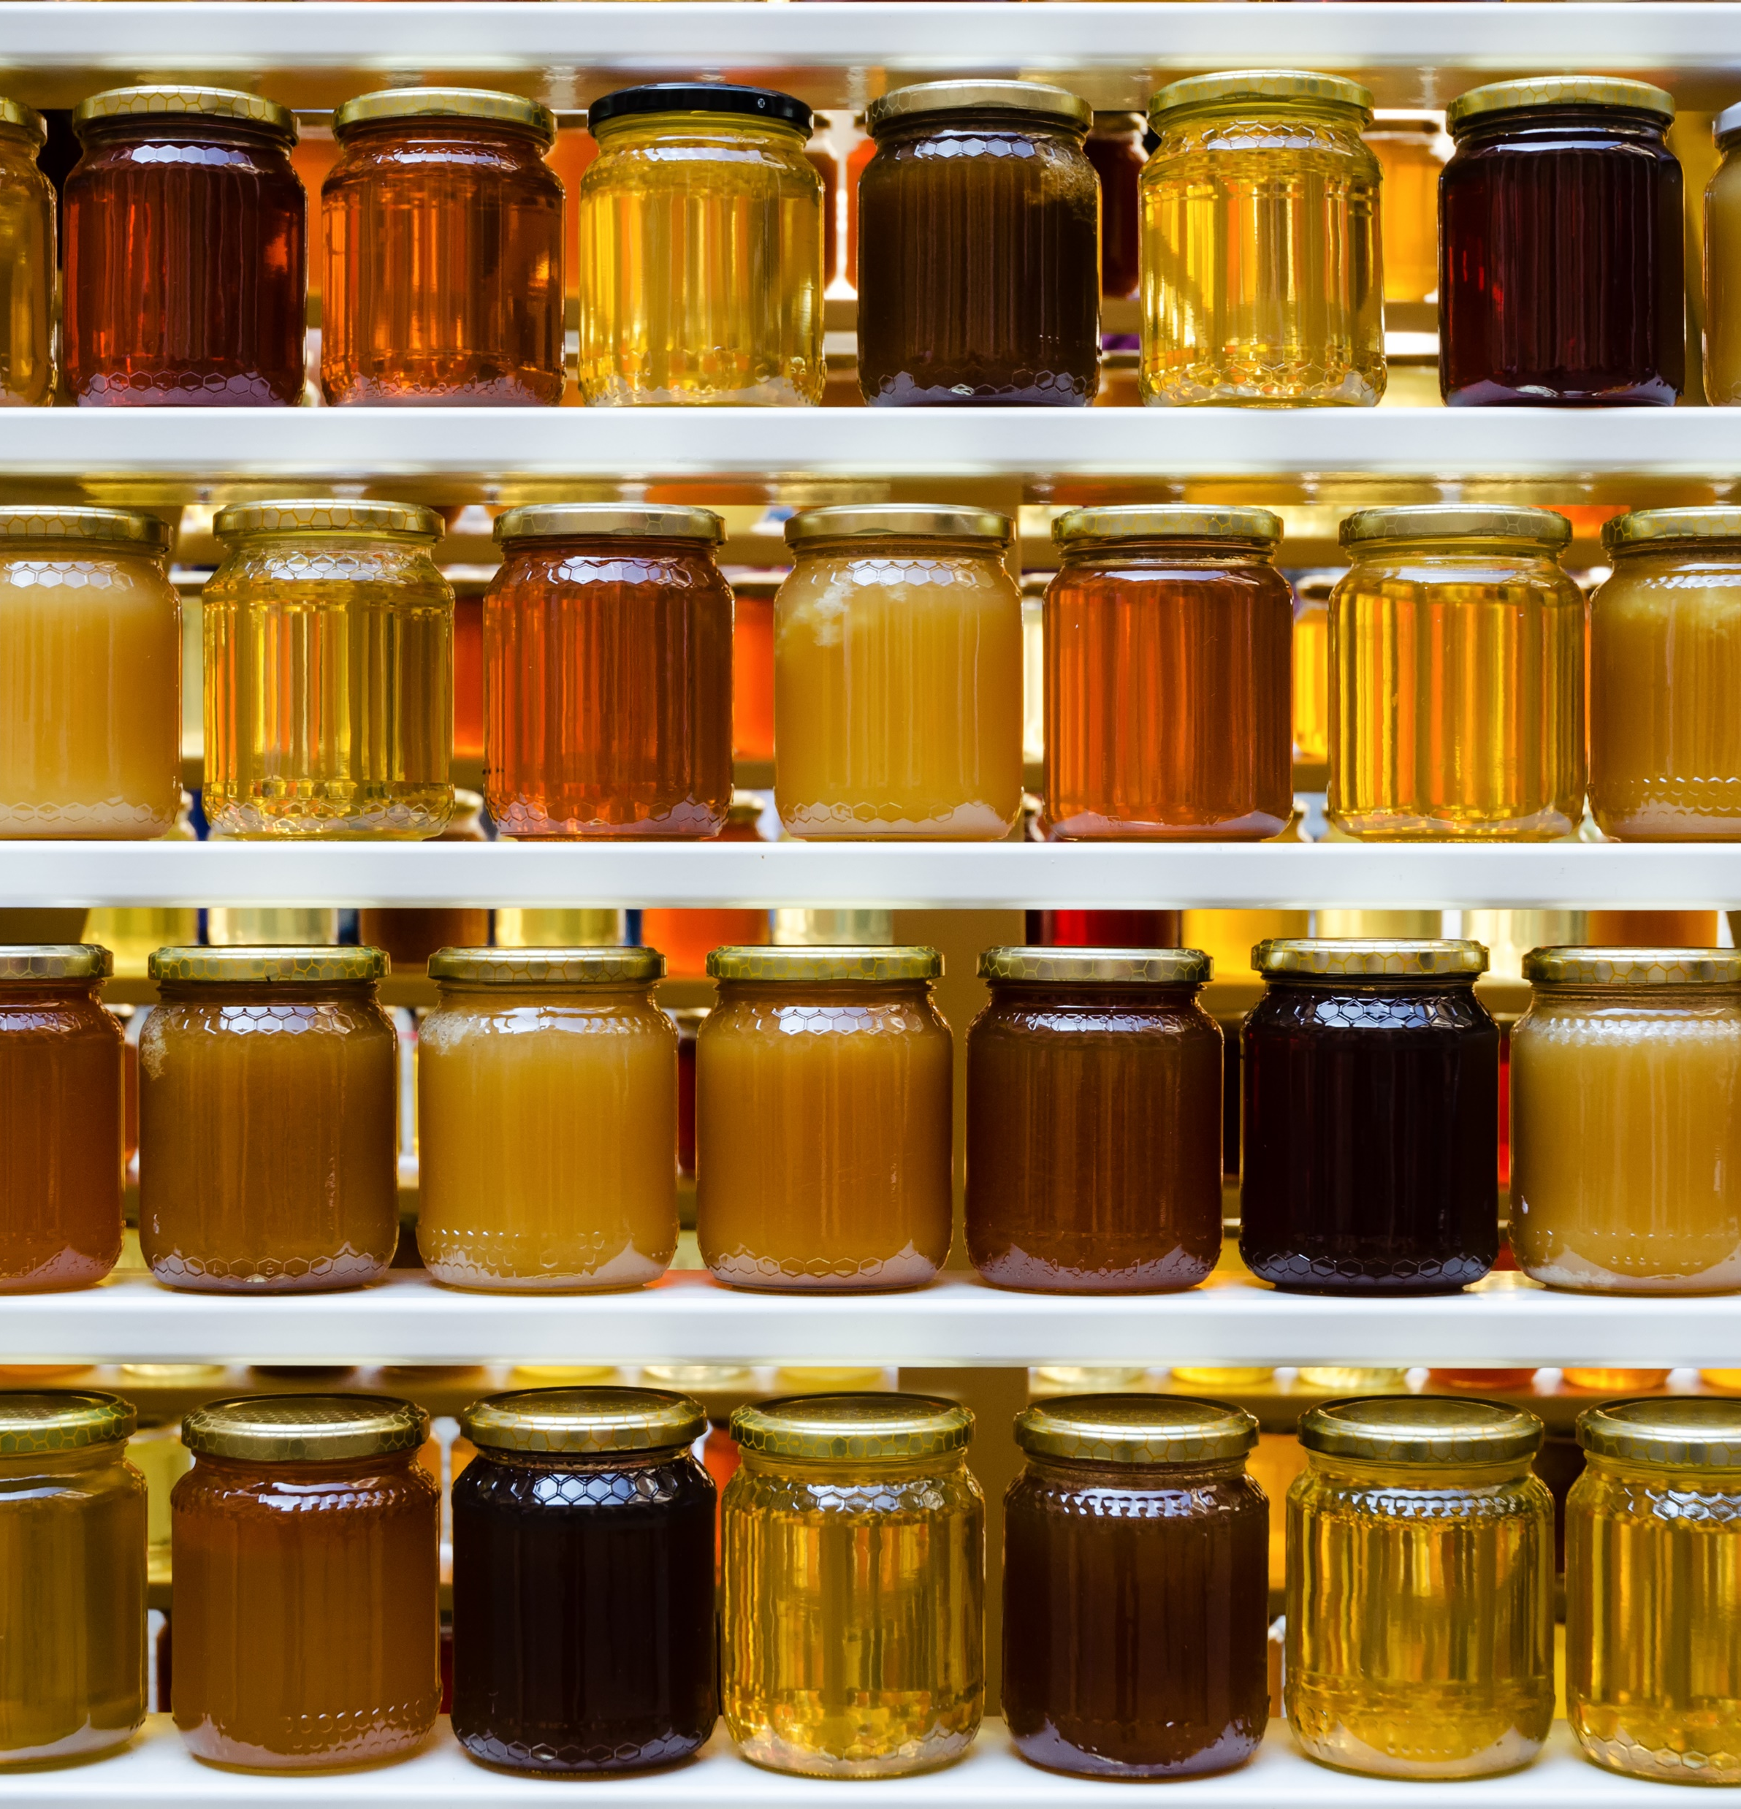
General Tips: Storing Canned Grains, Legumes and Pulses
Canned Items
Sealed cans should be stored in a cool dry space.
Unopened, canned legumes do not need refrigeration until opened.
If opened, store contents in an airtight container in a fridge until the item is used.
Unopened, canned legumes do not need refrigeration until opened.
Did You Know?
“Shelf life” is the time a food can be stored and used at a later date and be suitable for human consumption.
Notes:
Information supported by: ch9-pages-from-food-for-you-3ed-book-1-4pp-10-web.pdf (teachersuperstore.com.au)
Information Retrieved October 17, 2024 from https://oldwayspt.org/blog/whole-grains-are-part-your-heritage/

Slide 5
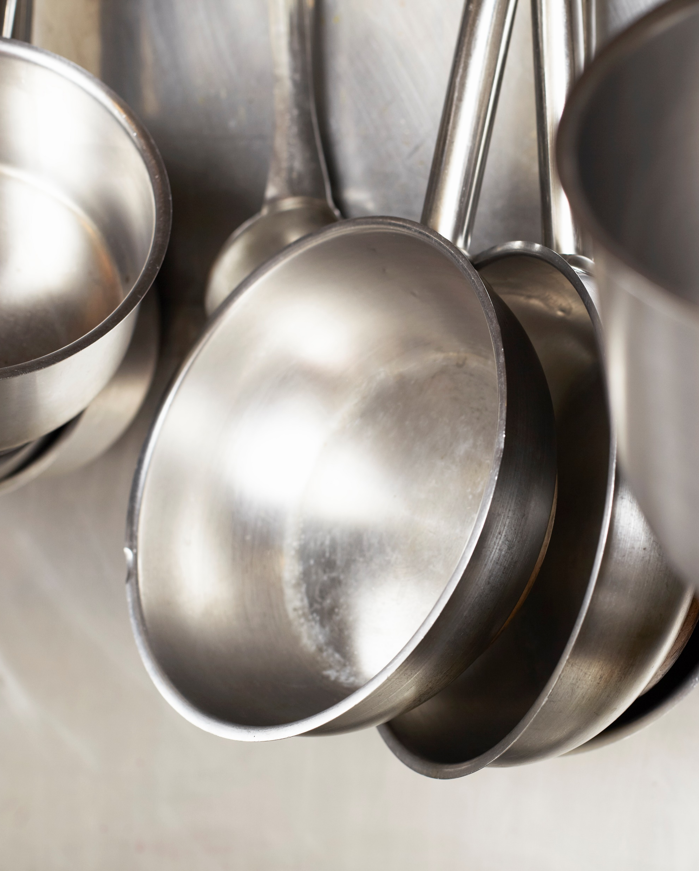
General Tips for Cooking & Preparing Grains, Legumes, Pulses, Nuts & Seeds
Generally, follow the directions on the package.
Preparation time may vary, depending on the item and/or format (dry versus canned).
whole grain brown rice takes longer to cook versus traditional white rice.
Steel cut oats take longer to cook versus regular oats or quick cooking oats.
Whole dry pulses and legumes usually require soaking for 8 – 24 hours and then need to be cooked 30 minutes to 2 hours before using.
Dry split peas and lentils do not require soaking but do need to be cooked either before using in a recipe or are cooked within the liquid of the recipe.
Canned pulses are already cooked and ready to use.
Notes:
Information Retrieved October 25, 2024 from https://www.teachersuperstore.com.au/assets/files/uploads/ch9-pages-from-food-for-you-3ed-book-1-4pp-10-web.pdf
Information Retrieved October 25, 2025 from Learn Alberta, https://www.learnalberta.ca/ProgramOfStudy.aspx?lang=en&ProgramId=561727#724051

Slide 6
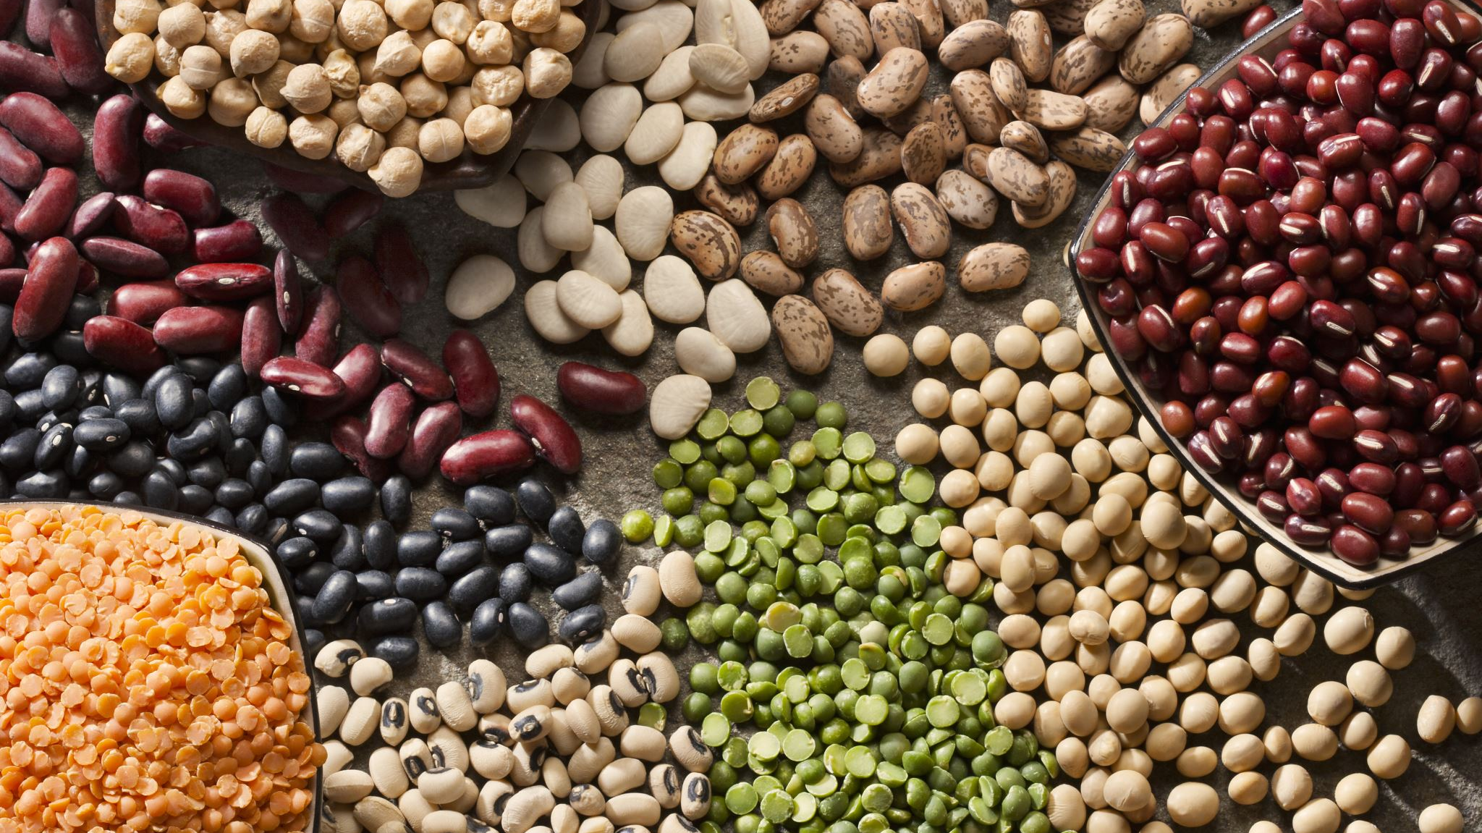
Specific Tips for Cooking Pulses & Legumes
When using dry pulses or legumes, be careful not to overcook them, as they can also go very soft and mushy.
Pulses are a source of resistant starch and slowly digested starch which along with their high fibre content, can cause bloating and flatulence. To improve your ability to digest pulses, try:
Change the soaking liquid often when rehydrating dry pulses and use fresh water to cook the soaked pulses.
Ensure the pulses are thoroughly cooked.
Drain and thoroughly rinse canned pulses and legumes before using.
Gradually increase the frequency and quantity of pulses you eat to help your digestive tract adapt to these complex carbohydrates.
Notes:
https://albertapulse.com/eating-pulses/pulses-101/preparing/

Slide 7
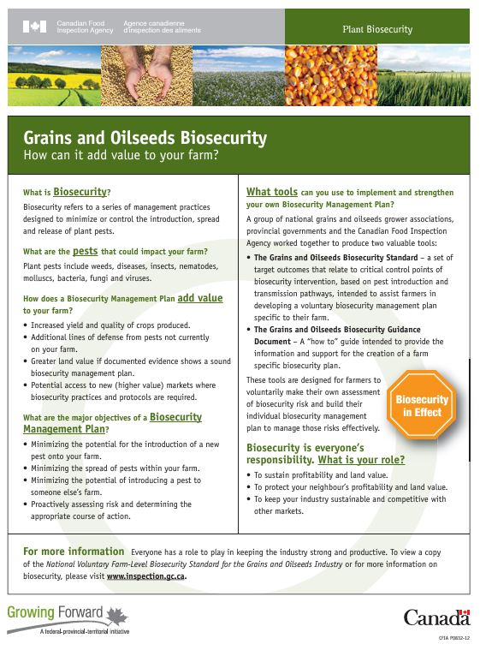
How Are Grains, Legumes, Pulses, Nuts and Seeds Produced Safely?
Biosecurity
As defined by the Canadian Government, “Biosecurity refers to a series of management practices designed to minimize or control the introduction, spread and release of plant pests.” (a)
Farmers in Canada practice a range of biosecurity management strategies to produce the best and healthiest food possible:
washing planting or harvesting equipment between fields
have guests ask permission before entering their fields to ensure they follow biosafety protocols to prevent transmitting potentially biohazardous plant diseases or infections.
Notes:
Information Retrieved October 25, 2024 from https://inspection.canada.ca/en/plant-health/invasive-species/biosecurity/fact-sheet as well as the image on the slide.

Slide 8

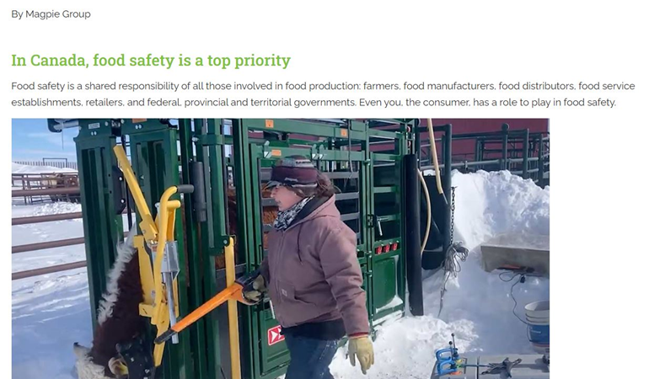
How Are Grains, Legumes, Pulses, Nuts and Seeds Produced Safely?
Government of Canada Regulations
Health Canada is the “government body responsible for creating the safety and nutritional quality regulations, policies and standards of all food sold in Canada.” (a)
This government agency ensures that grains, legumes, pulse, nuts, and seeds that are produced for Canadians are safe.
Notes:
a. Information Retrieved October 25, 2024 from https://canadianfoodfocus.org/on-the-farm/how-do-you-know-canadian-grown-food-is-safe/
Information Retrieved October 25, 2024 from https://canadianfoodfocus.org/on-the-farm/how-do-you-know-canadian-grown-food-is-safe/ and images are screen shots of the Canadian Food Focus website.

Slide 9

Health Canada – Ensuring Safe Food Supply
The regulations, policies and standards are set out in the:
Food and Drugs Act
ensures that all food sold is fit for human consumption.
Consumer Packaging and Labelling Act
requires prepackaged consumer products to supply accurate labelling information to help you make informed decisions.
Canada Agricultural Products Act
sets out the national standards and grades and regulates marketing of agricultural products.
Safe Food for Canadians Act
protects against food tampering, provides better traceability to track food safety issues, as well as oversees food imports.
Canadian Food Inspection Agency (CFIA)
is responsible for enforcing the food safety regulations and standards that Health Canada sets. (a)
Notes:
a. Information Retrieved October 25, 2024 from Canadian Food Focus – How do you know Canadian-grown food is safe? https://canadianfoodfocus.org/on-the-farm/how-do-you-know-canadian-grown-food-is-safe/

Slide 10
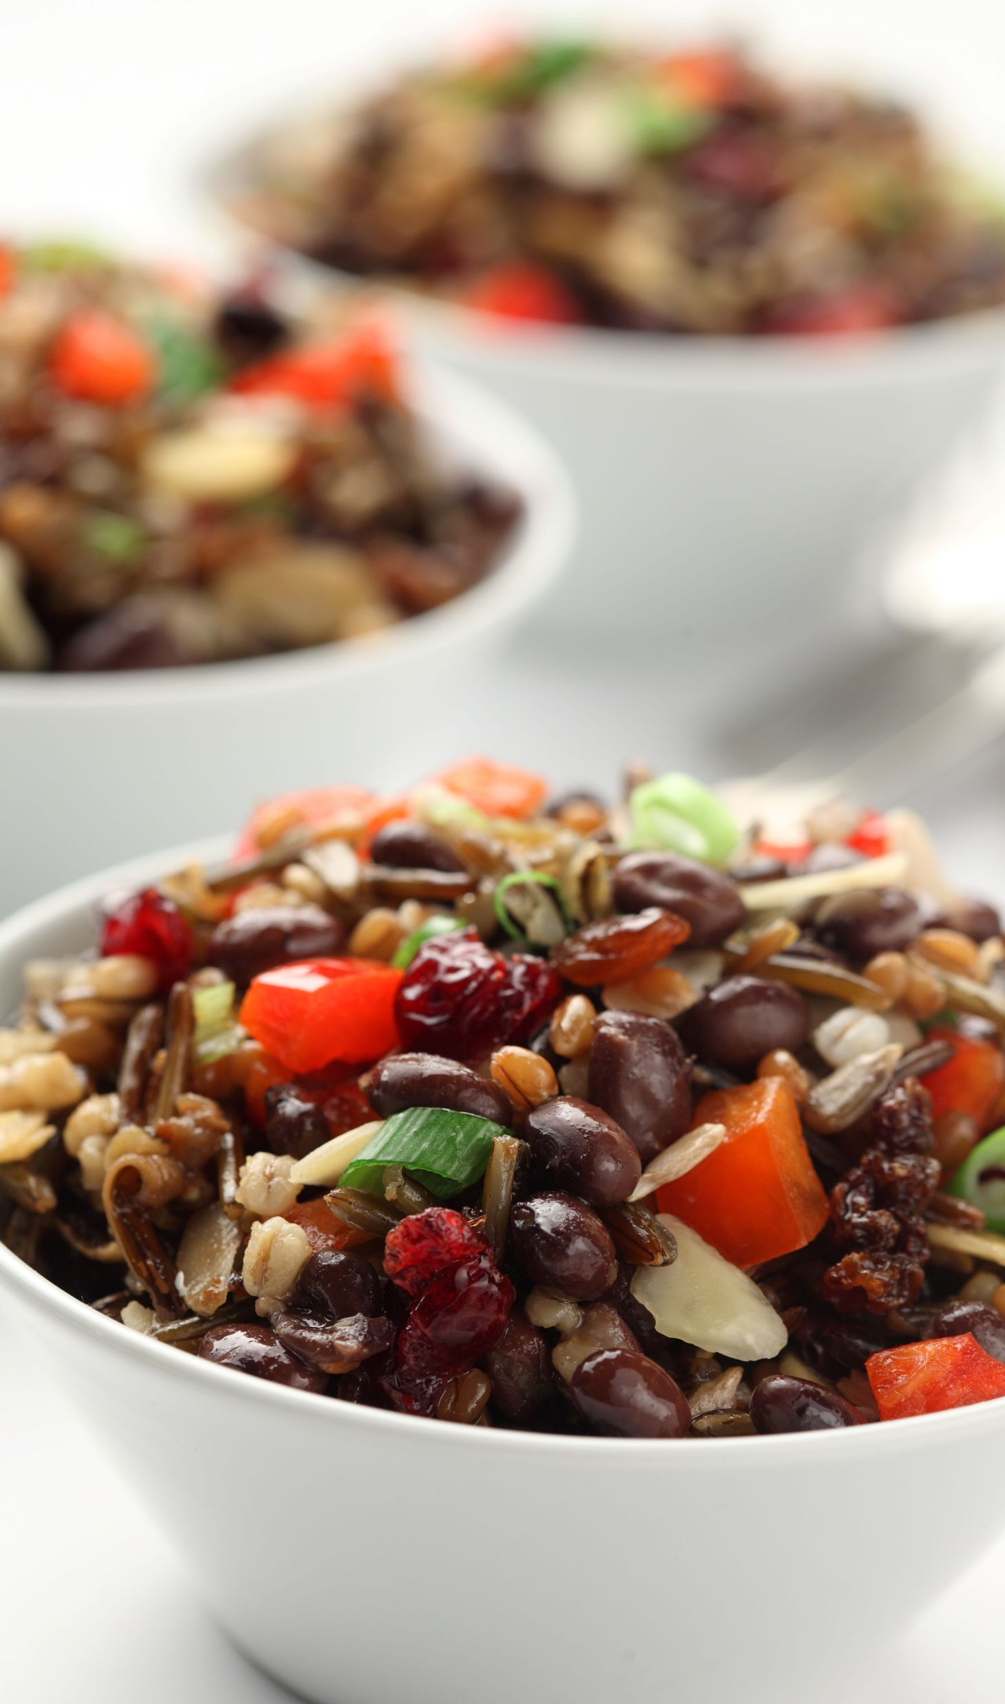
Optional Let’s Cook! Prairie Black Bean, Lentil & Grain Salad
Who is Hungry!?!
Let’s take a break and make Prairie Black Bean, Lentil & Grain Salad from Alberta Pulse Growers
After making the salad, complete the Recipe Reflections evaluation

Slide 11
Bonus Activity: Cost Breakdown
Look online or visit a nearby grocery store to find the following:
Product | Cost and amount of item | Cost/100 g | Ranking from best price (1) to most expensive (7)
Extra lean ground beef
Chickpeas, dried
Chickpeas, can
Boneless skinless chicken breast
Lentils, dried
Lentils, canned
Rump Roast
Notes:
Information supported by: ch9-pages-from-food-for-you-3ed-book-1-4pp-10-web.pdf (teachersuperstore.com.au)
Students can go online to look for the food items at the various grocery store websites (Superstore, Walmart, Voila (Safeway/sobeys), etc. or they can use the Grocery Tracker website at https://grocerytracker.ca/ which also provides the cost per 100 g or 100 mL, depending on the food item.

Slide 12
Bonus Activity: Cost Breakdown
Look online or visit a nearby grocery store to find the following:
Product | Cost and amount of the item | Cost/100 g | Ranking from best price (1) to most expensive (7)
Bulgar
White rice
Wild rice
Pearl barley
White flour
Whole grain flour
Corn meal
Notes:
Information supported by: ch9-pages-from-food-for-you-3ed-book-1-4pp-10-web.pdf (teachersuperstore.com.au)
Students can go online to look for the food items at the various grocery store websites (Superstore, Walmart, Voila (Safeway/sobeys), etc. or they can use the Grocery Tracker website at https://grocerytracker.ca/ which also provides the cost per 100 g or 100 mL, depending on the food item.

Slide 13

Cost Breakdown Questions
Which protein and grain source was:
Most affordable?
Least affordable?
Most sustainable? (Think back to everything you have learned and watched so far).
What did you learn from this activity?
Notes:
Information supported by: ch9-pages-from-food-for-you-3ed-book-1-4pp-10-web.pdf (teachersuperstore.com.au)

